Slide 1
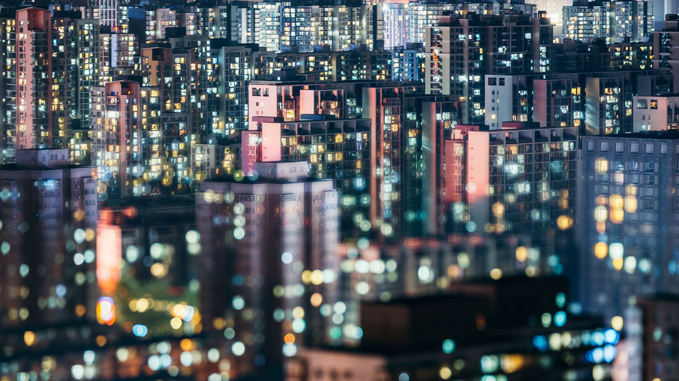
Reuse, Recycling, and Waste Diversion
2022 ENVIRONTHON TEACHER WORKSHOP
Megan Topham, Ph.D., Executive Director and Clinical Assistant Professor
INSTITUTE FOR HUMAN AND PLANETARY SUSTAINABILITY

Slide 2
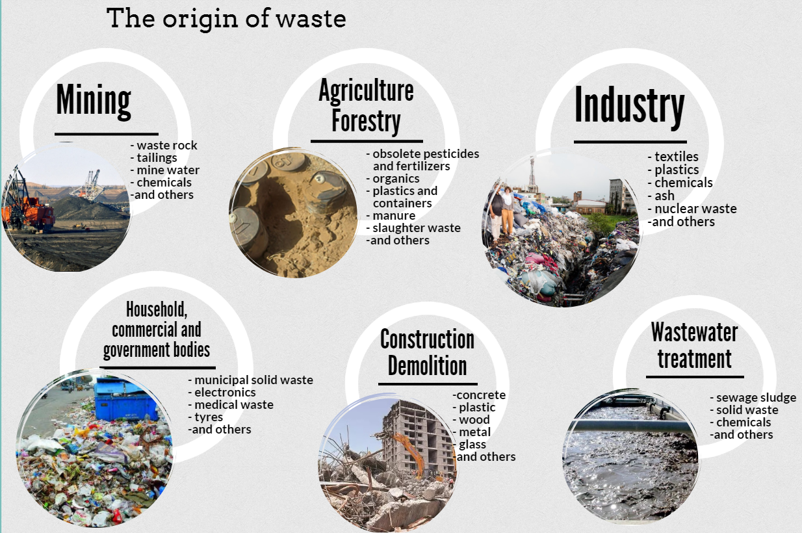
Types of Waste
Notes:
Most prominently, industrial waste streams have been found to be 18 times higher than the streams of municipal solid waste. Agricultural, construction and demolition wastes are globally generated in comparable amounts to that of municipal solid waste. Less voluminous but also important are hazardous, medical and electronic waste.

Slide 3
Municipal Solid Waste
Generation and disparities

Slide 4
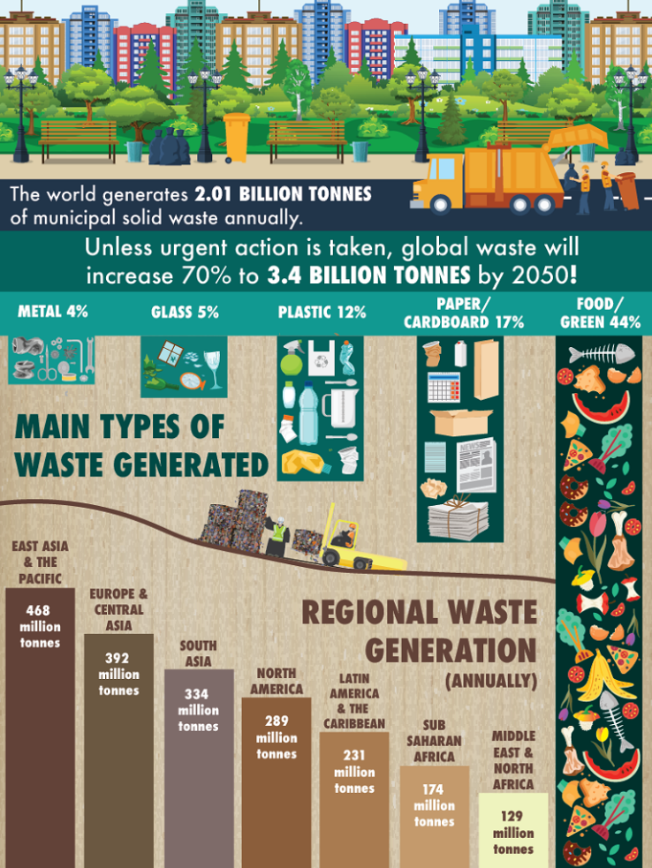
Notes:
Municipal Solid Waste (MSW)—more commonly known as trash or garbage—consists of everyday items we use and then throw away, such as product packaging, grass clippings, furniture, clothing, bottles, food scraps, newspapers, appliances, paint, and batteries. This comes from our homes, schools, hospitals, and businesses

Slide 5
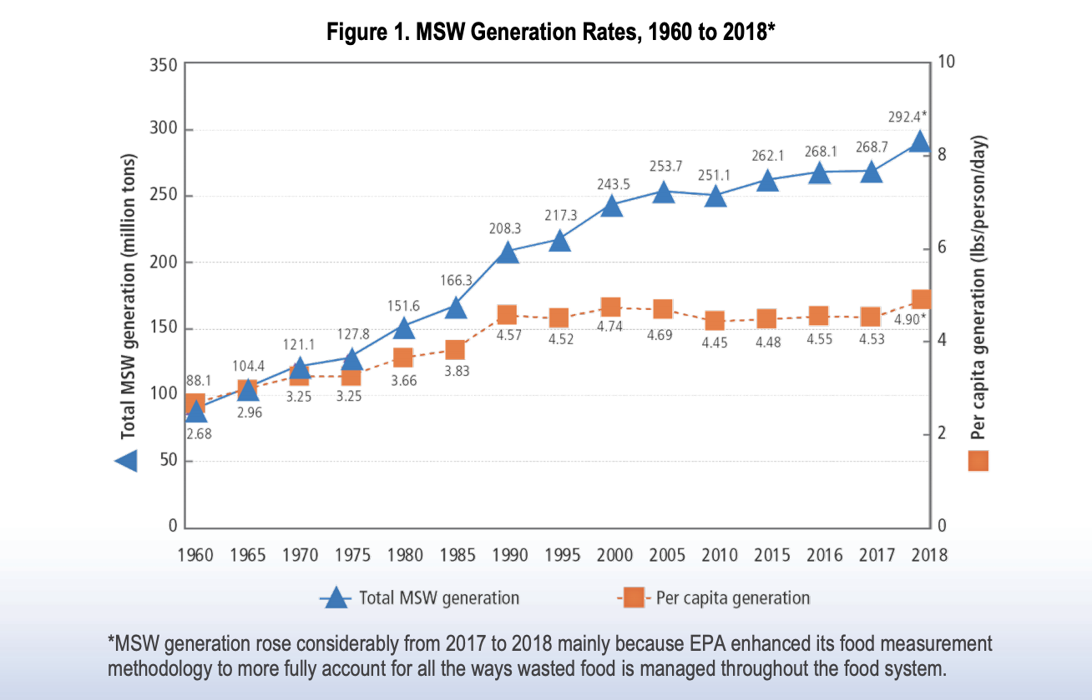
Notes:
The total generation of municipal solid waste (MSW) in 2018 was 292.4 million tons (U.S. short tons, unless specified) or 4.9 pounds per person per day. Of the MSW generated, approximately 69 million tons were recycled and 25 million tons were composted. Together, 93.9 million tons of MSW were recycled and composted, equivalent to a 32.1 percent recycling and composting rate. An additional 17.7 million tons of food were managed by other methods. Other food management includes the following management pathways: animal feed, bio-based materials/biochemical processing, co-digestion/anaerobic digestion, donation, land application and sewer/wastewater treatment.

Slide 6
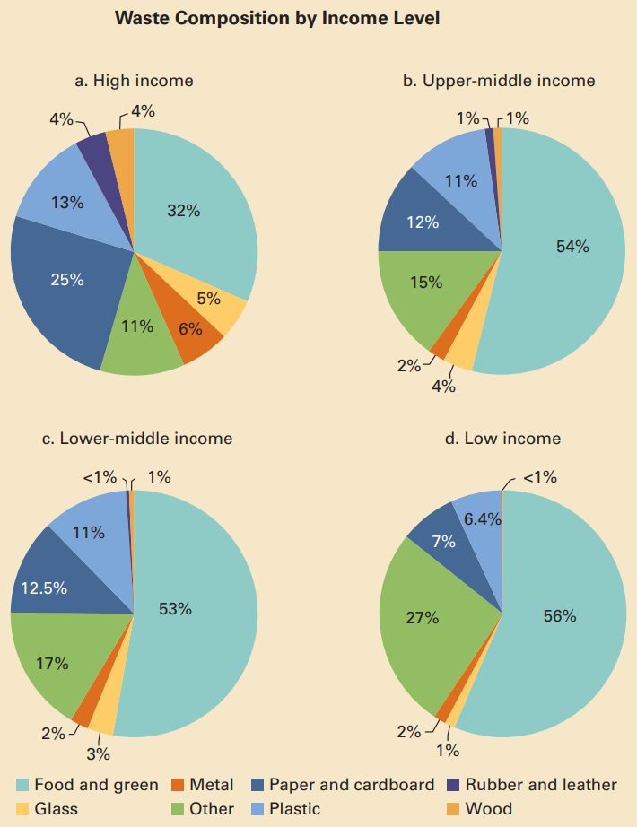
Notes:
Lower-income countries produce a relatively higher proportion of organic waste, while in higher-income countries, paper and other inorganic materials also make up a significant share of the total
Higher-income people not only consume more goods overall, but they also use up a higher concentration of packaged and complex durable goods like cars, appliances, and electronic equipment. Also, most waste in middle- and high-income countries consists of inorganic materials, notably paper and plastic.
While high-income countries generate more waste per capita, in terms of aggregate volume, developing countries produce more than half of total solid waste.
Many of the world’s highest waste generation rates per person are found in developing island nations, where tourism plays a large role. Scarcity of land—the critical resource for landfilling (or dumping)—makes these countries’ waste disposal problems especially acute. Rising sea levels due to global warming of course exacerbate this scarcity.
While most waste generated in low-income developing countries consists of biodegradable organic materials, this share shrinks as income rises.

Slide 7
Impacts of Waste
Environmental, Social, and Economic

Slide 8
Environmental Impacts – Waste (Mis)Management
Air emissions (fumes from the burning of waste and landfill gases)
Contamination of groundwater, aquifers, and surface water
Contamination of soil
Injuries to wildlife
Noise pollution
Ecosystem services in danger
Marine pollution
Notes:
Air emissions - A significant proportion of greenhouse gas emissions related to waste is released into the air during the degradation of organic matter in landfills. While methane typically constitutes 55% of emissions from landfills, carbon dioxide represents around 35%. Several other gases are released in smaller amounts.
Contamination of groundwater, aquifers, and surface water
Contamination of soil
Injuries to wildlife
Noise pollution
Ecosystem services in danger - Ecosystem services are the many and varied benefits to humans provided by the natural environment and from healthy ecosystems. Such ecosystems include, for example, agroecosystems, forest ecosystems, grassland ecosystems and aquatic ecosystems.
Marine pollution - Marine pollution is a combination of chemicals and trash, most of which comes from land sources and is washed or blown into the ocean. This pollution results in damage to the environment, to the health of all organisms, and to economic structures worldwide.

Slide 9
Economic Impacts – Waste (Mis)Management
Job loss - businesses leave the affected area or decide not to locate there
Decrease in property values
Neighborhood deterioration – lack of investment
Increase the need of public support services
Increases the cost of local-waste disposal

Slide 10
Social Impacts – Waste (Mis)Management
Health issues from breathing in air contaminants or direct contact with waste
Loss of amenities
Quality of life - Odor, littering, noise, and pests
Community factionalization
Vulnerable populations may be psychologically affected by having to live near landfills
Changes in neighborhood demographics/composition
Inconsistent access to adequate waste and recycling services/infrastructure
Notes:
Community Factionalization - the affected area among those who are opposed to it, those who favor it, and those who do not want the area harmed by heated, widely publicized conflict

Slide 11
Waste Management
Disposal Hierarchy and distribution

Slide 12
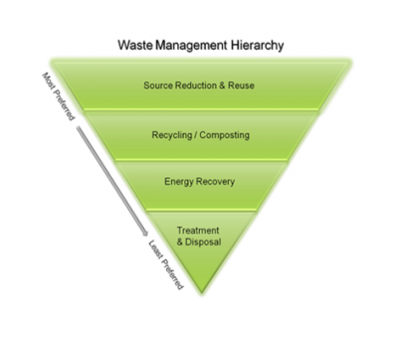
Notes:
Source reduction, also known as waste prevention, means reducing waste at the source, and is the most environmentally preferred strategy. It can take many different forms, including reusing or donating items, buying in bulk, reducing packaging, redesigning products, and reducing toxicity. Source reduction also is important in manufacturing. Lightweighting of packaging, reuse, and remanufacturing are all becoming more popular business trends. Purchasing products that incorporate these features supports source reduction.
Recycling is a series of activities that includes collecting used, reused, or unused items that would otherwise be considered waste; sorting and processing the recyclable products into raw materials; and remanufacturing the recycled raw materials into new products. Consumers provide the last link in recycling by purchasing products made from recycled content. Recycling also can include composting of food scraps, yard trimmings, and other organic materials.
Energy recovery from waste is the conversion of non-recyclable waste materials into useable heat, electricity, or fuel through a variety of processes, including combustion, gasification, pyrolization, anaerobic digestion, and landfill gas (LFG) recovery. This process is often called waste-to-energy (WTE). Converting non-recyclable waste materials into electricity and heat generates a renewable energy source and reduces carbon emissions by offsetting the need for energy from fossil sources and reduces methane generation from landfills. After energy is recovered, approximately ten percent of the volume remains as ash, which is generally sent to a landfill.
Prior to disposal, treatment can help reduce the volume and toxicity of waste. Treatments can be physical (e.g., shredding), chemical (e.g., incineration), and biological (e.g., anaerobic digestor). Landfills are the most common form of waste disposal and are an important component of an integrated waste management system.

Slide 13
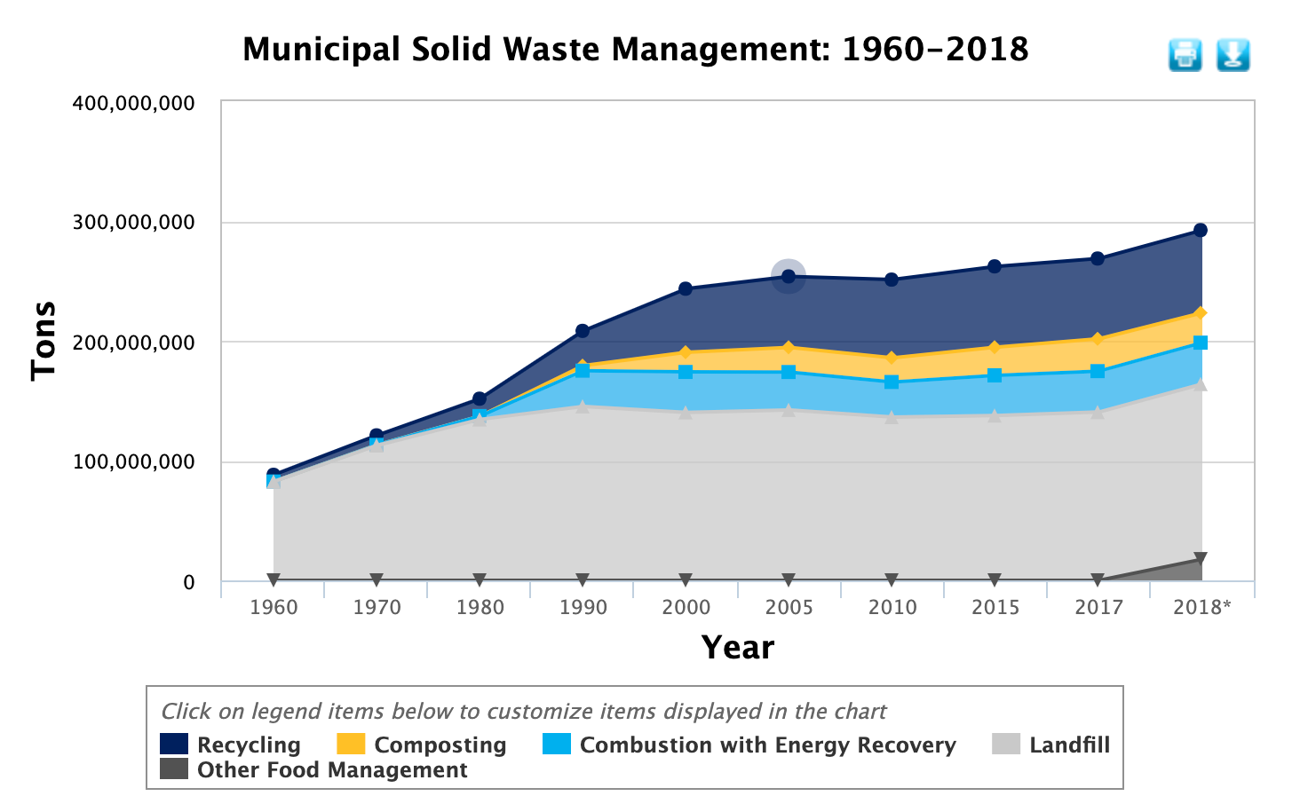
Notes:
*MSW generation rose considerably from 2017 to 2018 mainly because EPA enhanced its food measurement methodology to more fully account for all the ways wasted food is managed throughout the food system.
Management of MSW continues to be a high priority for state and local governments. This includes the source reduction of wastes before they enter the waste stream and the recovery of generated waste for recycling, composting or other methods. It also includes environmentally sound waste management through combustion with energy recovery and conversion, as well as landfilling practices that meet current standards or newly emerging waste conversion technologies.

Slide 14
Waste Diversion
Recycling and repurposing

Slide 15
Metals
Recycling uses a considerable amount of energy, but less than if using virgin ore.
Can be recycled over and over without altering its properties
Primary Types:
  Steel, Aluminum, Copper, Silver, Brass, and Gold
Uses:
  Automobiles, Aircraft, Appliances, Industrial Containers, Ductwork, and Plumbing
  Recycled aluminum and steel are commonly reused as new food packaging

Slide 16
Glass
Unlimited Life
Can be melted and recycled endlessly
Recycling reduces the need for raw materials (i.e. sand, soda ash, limestone) and energy (e.g. running furnaces at lower temperatures)
Uses - new glass products with no loss in quality
  Glass Bottles
  Composite Glass Countertops
  Recycled Glass Tiles and Backsplashes
  Glassphalt
  Beads
  Construction Materials
Notes:
1. Glass Bottles
The glass industry was the first to realize the true benefits of collecting and processing its own packaging in order to create new packaging for products. These days, the glass industry achieves a recycling rate to aspire to, unlike many other industries that are slowly lagging behind.
2. Composite Glass Countertops
Recycled glass can be turned into durable and beautiful countertops for use in bathrooms and kitchens and this attractive product is gaining a lot of popularity in modern interiors thanks to its amazing reflective properties and the fact that its durability can compete with tough granite and some other types of composite countertops. The majority of glass composite countertops consist of a combination of 15% cement and 85% recycled glass.
3. Recycled Glass Tiles
Pearlescent, shiny, matte or sandblasted, the choice of finish when you are looking for recycled glass tiles is as astounding as the amazing variety of colors. Many companies offer a customized service allowing their customers the opportunity to choose the shape and dimensions of their tiles, allowing people to create a unique look of their own using this green product.
4. Recycled Glass Backsplashes
Made with recycled glass, glass backsplashes come in a wide range of sizes. They are a durable and hygienic surface for homes as well as businesses and the options in terms of their design and color are plentiful. Fiber optic lights that are fitted beneath the surface are one of the numerous creative ways to use this green product to enhance an interior.
5. Glassphalt
This specific variant of asphalt uses a quantity of crushed glass in place of sand and makes a stunning alternative to standard pavement because apart from being durable and tough, it sparkles in the sunlight!
6. Beads
Recycled glass is also used to make beads that are then utilized to manufacture all kinds of craft and jewelry products. Glass has been used for beads for centuries so recycling this material for this specific purpose makes perfect sense.
7. Construction Material
There are a wide range of uses for recycled glass in construction. When it is crushed thoroughly, it can be used to replace sand. And if it is crushed less thoroughly, it is still useable as it can replace gravel.
Following are some of the uses of recycled glass in construction:
• In aggregate
• Backfill for foundations
• Backfill for pipes and trenches
• Road surfaces
• The production of insulation materials
• Mixing concrete

Slide 17
Plastics
  Process:
    Collection, Sorting & Categorizing, Washing, Shredding, Melting, and Pelletizing
    The actual particular processes vary based on plastic resin or type of plastic product
  Tons of environmental, social, and economic benefits
  Recycling can give people an incentive to buy and use more plastics
  Can only be recycled a few times
  Uses:
    Bottles and Cups, Film and Sheeting, Traffic Cones, Packing Materials, Clothing, Trash Bags, Kitchenware, Countertops, and Carpeting, Animal Collars, Rugs and Mats, Shoes, Waste Bins, Building Materials, Outdoor Furniture, Surf Boards, Back Packs, etc.

Slide 18
Paper & Cardboard
  Process for Paper:
    Separated, Baled & Shipped to Mills, Cleaned, Dried & Rolled
  Process for Cardboard:
    Sorted & Shredded, Mixed w/ Water and Pulped, Filter, More Water, Rolled & Dried, Converted to New Cardboard
  Paper products have a lifespan of 5-7 recycling processes.
  Despite the negative impact, the pros continue to outweigh the cons
  Uses:
    Office paper, Tissues and Toilet Paper, Napkins and Paper Towels, Greeting Cards, Cardboard, Newspapers and Magazines, Coffee Filters, Diapers, Egg Cartons, Shoe Boxes, Napkins, Insulation, Fiber Board, Animal Bedding, Paper Bowls, Vases, and other Housewares, Wallpaper, lamps, Seating, etc.
Notes:
LIFESPAN - Paper is mainly made from wood fibers. Those fibers become shorter each time paper is recycled. Shorter fibers make thinner and less durable paper.

Slide 19
Concrete
Process:
  Crushed and impacted, and then screens come into play, which help separate the useful material from dirt and particles within the mix.
  Additional processes and equipment, such as water flotation, separators, and magnets, may also be used to remove specific elements from the crushed concrete.
Recycling one ton of cement can save 1,360 gallons water, 900 kg of CO₂.
Uses:
  Permeable paving, Base for new asphalt paving, Bed foundation material, Aggregate for mixing new concrete, Mulch, Controlling streambank erosion, Retaining Walls, Privacy Screens, Ocean reef habitats, etc.
Notes:
Permeable paving for walkways, driveways, and other outdoor hard surfaces: Broken concrete that is carefully laid creates a stable, porous traffic surface that rainwater can filter through. This technique reduces the amount of runoff water that must be managed by storm sewer systems and helps to replenish groundwater.
Base for new asphalt paving: Through a process called rubblization, old concrete pavement can be broken in place and used as a base layer for asphalt pavement laid over it.
Bed foundation material for trenches containing underground utility lines: Utility trenches are oven covered with gravel to assist drainage, and crushed concrete makes a good, inexpensive substitute for gravel.
Aggregate for mixing new concrete: Crushed concrete can replace some of the virgin (new) aggregate used in ready-mix concrete.
Controlling streambank erosion: Larger pieces of crushed concrete placed along vulnerable stream banks or gullies can help control erosion.
Landscaping mulch: When properly crushed and well sorted, ground concrete can replace river rock or other gravels used as ground covers and mulch.
Fill for wire gabions: Wire cages (gabions) filled with crushed gravel can make decorative and functional privacy screen walls or retaining walls.
Material for building new oceanic reef habitats: Large pieces of concrete carefully positioned offshore can form the foundation for coral to build new reefs.

Slide 20
Tires/Rubber
Process:
  Devulcanized - breaks down the bonds formed during the vulcanization process
  Collect, Remove Steel Wires, Breakdown Whole Tires, Rubber Screening, Cleaning
300 million tires are scrapped annually and most are put into landfill
Rubber is poisonous when just thrown away and has severe negative environmental impacts
About 250 million tires are recycled every year in the United States.
Uses:
  Recycled Rubber Planters, Shoes, Mats, Mulch, Sports Turf, Gravel Substitute, Wastewater Treatment Filters, Tire-derived fuel (TDF) for controlled fires, Aggregate, etc.
Notes:
Process:
Devulcanized - breaks down the bonds formed during the vulcanization process (many involving high heat and toxic chemicals, which can make environmentally sound rubber recycling difficult.)
Collect, Remove Steel Wires, Breakdown Whole Tires, Rubber Screening, Cleaning
300 million tires are scrapped annually and most are put into landfill
Rubber is poisonous when just thrown away and has severe negative environmental impacts
About 250 million tires are recycled every year in the United States.
many involving high heat and toxic chemicals, which can make environmentally sound rubber recycling difficult.

Slide 21
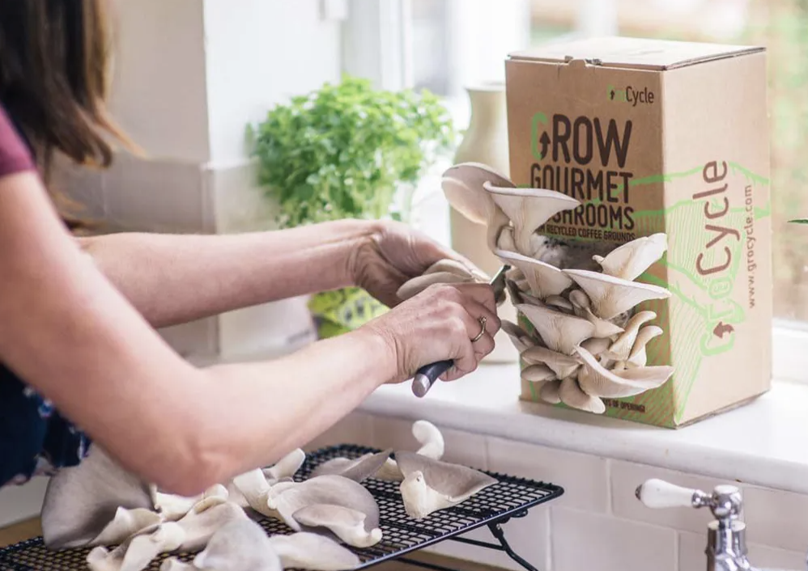
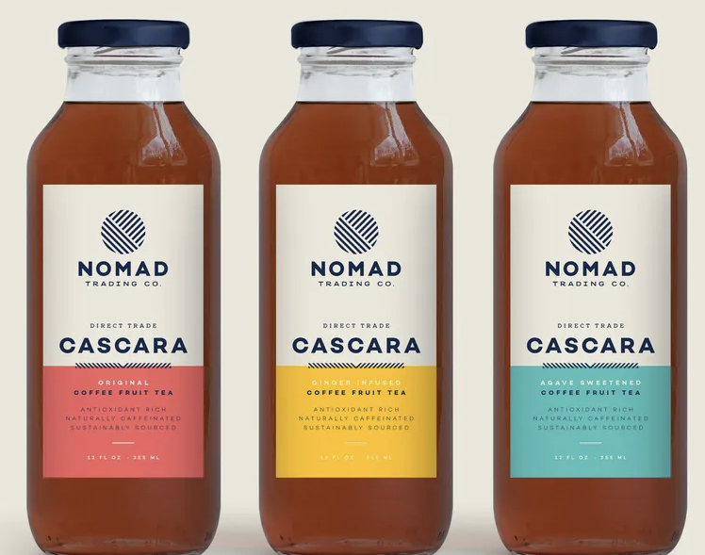
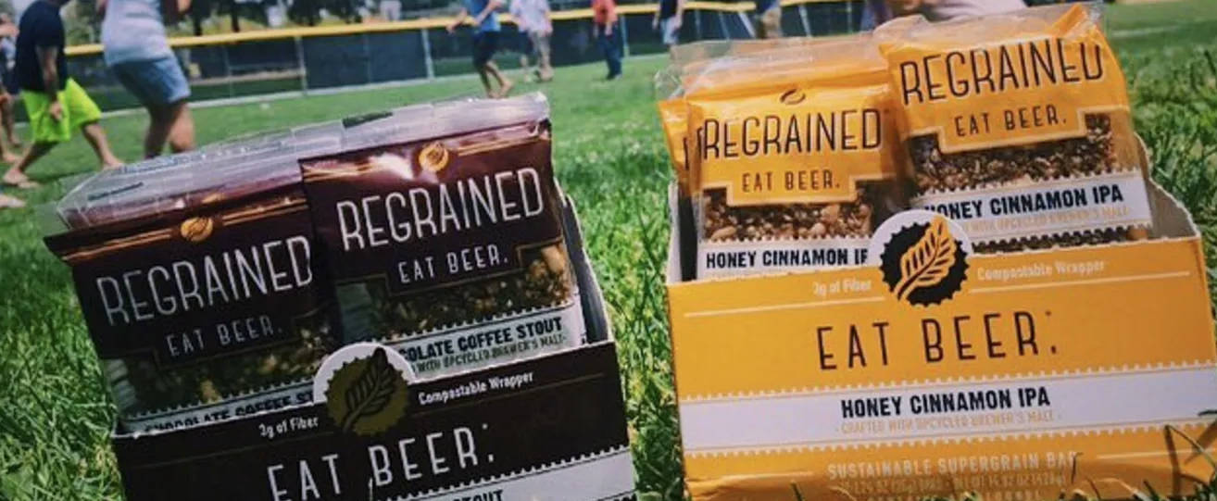
Food & Agriculture
Notes:
SPENT GRAINS:
ReGrained saw an opportunity in the nutritional qualities of spent grain. It has almost as much protein as almonds, three times the amount of fiber than oatmeal, and is low in sugar. Granola bars are made with these ingredients for flavors like Honey Cinnamon IPA and Chocolate Coffee Stout. ReGrained is developing other products to include bread, cookies, cereal, and chips.
Rise flour is based in Brooklyn, New York, and collects spent grain from local breweries to make barley flour. The flour takes on the flavors and scents of the original brews. Flours made from ales taste nutty and light, for example, and porters make dark and rich flours that smell like chocolate. (King Arthur Flour has some useful tips on when to replace AP flour with barley flour, and community member AntoniaJames has a mean recipe for Ricotta Whey and Barley Bread).
Dog owners can also benefit. Doggie Beer Bones makes natural dog treats from locally sourced spent brewing grains. Flavors include malted barley, peanut butter, egg, and barley flour.
COFFEE HUSKS AND GROUNDS
Nomad Trading Co., one of the companies brewing this coffee-tea infusion, sources their coffee husks from small organic farmers in Costa Rica. To promote sustainable and social impact initiatives, the company considers the farmer's agronomic practices and trades directly with farmers to ensure they are paid fairly.
GroCycle, based out of Devon in the UK, has been growing oyster mushrooms from spent coffee grounds since 2011. They've since expanded and started an urban mushroom farm where hundreds of pounds of used coffee grounds are collected for growing oyster mushrooms; the harvest is sold to local restaurants and markets, and the waste from the farming process is then turned into compost. Last year, over 65,000 pounds of coffee grounds have been recycled and turned into 7 tons of oyster mushrooms.
OTHER EXAMPLES:
Vegetable and Fruit Pulp - seasonings, gelato, etc

Slide 22
Waste Reduction
Strategies, Policies, and change management

Slide 23
Procedures or Practices that People Follow
Preventive maintenance program
Inventory control system
Start-up/shut down procedures
Improve floor layout for production
Employee training programs
Water conservation measures
Employee incentive programs
Prevent leaks and spills
Improved purchasing practices

Slide 24
Processes or Equipment to be More Efficient
Improve process efficiency through retrofits
Upgrade to new more efficient equipment
Train staff on proper equipment operation
Dedicate process equipment for different colors, material types, etc.
Ongoing process evaluation

Slide 25
Products or Chemicals to Make Something Safer
Optimize solution concentration
1
Find alternative or substitute chemicals
2
Plan and schedule production to minimize chemical use
3
Evaluate product formulation needs
4
Use aqueous-based products in place of solvents
5
Prolong process solution life
6

Slide 26
Circular Economy
Transform the 'take-make-waste' linear model
How we manage resources
How we make and use products
What we do with the materials afterwards
A model of production and consumption, which involves sharing, leasing, reusing, repairing, refurbishing and recycling existing materials and products as long as possible

Slide 27
Net Zero Commitments
Net Zero means consuming only as much energy as is produced, achieving a sustainable balance between water availability and demand, and eliminating solid waste sent to landfills.
  Net Zero Water
  Net Zero Energy
  Net Zero Waste
    Net Zero Plastic
Notes:
Achieving Net Zero Water means limiting the consumption of water resources and returning it back to the same watershed so as not to deplete the resources of that region in quantity or quality over the course of the year.
Achieving Net Zero Energy means producing, from renewable resources, as much energy on site as is used over the course of a year. Achieving Net Positive Energy means producing, from renewable resources, more energy on site than is used over the course of a year.
Achieving Net Zero Waste means reducing, reusing, and recovering waste streams to convert them to valuable resources with zero solid waste sent to landfills over the course of the year.
Net Zero Plastic
New strategy for plastic waste management to address shortfalls regarding the unaccounted for fate of non-recyclable plastics in the Circular Economy.
Plastics is a hydrocarbon that should only be deemed to have recycled when the carbon is placed back underground where it originated from
Argue that all non-recyclable plastic has brand value when incinerated and the CO2 is captured and sequestered underground to offset an equivalent volume of produced plastics

Slide 28
Changing Behaviors through Policy
Advanced Disposal Fee
Pay up front for the waste you are about to create.
The best-known type of policy is the plastic bag tax.
To date 30 countries have a plastic bag tax to help reduce waste and help save the environment.
“Pay-As-You-Throw” taxes
You are charged by the garbage bin, plastic bag or, in more sophisticated systems, the weight of your garbage.
Studies show that these schemes can significantly reduce the amount of waste people generate.

Slide 29

Questions/Comments?

