Slide 1
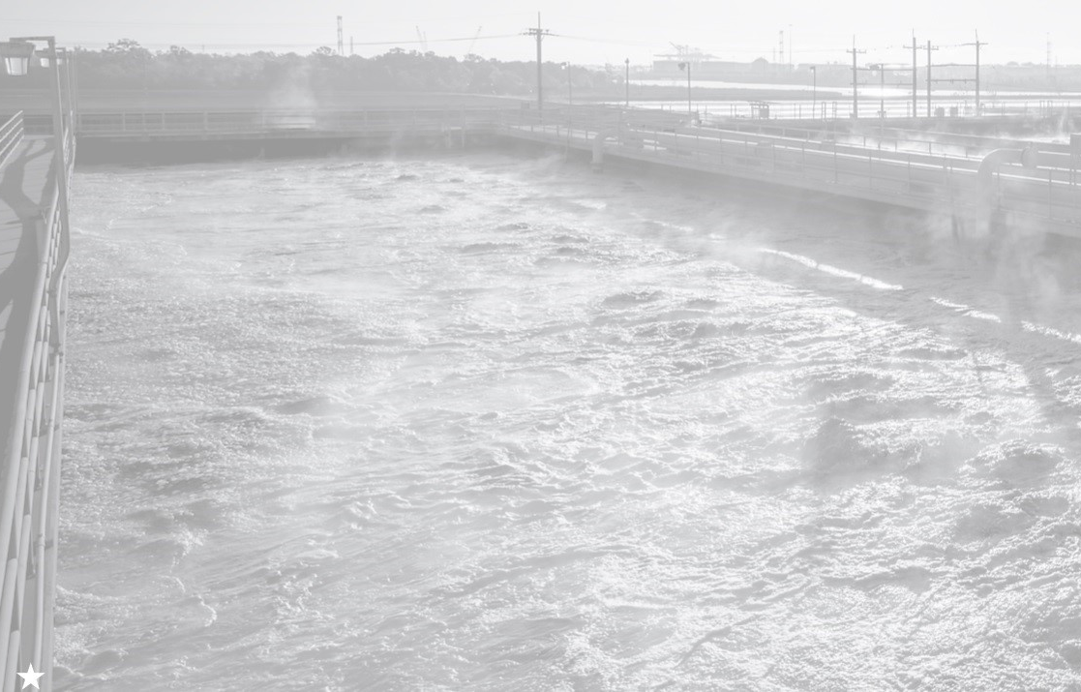
What is
Wastewater Treatment?

Slide 2
Purpose of Wastewater Management
Protect public health
Reduce oxygen demand on waterways
Remove most organics from waste
Oxidize NH3 to NO2 and NO3
  NH3 + O2 → NO2 - + 3H+ + 2e-
  NO2 - + H2O → NO3 - + 2H+ +2e-
Bacteria must be removed before discharge, or they impose oxygen demand

Slide 3
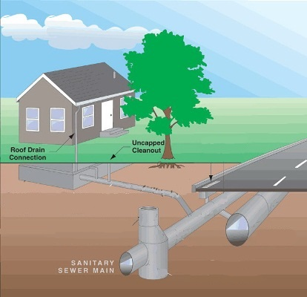
Wastewater Collection System
A sanitary sewer is an underground pipe or tunnel system for transporting sewage from houses and commercial buildings (but not stormwater) to treatment facilities for disposal. Sanitary sewers are part of an overall system called a sewage system or sewerage.

Slide 4
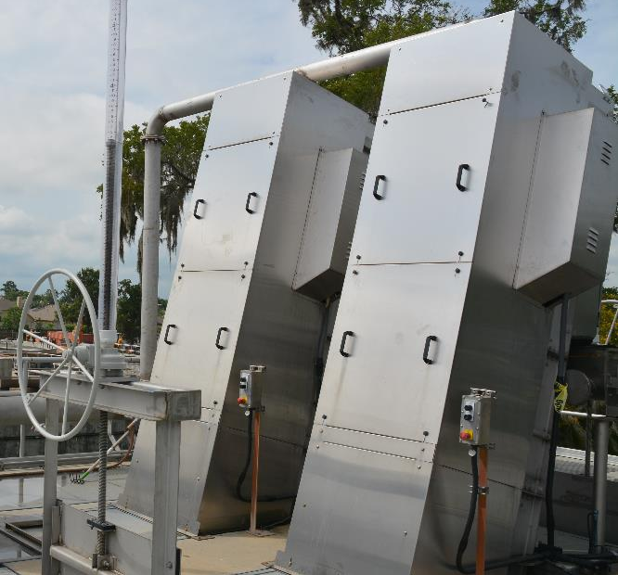
Wastewater Treatment – Pretreatment
Pretreatment removes all materials that can be easily collected from the raw sewage before they damage or clog the pumps and sewage lines of primary treatment clarifiers. Objects commonly removed during pretreatment include trash, tree limbs, leaves, branches, and other large objects.

Slide 5
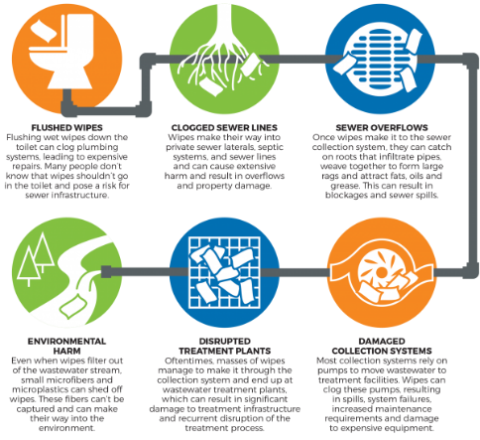
Wastewater Treatment – Pretreatment
Bar Screens:
Screening Inorganics
Should not be flushed:
Baby wipes
Fats
Oil & Grease
Coffee grinds
Medicine

Slide 6
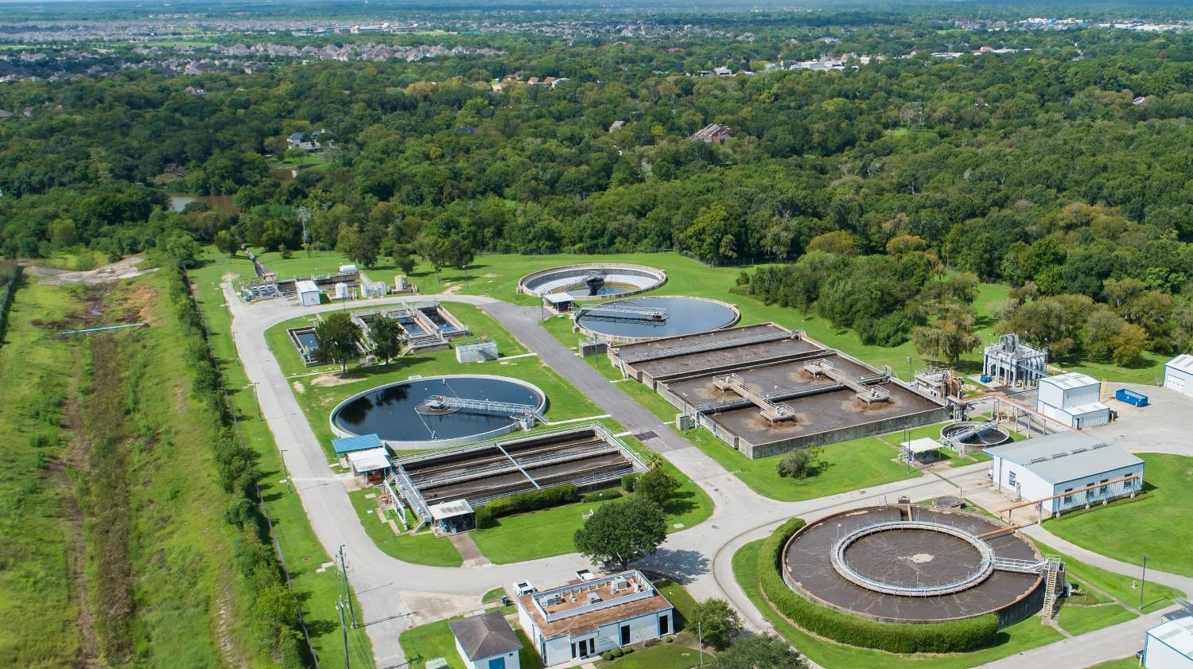
Headworks – Raw Influent

Slide 7
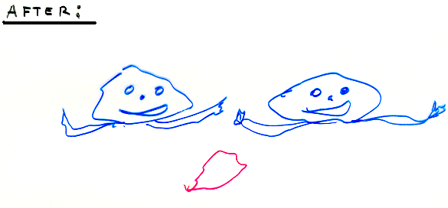
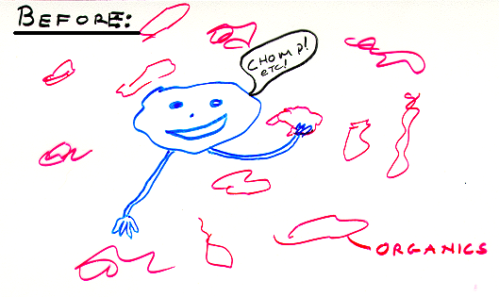
Biotreatment

Slide 8
Aerobic Biological Organic Removal
Bacteria + Organics (food) + Oxygen + Nutrients
YIELDS
More Bacteria + Carbon Dioxide + Organics (leftovers)

Slide 9
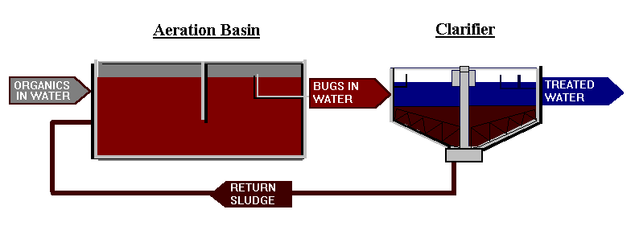
Activated Sludge System

Slide 10
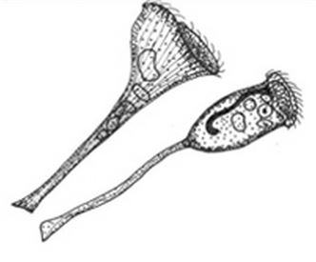
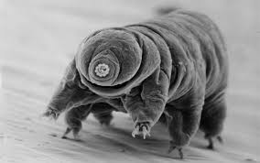
Wastewater Treatment – Secondary Treatment
Aeration Basin:
Biological Process
Raw sewage mixed with sludge
Compressed air is injected into the mixture
Provides oxygen and rapid mixing action
Stalked Ciliates
Water Bear
(Tardigrade)

Slide 11

Aeration Basins

Slide 12
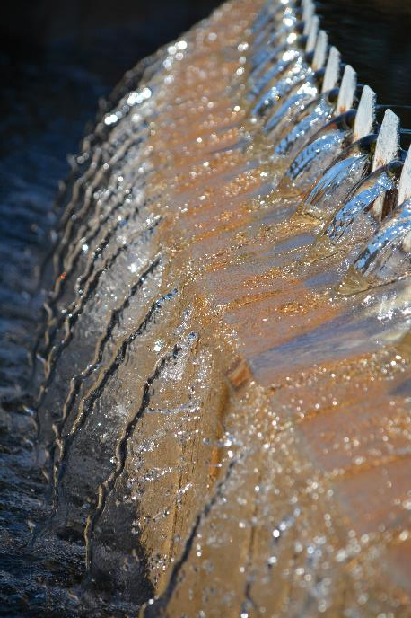
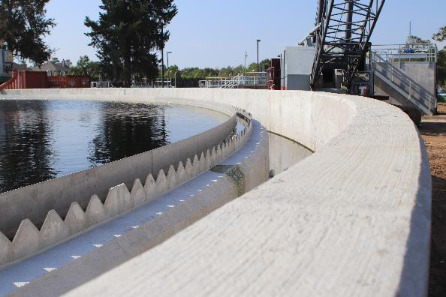
Wastewater Treatment – Secondary Treatment
Clarifier:
Physical Process
Sludge settles
Settled sludge is returned or wasted

Slide 13
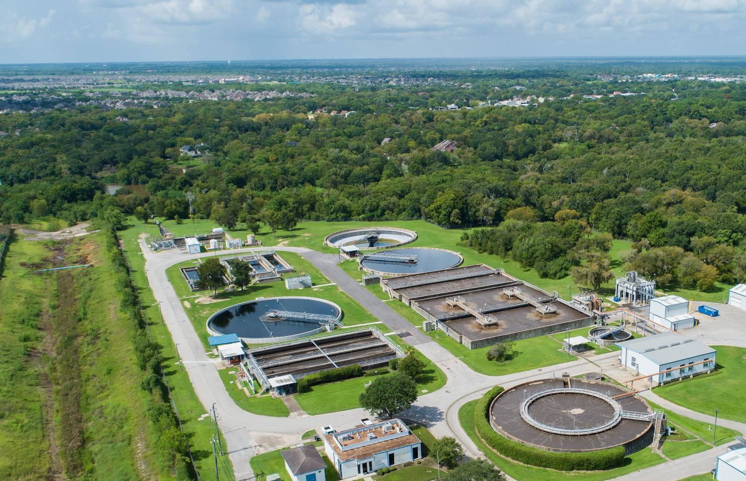
Secondary Clarifiers

Slide 14
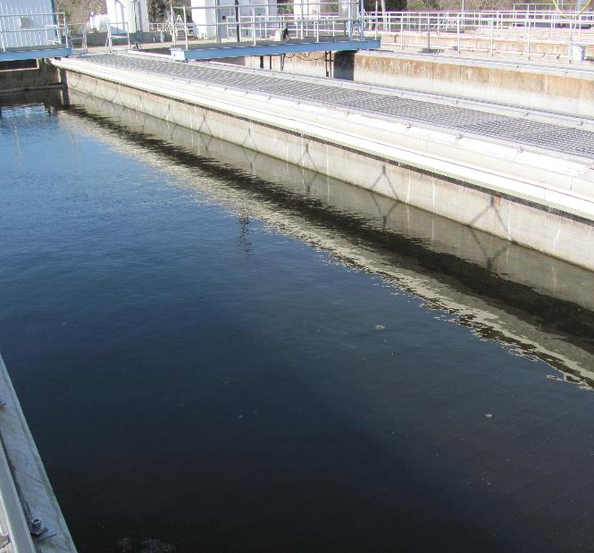
Wastewater Treatment – Tertiary Treatment
Gravity Filter:
Effluent Polishing
Improves effluent quality

Slide 15
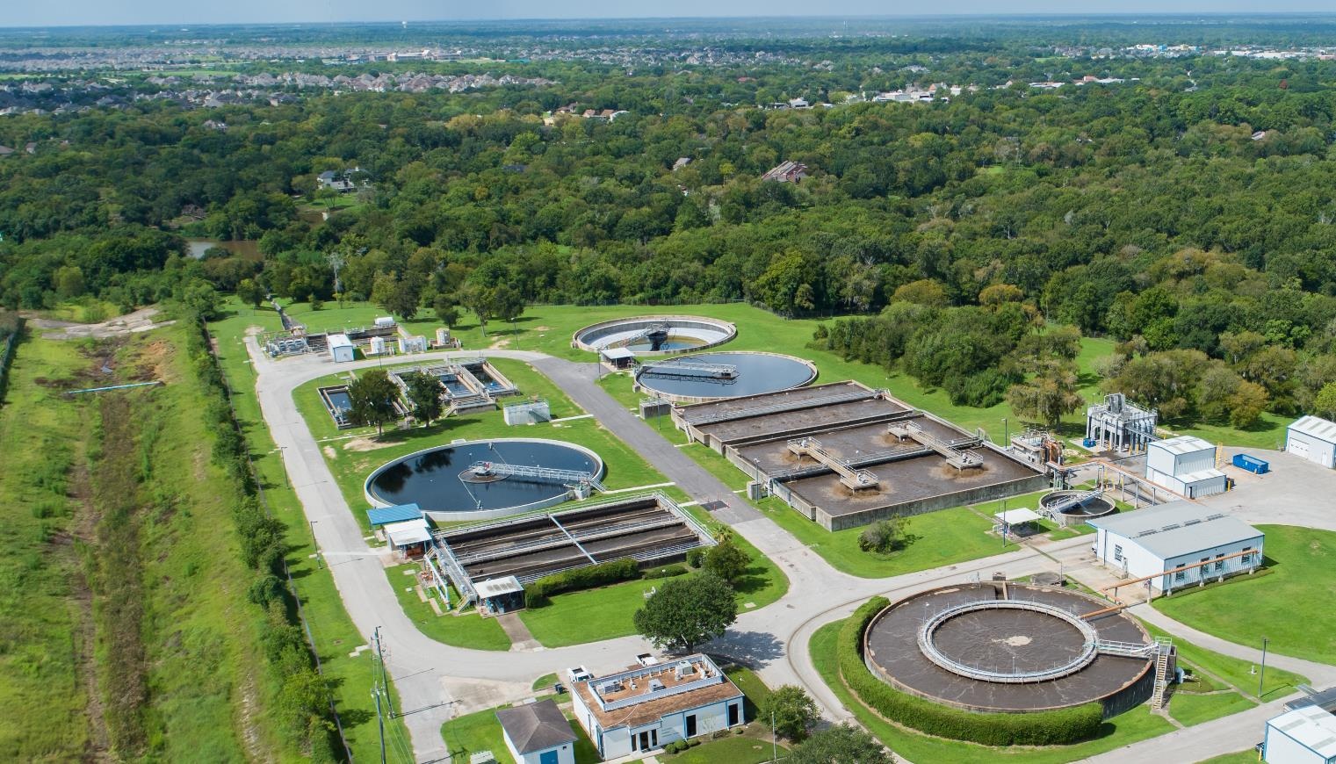
Tertiary Treatment

Slide 16
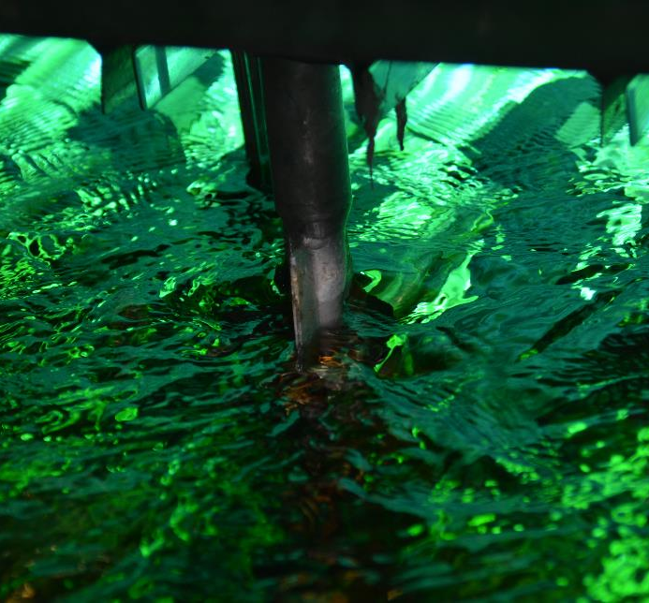
Wastewater Treatment – Disinfection
Ultra-Violet Light:
Reduces microorganisms in the water
Discharged into the environment
Water reused for drinking, bathing, irrigation, etc.

Slide 17

Disinfection

Slide 18
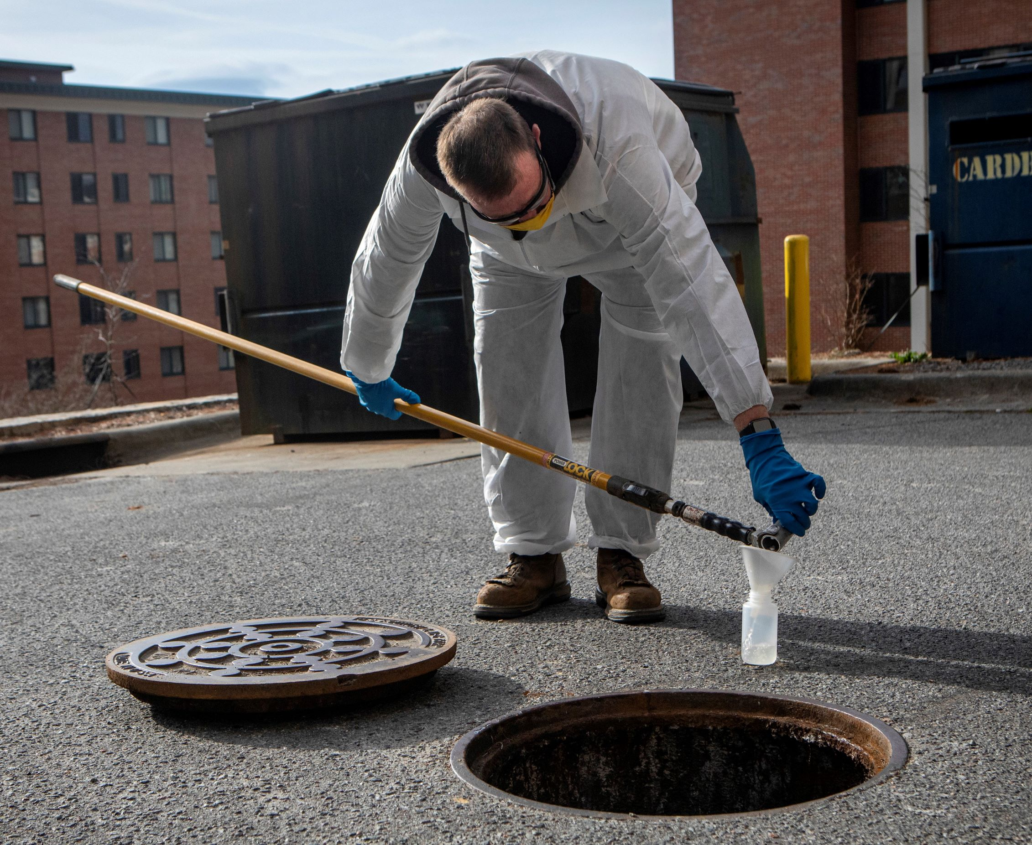
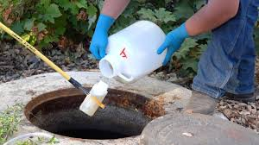
Sampling & Testing Technique
Proper sample
Accurate sample volumes
Choose the proper point in your system to sample
Obtain a representative sample
Sample should be delivered and analyzed as soon as possible
Stored samples must be refrigerated at 0 to 6° C
Grab or composite sample types

Slide 19

BUG Health & Condition
DO Uptake
  Measures rate of oxygen use
SVI (ml/gm)
  How is the sludge thickening
  Volume a gram of sludge will take up
  Settleability and MLSS calculation
ZSV (Zone Settling Velocity)
  How fast will the sludge settle
  30-min settleability test

Slide 20




Wastewater Discharge Permits
Clean Water Act
Discharge without a permit is prohibited
TCEQ/TPDES Permit
  Texas Water Code
  Permit to Dispose of Wastes

Slide 21
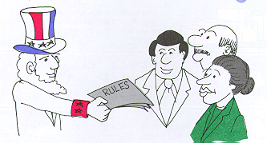
Conditions Upon Discharge Being Permitted
Limitations & Conditions
  Treatment
    Minimize Discharge through Treatment
  Compliance
    Demonstrate Continued Compliance
    Effluent Limitations
    Monitoring
    Reporting

Slide 22
Wastewater Permit Conditions
Two Basic Functions:
  Establishes Specific Levels of Performance
  Requires Discharger to Report Failures to Meet Levels

Slide 23
Conclusion:
Protects Public Health and Environment
Consists of Different Steps to Meet Treatment Goal
Authorized by Specific Permit Requirement
Monitoring Required to Demonstrate Compliance

Slide 24
Questions or Comments
Shannon Miftari
Facility Manager - Municipal
smiftari@gcatx.org
281-226-1090

