Slide 1
Current ISSUE 2021: Water Resources Management: Local Solutions
Envirothon Teacher Training
February 13, 2021

Slide 2
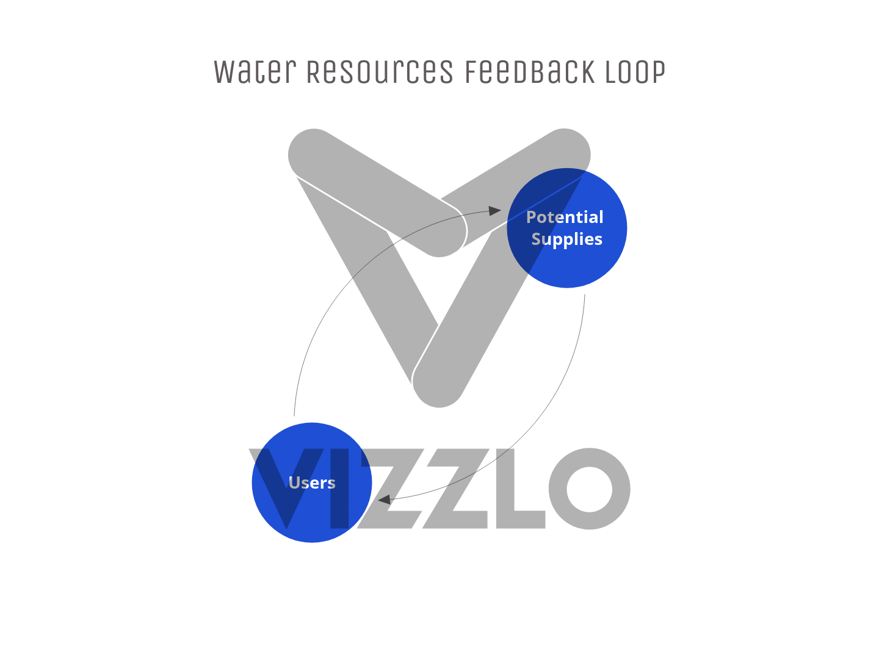
Last Year, We talked about the Issue
Economics of water: a supply and demand issue
Issue is mediated by environmental and societal externalities
Supplies and users are affected by climate change, human migration, weather, and pollution
This year, Here are some local solutions

Slide 3
Luce Bayou interbasin Transfer Project
The Luce Bayou Interbasin Transfer Project: Connects the Trinity and San Jacinto Watersheds
Takes water from the trinity to Lake Houston (RESERVOIR ON THE SAN JAC): 500 MILLION GALLONS/DAY MAX CAPACITY
Extraction from Lake Houston to the Northeast Water purification Plant
GOAL: MAINTAIN SUPPLY FOR THE CITY OF HOUSTON INTO THE FUTURE
REDUCE RELIANCE ON GROUNDWATER = REDUCE SUBSIDENCE
https://reduceflooding.com/2019/12/17/luce-bayou-interbasin-transfer-project-construction-photos/

Slide 4
Expansion of the Northeast Water Purification Plant
Plant currently treats 80 million gallons/day
Expansion will add 320 million gallon/day capacity
This pairs with the Luce bayou IBTP which will provide the water to Lake Houston
https://greaterhoustonwater.com/

Slide 5
East Fork Water Reuse Project
In Northeast Texas, on the East fork of the Trinity River
Farmersville, Forney, Garland, McKinney, Mesquite, Princeton, Plano, Rockwall, Royse City, Wylie, Richardson, Allen, and Frisco
1840 acres of wetlands and canals
Treated wastewater travels 44 miles to Lavon Lake
Lavon Lake is the source for the Wylie Water Treatment Plant
https://texaslivingwaters.org/bestbets/reuse.html
https://www.ntmwd.com/east-fork-water-reuse-project/

Slide 6
Inland Salination: El Paso Water and the Kay Bailey Hutchison Desal Plant
27 Million GPD of fresh water from Brackish Groundwater
Groundwater is otherwise unusable
Full Recovery plant—collaboration to use all liquid products, including the salts that are removed
What is the energy demand of such a facility?
https://www.waterworld.com/drinking-water/article/16223806/video-texas-desalination-plant-marks-10-years-of-innovation

