Slide 1
Aquatics
Texas Envirothon
2021
Jenny Oakley, Ph.D.
Environmental Institute of Houston
oakley@uhcl.edu
Notes:
Hello everyone, I’m Jenny Oakley, and I’m the Associate Director of Research Programs at the Environmental Institute of Houston and adjunct faculty at the University of Houston-Clear Lake. Sorry I’m not presenting to you live today, but I’ve provided my e-mail address here in case you have any questions or want to reach out to me regarding this talk on Aquatics.

Slide 2
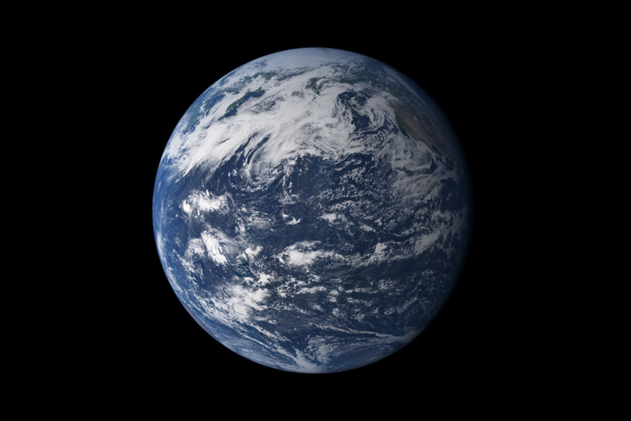
75% of the Earth Surface Area
Oceans 97%
Freshwater 3%
Glaciers & Ice Sheets 75%
Groundwater 24.7%
Surface Water <0.3%
Notes:
I’m a little biased, but Aquatics is the most important of the subjects in Envirothon. Understanding aquatics is central to all ecosystems, all habitats, and critters on our BLUE planet. They call Earth the blue planet because 75% of the surface is water. Of that most is saltwater, but of the fresh water most is in glaciers and ice sheets (at least for now). In fact, did you know that water makes up about 60% of the average human’s body mass?

Slide 3
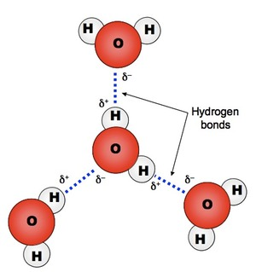
Basics of Water
Universal solvent
High surface tension
Neutral pH
Exists in all three physical states
Notes:
Water or the compound H2O is what makes life on earth possible. First, it is a universal solvent because it is able to dissolve more substances than any other liquid. This is extremely important for living things, and why H2O plays such an important part in our human bodies. But the fact that water is a great solvent also makes it extra difficult to manage when we are looking at pollutants, which we’ll talk about later. Water also has a high surface tension, which many animals have evolved to take advantage of, think of the water strider. Water also has a neutral pH and naturally exists in all three states that is: liquid, solid, and gas.

Slide 4
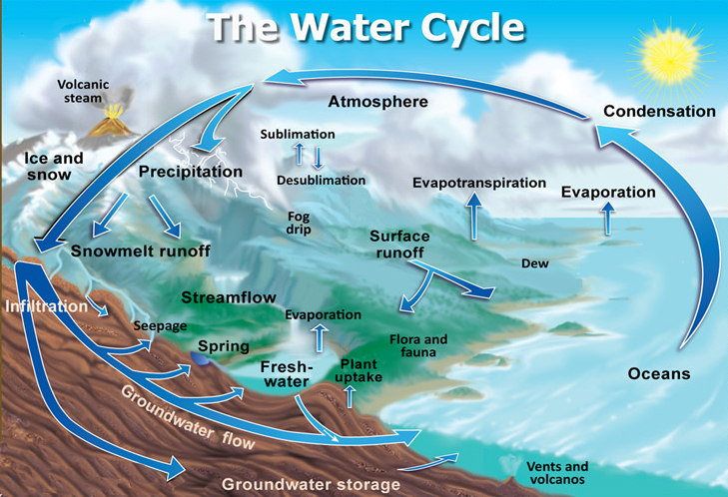
By John Evans and Howard Periman, USGS - http://ga.water.usgs.gov/edu/watercycle.html, Public Domain,
Notes:
The water cycle, also known as the hydrologic cycle or the hydrological cycle is a rather complex process that describes the continuous movement of water on earth. Water is neither created or destroyed, in fact it has stayed fairly constant over earth’s history, however the partitioning of the water can change drastically. Water, in all of it’s states is cycled using the processes displayed in this diagram. The water cycle directly impacts temperature, weather, and climate on earth. Many of the processes in the water cycle also naturally purify water.

Slide 5
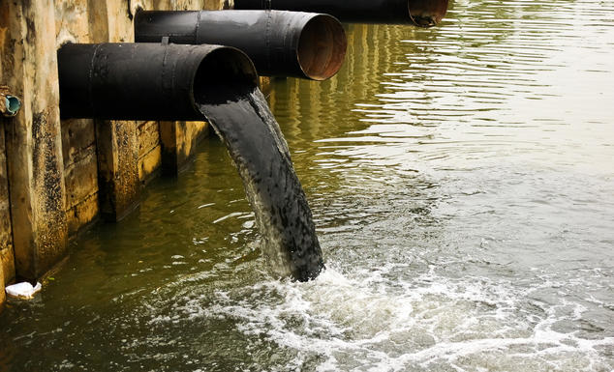
Water and Pollution
By Melissa Denchak
https://www.nrdc.org/stories/water-pollution-everything-you-need-know#whatis
Notes:
Water pollution comes in many forms, but as I briefly mentioned, the vary properties of water make it so effective at spreading pollution throughout the environment and in terms of aquatic critters, makes that pollutant more impactful.

Slide 6
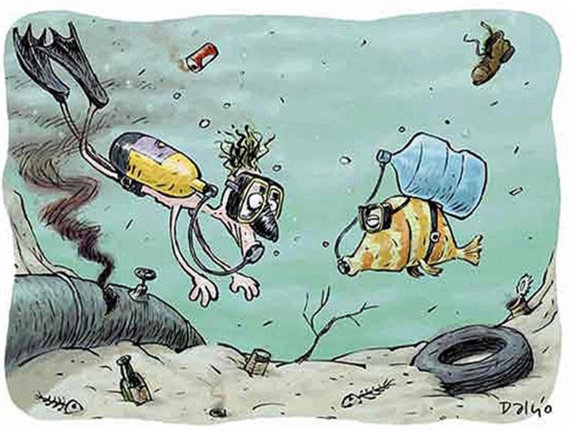
History of the Clean Waters Act (CWA)
Water Pollution Control Act (1948):
“…for eliminating and reducing the pollution of interstate waters and tributaries and improving the sanitary condition of surface and underground waters.”
Water Quality Act (1965):
Required states to establish water quality standards
Notes:
Here is a quick history of measures to protect water quality in the U.S. The history of the Clean Waters Act goes back to 1899 (and earlier) with the Rivers and Harbors Act and subsequent Oil Pollution Act of 1924.
But the first major implications for surface water quality was in the Water Pollution Control Act of 1948. This act has many amendments, but some of the most important were the 1956 amendment and the 1965 amendment which renamed the Act. This was the initiation of the development of standards for water quality.
There was a regulatory understanding for the need to protect water quality, but for many citizens they were “removed” from some of the major issues surrounding water impairments.

Slide 7
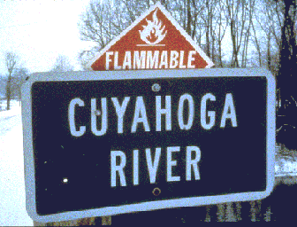
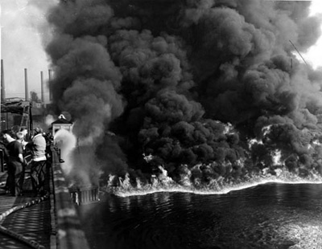
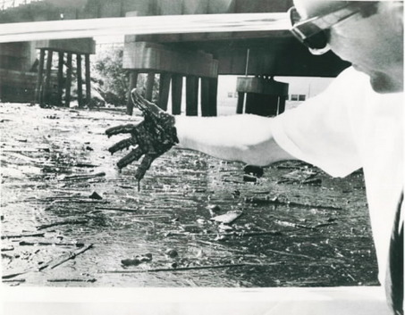
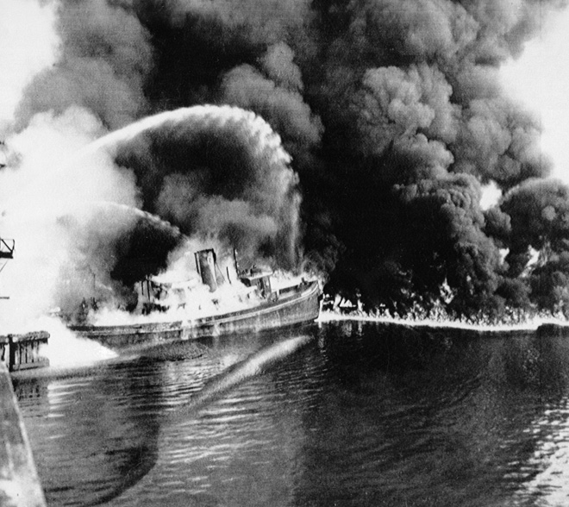
Cuyahoga River Fire
Cleveland, OH
Not the first time the River had burned
1969 Fire – Publicity that demanded stronger action
Time Magazine:
“River that oozes rather than flows”
“Where a person does not drown but decays”
Cuyahoga River Fire of 1952, $1.3 million in damages
Notes:
Then in 1969 the KY-e-HOH-ge River near Cleveland, OH caught on fire. Now, this is not the first time the river burned, at least 13 fires have been reported on the River (first occurring in 1868). But what made this time different is that Time magazine did a piece on the fire (using photos from the 1952 fire) which opened the eyes of many readers across the country that we have water quality issues that need to be addressed. Publicity demanded stronger action and just one year later the

Slide 8
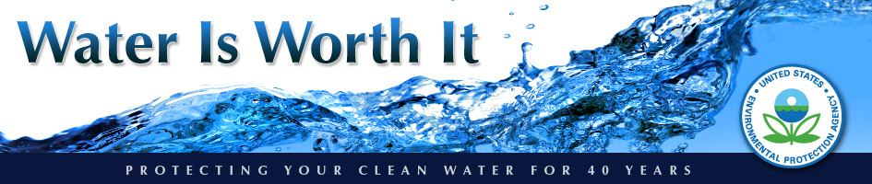
Clean Water Act
Stipulated broad national objectives to restore and maintain the chemical, physical and biological integrity of the Nation’s waters
Provided EPA authority to implement pollution control programs
Notes:
Clean Water Act established the basic structure in use today for regulating pollutant discharge into waters of the US and setting water quality standards for surface waters.
Control programs such as construction of wastewater treatment plants. NPDES – point source permits & dredged material.

Slide 9
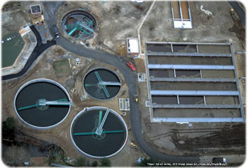
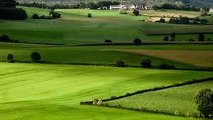
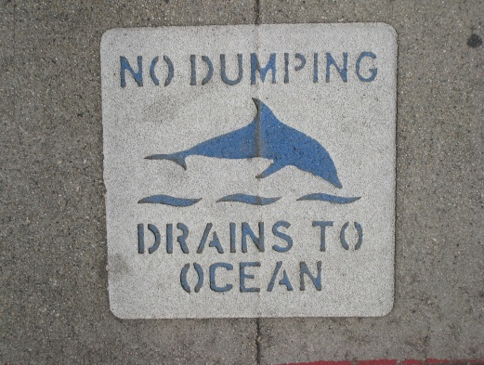
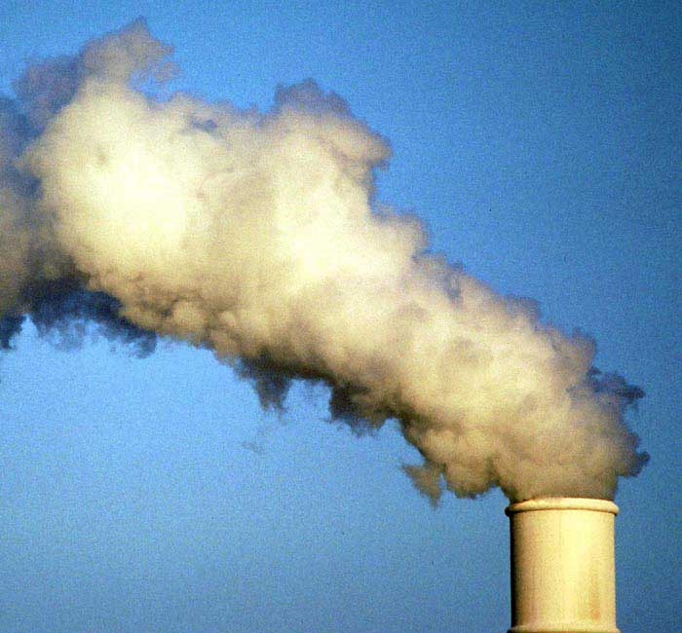
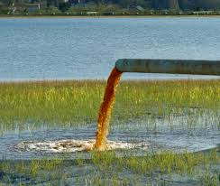
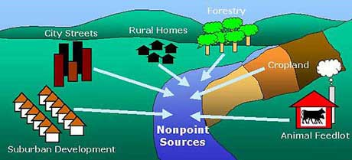
Pollution
Point Source
Non-point Source
Pollution that enters water at a single, identifiable and discrete point
Pollution that enters water without a single, identifiable and discrete point of entry
Notes:
In terms of water there are two categories of sources of pollution. Point source and non-point source pollution.
Point source pollution enters water at a single, identifiable and discrete point, think of pipe, conduit, animal feedlot, power plant discharge.
Non-point source pollution that enters water without a single, identifiable and discrete point of entry such as overland runoff from agricultural lands (fertilizers, pesticides, herbicides), urban runoff (oil and grease), stormwater runoff.

Slide 10
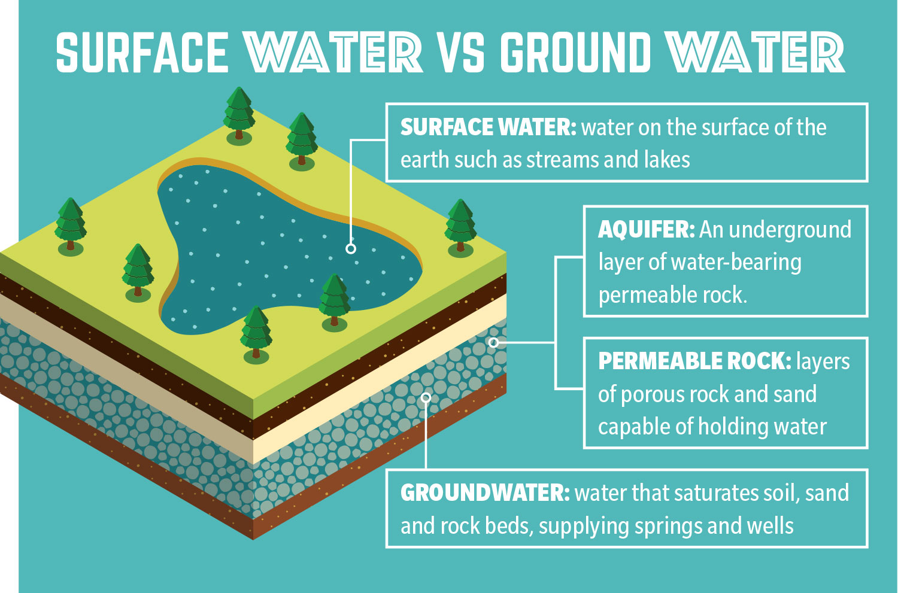
Water Types
Ground Water
Surface Water
Notes:
There are two types of water in liquid form (other than oceans), that is ground water and surface water. If you remember back to our water cycle, when rain falls some of it seeps into the earth (that’s infiltration), filling the cracks, crevices, and porous spaces of an aquifer (basically an underground storehouse of water), it becomes groundwater. Nearly 40 percent of Americans rely on groundwater, pumped to the earth’s surface, for drinking water. Groundwater gets polluted when contaminants—from pesticides and fertilizers to waste leached from landfills and septic systems—make their way into an aquifer. Groundwater can also spread contamination far from the original polluting source as it seeps into streams, lakes, and oceans. Furthermore, the overuse of groundwater can cause the water table in the aquifer to fall, and in some systems this can cause the surface water to fill the void, causing reduced flow in surface water systems.
Surface water from freshwater sources (so things like rivers, streams, bayous, lakes, and ponds) accounts for more than 60 percent of the water delivered to American homes. According to the most recent surveys on national water quality from the U.S. Environmental Protection Agency, nearly half of our rivers and streams and more than one-third of our lakes are polluted.

Slide 11
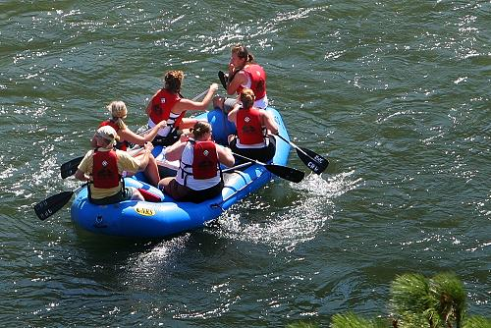
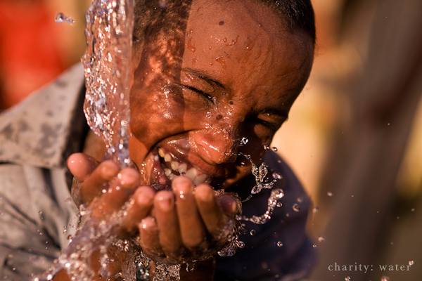
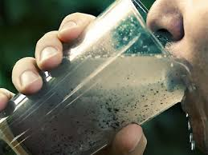
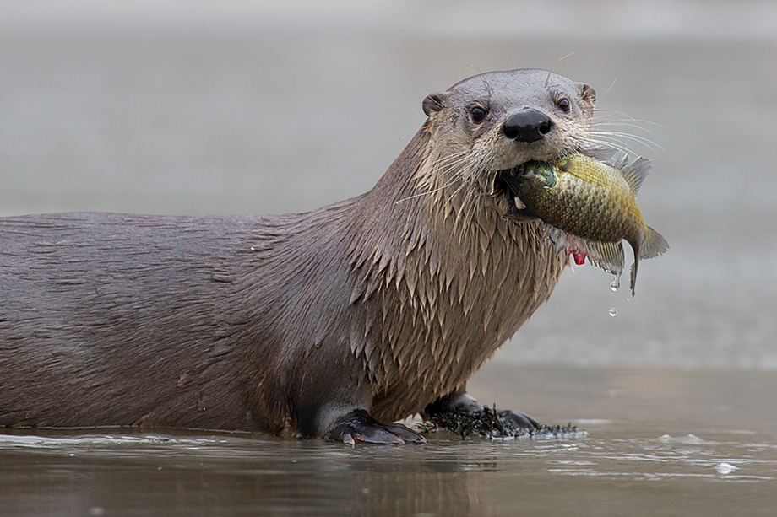
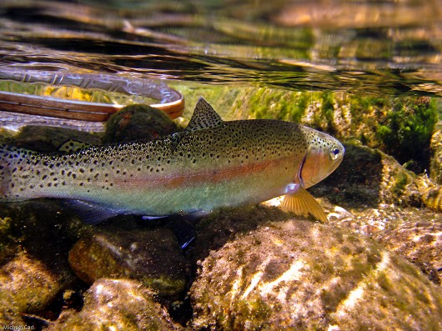
Water Quality Standards
Texas Commission on Environmental Quality
Human Health
Municipal purposes
Recreation
Aquatic Life
Notes:
Here in Texas the agency charged with monitoring water quality is the Texas Commission on Environmental Quality or TCEQ. Their Surface Water Quality (or SWQM team) works to and I quote “establish explicit goals for the quality of streams, rivers, lakes, and bays throughout the state. The Standards are developed to maintain the quality of surface waters in Texas so that it supports public health and enjoyment and protects aquatic life, consistent with the sustainable economic development of the state.”
Water quality standards identify appropriate uses for the state’s surface waters, including aquatic life, and Human Use for example: recreation, and sources of public water supply (or drinking water). The criteria for evaluating support of those uses include dissolved oxygen, temperature, pH, dissolved minerals, toxic substances, and bacteria.

Slide 12
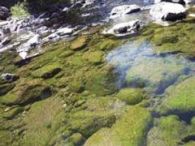
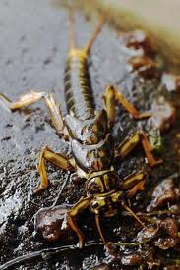
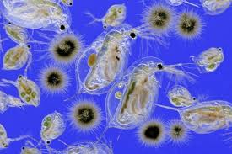
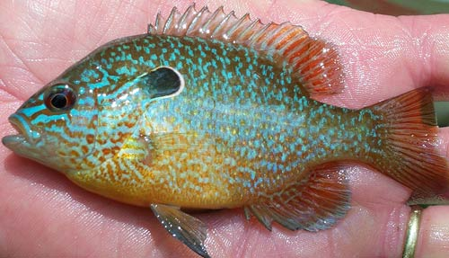
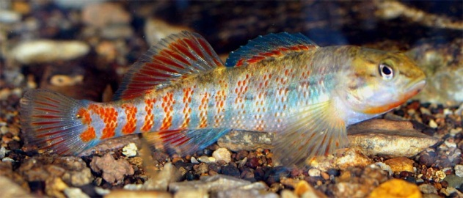
Aquatic Life
Support healthy aquatic systems
Fish
Invertebrates
Plankton
Periphyton
Notes:
For Aquatic Life, the goal is that surface waters of the state is able to support diverse and healthy communities of aquatic critters. Those critters include fish, invertebrates, plankton, and plants (including periphyton).

Slide 13
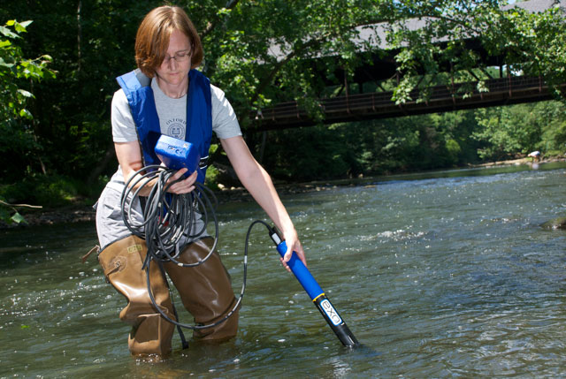
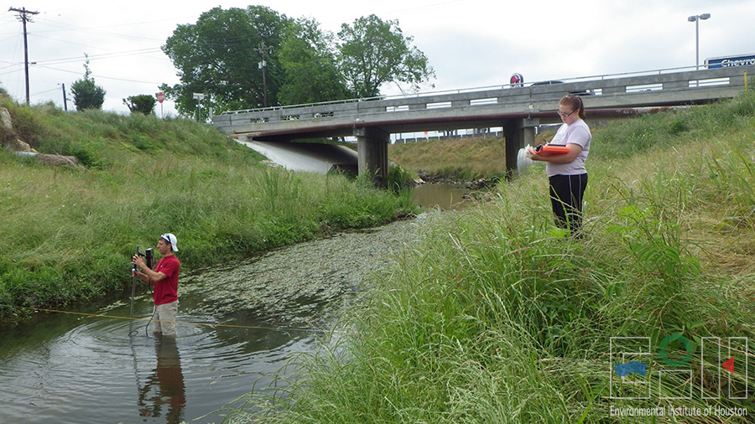
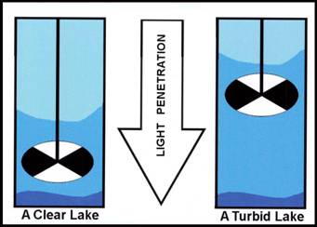
Water Quality Parameters
Standard Parameters
Temperature
Dissolved oxygen
pH
Specific conductivity
Turbidity
Flow
Notes:
These are some examples of typical criteria measured to determine if surface waters meet standards set for human contact and aquatic life use. Many times scientists use something called a multiparameter sonde (picture on top right) to measure things like temperature, dissolved oxygen, pH, specific conductivity and even things like chlorophyll a levels in the water. They can also use something called a secchi disk to measure the water clarity, and many different methods to measure flow or discharge when dealing with flowing water. If working in a flowing water system, like a river or stream discharge is key to understanding the water quality and more importantly loading of pollutants in the system. Discharge is the amount of water that flows through a specific sized area in a specific time, often represented as cubic feet per second.

Slide 14
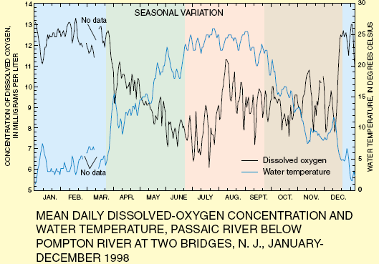
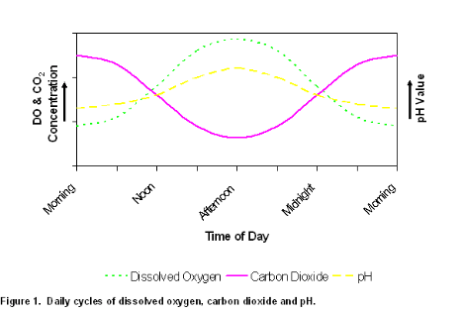
Dissolved Oxygen
Seasonal – temperature + precipitation
Fall/winter = higher DO
Spring/summer = lower DO
Diel – respiration + photosynthesis
Sunset = higher DO
Sunrise = lower DO
Notes:
Low dissolved oxygen is the leading cause of fish kills in Texas. Dissolved oxygen naturally fluctuates with temperature and time of day. The warmer the water temperature the lower the capacity for the water to hold dissolved oxygen. This along with other factors including decreased flow due to less rainfall are why we tend to see the lowest dissolved oxygen levels in the summer in Texas. There are also daily fluctuations in dissolved oxygen. For example, if I were monitoring the 24 hr dissolved oxygen at a river, I’d expect to see the highest DO levels just before the end of the day, and the lowest just before sunrise. Now, this makes sense if you think about that fact that much of the DO in these freshwater systems comes a the byproduct of photosynthesis from plants and algae. All day long as the sun is out DO is being added to the water by plants. While at night that source of DO stops, but the respiration that is happening from all of the critters that live in the steams continues, using up the DO available, with no photosynthesis to re-supply, until the morning when the sun comes out again.

Slide 15
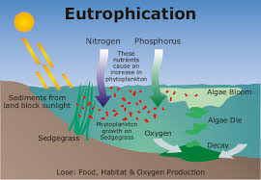
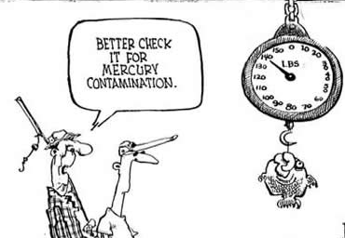
Water Quality
Nutrients
Metals
Phosphorus
Nitrogen
Ammonia
Arsenic
Mercury
Lead
Notes:
Often times, low dissolved oxygen is caused by something called eutrophication. This is when there are excess nutrients (think about herbicides washed into streams and rivers from non-point sources) in rivers or streams, or even the ocean. These excess nutrients are food for bacteria and algae which can multiply in great numbers when there is plenty of food/nutrients available. But eventually they’ll die off, creating an influx of material that needs to be decomposed. That process burns through dissolved oxygen causing there to be too little oxygen in the water for other critters like fish or clams. This is called hypoxia.
Another metric for measuring water quality can be heavy metals. Metals such as arsenic, mercury, and lead tend to bioaccumulate. This means that they are rarely processed in the digestion of aquatic critters so they accumulate in their bodies. Then those pollutant loads can be transferred to the predator that consumes them, causing top predators to have sometimes very high levels of these and other bioaccumulating pollutants, which can have health impacts.

Slide 16
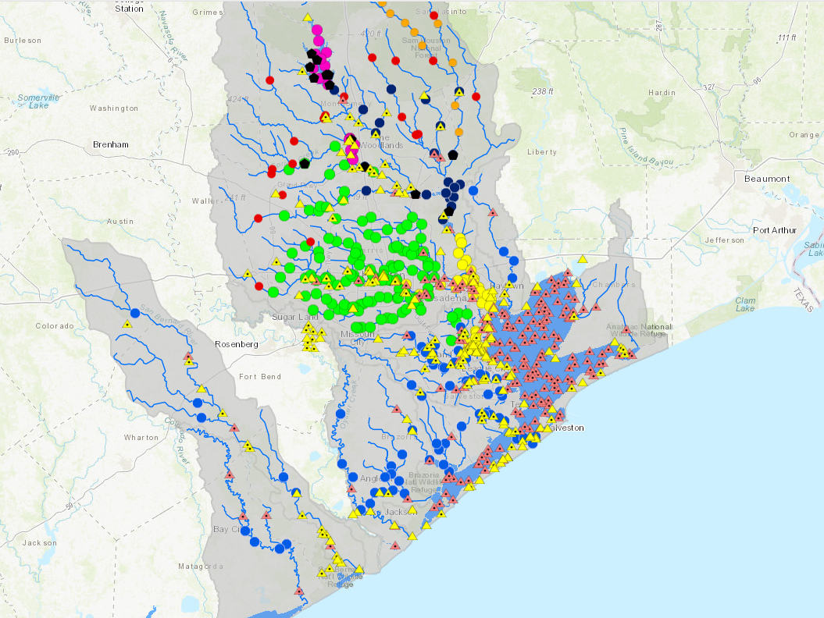
Water Pollution – Clean Rivers Program
Houston-Galveston Area Council – Basin Highlights Report - 2020
Regional Partners:
City of Houston
Health Department
Drinking Water Operations
Harris County Pollution Control
San Jacinto River Authority
Sam Houston State University
EIH/UHCL
https://www.h-gac.com/clean-rivers-program/basin-highlights-summary-reports
Notes:
As I mentioned earlier, in Texas, the Texas Commission on Environmental Quality is charged with monitoring the quality of the surface water. This is mostly done through the Clean Rivers Program or CRP which is a consortium of agencies, organizations, NGOs and academic institutions that regularly monitor water quality. In our area, Houston, the organization that acts as the organizer for CRP is the Houston-Galveston Area Council. They corral the six regional partners and the over 370 monitoring sites and make sure that the monitoring data are submitted to the TCEQ and quality controlled. This map shows all of the monitoring sites in the Houston area. The light blue circles are sites monitored by EIH here on the UHCL campus.

Slide 17
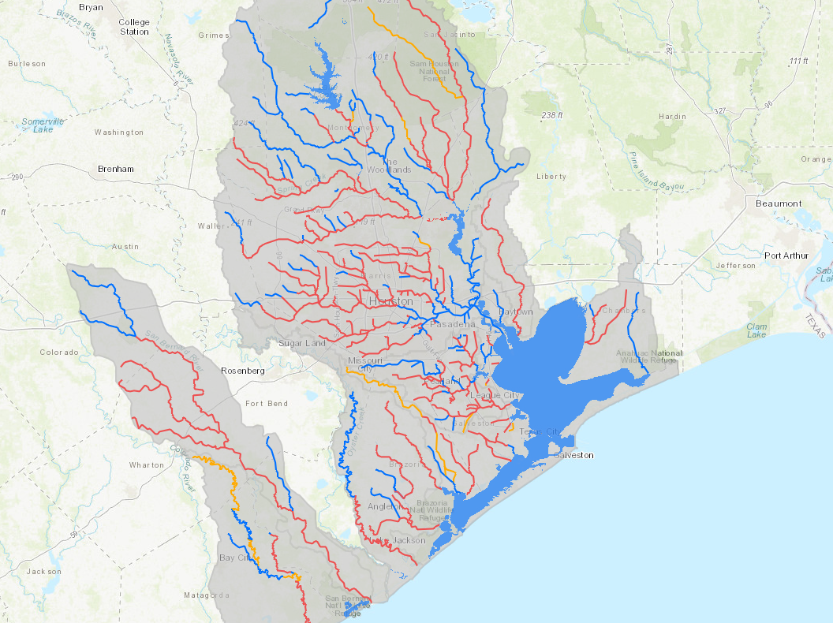
Water Pollution
Houston-Galveston Area Council – Basin Highlights Report - 2020
Bacteria
Recreational Standard
Enterococci - Tidal
E. coli - Fresh
42% of stream miles impaired
Sources:
WWTF releases
Sanitary sewer overflows
Failing OSSF (septic systems)
Fecal waste - animals
https://www.h-gac.com/clean-rivers-program/basin-highlights-summary-reports
Notes:
Out of the parameters that are monitored, Bacteria is one of the most significant water quality issues in the Houston area. Bacteria concentrations are monitored to determine if the water body is safe for recreation. The bacteria tested are Entero for tidal waters and E. coli for fresh waters. These are pathogen indicator bacteria, meaning typically when we see high entero or E. coli levels we also see higher levels of other pathogenic bacteria, viruses, or protozoans. 42% of stream miles that we monitor in our region are impaired due to elevated bacteria levels. In the map on the right, the blue lines are the stream segments that meet water quality standards, while the yellow and red lines exceed the standards, with the red lines having more extreme exceedences. Sources of bacterial contamination include: untreated wastewater treatment facility releases, sanitary sewer overflows, failing on site sewage facilities (septic systems), and fecal waste from livestock, pets, hogs, and other wildlife.

Slide 18
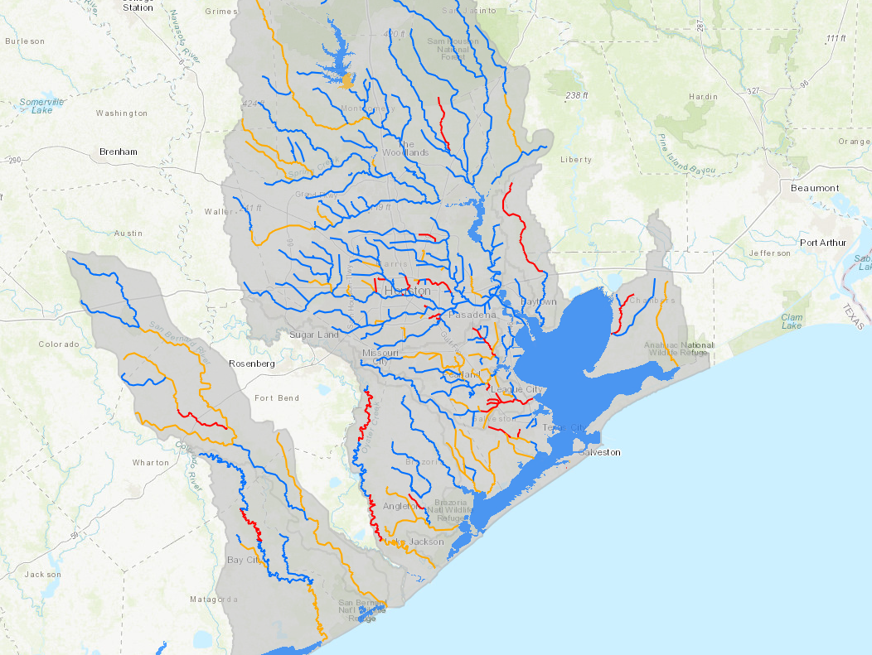
Water Pollution
Houston-Galveston Area Council – Basin Highlights Report - 2020
Dissolved Oxygen
Aquatic life standard
22% of stream miles impaired
Sources:
Nutrient loading
Algal blooms
Sedimentation
Reduced riparian cover
= higher temps
https://www.h-gac.com/clean-rivers-program/basin-highlights-summary-reports
Notes:
Another parameter that is monitored is dissolved oxygen. As Alex mentioned in our interview in last weeks lecture, low DO is a common cause of fish kills. DO is measured to determine if a waterbody can support aquatic life. DO levels can be negatively impacted by human actions like high concentration of nutrients from agriculture runoff, which can cause algal blooms that can temporarily increase the dissolved oxygen but typically result in crashes in DO after a die off (this process of excess nutrients and resulting algal blooms, and the aftermath can also be termed Eutrophication. Also, the reduction of shade from a natural riparian buffer along the water can result in higher temperatures in the water, and warmer water holds less dissolved oxygen compared to cooler water.

Slide 19
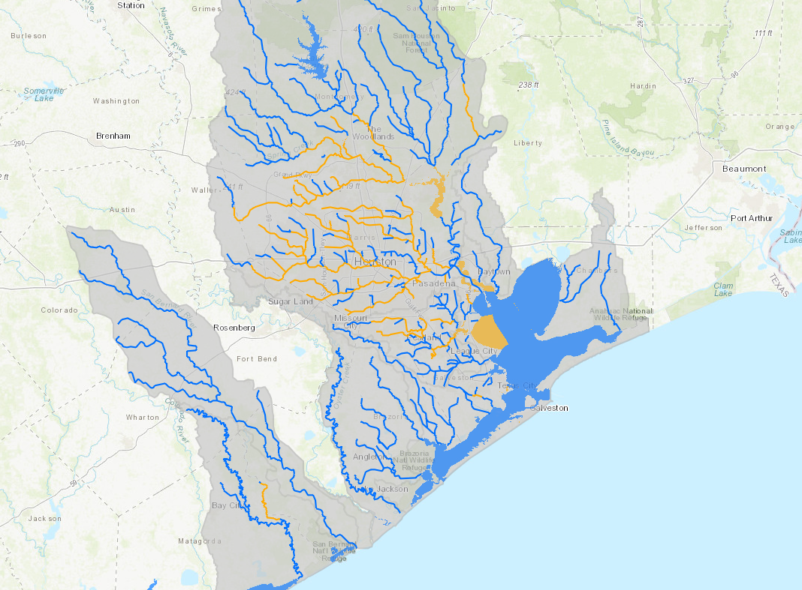
Water Pollution
Houston-Galveston Area Council – Basin Highlights Report - 2020
Nutrients
Phosphorus and Nitrogen
35% of stream miles impaired
Sources:
Fertilizer runoff
Stormwater runoff
Animal manure
WWTF discharges
OSSF failures
https://www.h-gac.com/clean-rivers-program/basin-highlights-summary-reports
Notes:
Nutrients including phosphorus and nitrogen naturally occur in surface waters, however human activities can cause excess nutrients which can in turn impact the water quality and case algal blooms, depress DO and produce toxins harmful to humans and wildlife. 35% of stream miles exceed state standards for nutrients such as nitrate, ammonia, and phosphorus. Sources include runoff both point and non-point source from fertilizers and animal manure, and excess nutrients from waste water treatment facilities and on-site sewage facility failures.

Slide 20
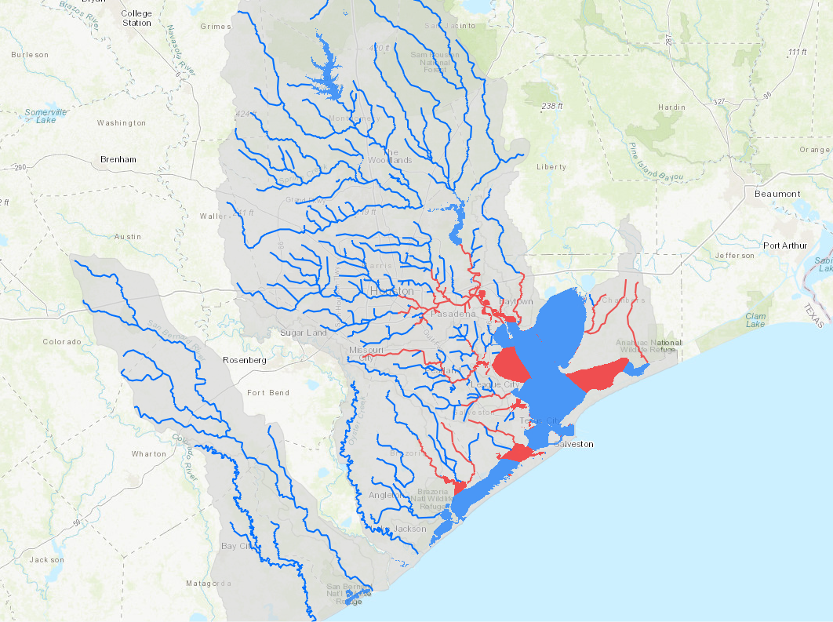
Water Pollution
Houston-Galveston Area Council – Basin Highlights Report - 2020
PCBs and Dioxin
Phosphorus and Nitrogen
6% of freshwater streams
60% of tidal streams
75% of Bays
Sources:
Fertilizer runoff
Stormwater runoff
Animal manure
WWTF discharges
OSSF failures
https://www.h-gac.com/clean-rivers-program/basin-highlights-summary-reports
Notes:
Finally, PCBs or polychlorinated biphenyls and Dioxins are broad groups of synthetic organic compounds developed for industrial purposes or are by-products of industrial processes. They are toxic and carcinogenic and considered legacy pollutants remaining in the environment long after they are introduced. They also bioaccumulate (or as your book called it biomaginfication). 6% of freshwater streams, 60% of tidal streams, and 75% of bays in our area are impaired for PCBs and Dioxin.
Now you might have noticed that I began discussing CRP data with the statement “out of the parameters that are monitored” because on a consistent basis there are many other parameters that aren’t regularly monitored such as heavy metals, Organic Carbon, and biological communities

Slide 21
Biological
Index of Biotic Integrity
Sensitive—Intolerant to poor stream conditions.
Intermediate—Moderately tolerant to degraded habitat and water quality.
Tolerant—Most tolerant to degraded habitat and water quality.
Notes:
One way that scientists can evaluate a surface water body is to see what types of critters are living in it. To do this, they’ll go out and collect as many aquatic fish or invertebrates as they can in their study area. For example the numbers, types, and life history of the fish caught can tell the scientist about the health of the water. Many aquatic fish or invertebrates are categorized into one of these categories. Sensitive species are only found in very specific conditions, typically indicative of very clean water, while other species (for example the western mosquito fish) are found everywhere! The proportion of the fish population that is made up of each of these sensitivity types helps to score or rate the biological integrity of that waterbody.

Slide 22
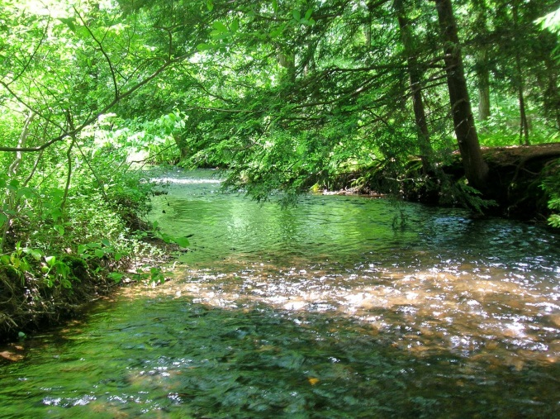
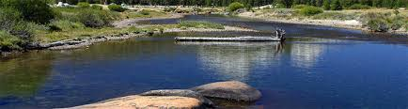
Healthy Stream
Characteristics
Effects
Meandering pattern
Habitat diversity
Intact riparian zone
Natural deposition and erosion
Species diversity
Stream shading
Notes:
Along with water quality, and biotic community, there are also physical habitat characteristics that are indicative of a healthy surface water body. For streams or rivers, a natural meandering pattern increases habitat diversity, which in turn increases species diversity. Also, an intact riparian zone (the interface between land and water (so the edges of a river or stream) can provide habitat and is important in stream shading which can help regulate water temperature.

Slide 23
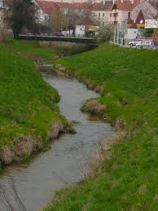
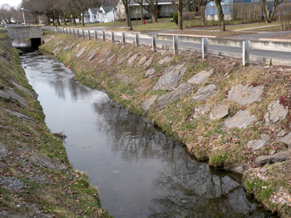
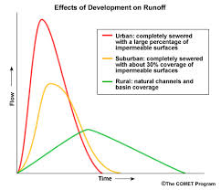
Degraded Stream
Characteristics
Effects
Channelization
Artificial substrate
Lack riparian
Scouring / Erosion
Lower diversity
Higher water temperature
Notes:
Signs of a degraded stream are channelization which can result in higher velocities during rain events that cause scouring and erosion. Also artificial substrate like concrete create streams with little habitat complexity which results in lower species diversity. Also, the lack of riparian plants cause higher water temperatures.

Slide 24
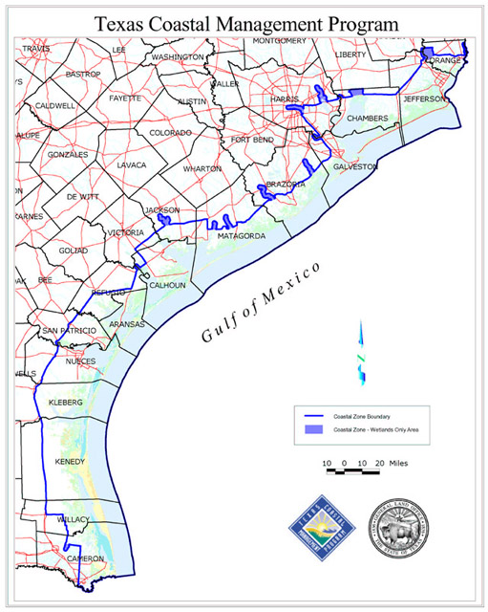
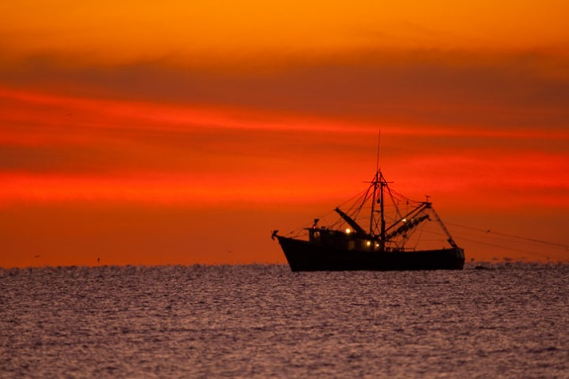
Coastal Zone
Bays
Estuaries
Tidal creeks
Freshwater Inflows
Saltwater Tides
Brackish
Notes:
Along the coast, the fresh surface and ground water meet the salt water of the gulf of Mexico. This mixing zone occurs in the bay and estuaries and up into the tidal rivers/bayous/creeks along the coastal plain. This mixed fresh and salt water is called brackish water.

Slide 25
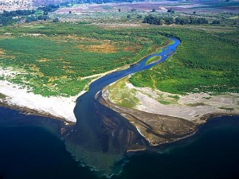
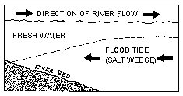
Salt Wedge
Composition – saltwater/freshwater interface
Effects
Halocline
Increased Sedimentation
Notes:
Many times where the two water masses meet there is something called a salt wedge. Salt water is heavier than fresh water… because salt water has many more dissolved minerals in it. So when freshwater flows into salt water, the fresh water tends to float on top of the salt water. The salt water layer below is called a salt wedge. The wedge can move up or down stream based on freshwater inflow and tides. Often times there is a distinct layering of the water here called a halocline. This can impact mixing, dissolved oxygen, and nutrient cycles in these dynamic brackish systems. The salt wedge also causes the flowing water mass to slow down which allows the suspended sediments to precipitate from the water column, I’ll explain why this is so important in a minute.

Slide 26
Water Quantity
Water Rights
“a right acquired under the laws of Texas to impound, divert or use state water.”
Permitted resources managed by TCEQ
Senate Bill 2 – Texas Instream Flows Program
Senate Bill 3 – Environmental Flows Process
Notes:
So I’ve talked a lot about water quality, but another challenge water resource managers face is water quantity. As climate change continues to create more extreme weather patterns, excess waters in the form of floods, and insufficient water in the form of droughts will continue to be a challenge. In Texas, water from both surface and ground water sources are used for irrigation and municipal systems. In fact irrigation accounts for 59% of total water use in Texas and municipal use accounts for 28% of total water use. Texas surface water is owned by the state and is held by the state in trust for the public. A water right is defined as “a right acquired under the laws of Texas to impound, divert or use state water.” the TCEQ manages and permits the use of water. Currently if you added up all of the water rights approved in the state, during times of drought, there is the possibility that there would not be enough water for farmers to irrigate their crops, or people to drink, and certainly not enough to leave any surface water flowing into our bays and estuaries. The concern that in future extreme droughts, there would be insufficient water flowing to the bays to keep them healthy prompted something called Senate Bills 2 and 3.

Slide 27
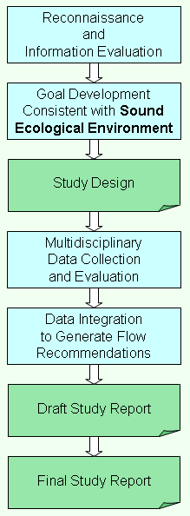
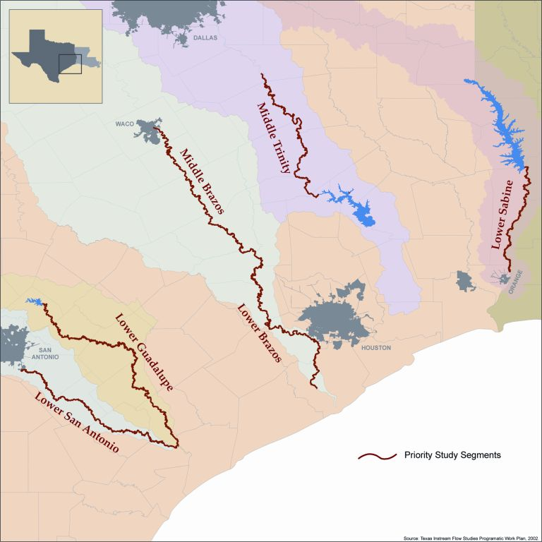
Texas Instream Flows Program
Notes:
In 2001, Senate Bill 2 directed the Texas Parks and Wildlife Department (TPWD), the Texas Commission on Environmental Quality (TCEQ), and the Texas Water Development Board (TWDB), in cooperation with other appropriate agencies, to "jointly establish and continuously maintain an instream flow data collection and evaluation program." In addition, the legislature directed the agencies to "conduct studies and analyses to determine appropriate methodologies for determining flow conditions in the state rivers and streams necessary to support a sound ecological environment." The resulting program, known as the Texas Instream Flows Program (TIFP), conducts detailed instream flow studies which consider a wide range of environmental variables such as habitat, hydrology, biology, physical processes, water quality, and connectivity - all dictating a multidisciplinary effort. The goal of each study is to identify appropriate flow regimes that conserve fish and wildlife resources while also providing sustained benefits for other human uses of water resources. Given their complexity, instream flow studies take many years to complete with only a small portion of the State's rivers having been addressed to date.
TIFP studies for specific river sub-basins will be conducted in a four step process involving public/stakeholders and scientific peers as well as multidisciplinary technical studies. The process for instream flow studies is shown in this flow chart. Six river sub-basins have been identified as priority instream flow studies. These sub-basins were selected based on potential water development projects, water rights permitting issues, and other factors.

Slide 28

Environmental Flows Process
Notes:
Whereas Senate Bill 2 provides for detailed studies and determinations of the instream flow needs for priority river basins, the Legislature recognized the need to more quickly identify appropriate amounts of water to set aside for the environment and so passed Senate Bill 3 in 2007. Senate Bill 3 (SB3) is an accelerated, stakeholder-driven process designed to use existing information and the best available science to establish environmental flow recommendations and standards for all Texas river basins and estuaries. The intent of the Senate Bill 3 process is to address three major questions:
How much water is needed to sustain a sound ecological environment in the state's rivers and estuaries?
How can this water be protected?
What is the appropriate balance between water needed to sustain a sound ecological environment and water needed for human or other uses?
Now freshwater is needed for our bays to say healthy by regulating the salinity for some of the critiers that specialize at living in low salinity waters, for delivering nutrients that support the base of the food web in the bays, and for delivering sediment. This is a very important process that develops these complex and dynamic river deltas (the satellite image here is of the Trinity River Delta). The sediment deposited into the deltas is critical to naturally combat sea level rise along our coasts. When the freshwater inflow is reduced, along with it the sediment that naturally builds up our coastal areas is reduced.

Slide 29

Habitat Loss and Habitat Preservation
Image source:
Living on Earth – Adam Wernick
Notes:
Here along the Gulf Coast we lose more than 1 football field of coastal land every hour! That seems impossible. <change picture> But with development, subsidence, the reduction in natural sedimentation from reduced freshwater inflows and sea level rise that loss of coastal wetlands is really astonishing.

Slide 30

Habitat Loss and Habitat Preservation
“Losing Ground”
Living on Earth Interview
https://projects.propublica.org/louisiana/#
Notes:
I’m going to play an interview on a radio show called “Living on Earth” where Bob Marshall explains the land loss in Louisiana and mentions a project called Losing Ground. I’m going to navigate to the website (posted here) and explore it and follow along with Bob’s interview. Bare with me, the maps contain a lot of data so the first time I scroll through the time lapse they can be a little jumpy, but after I do, I’ll go back and forth a few times so you can really see the slide bar and wetland change through time.
While this example is from Louisiana, the same thing is happening along the coast of Texas. But there is hope, I’m not sure if you noticed it, but the last spot I zoomed in to the Athchafalaya River Delta, actually is a success story. These areas have naturally built about 18 square miles of new land in the past 40 years because the resource managers have managed the freshwater inflows in this area, allowing for natural sedimentation.

