Slide 2

Exploration Green
16205 Diana Lane,
Houston TX 77062
John Branch
Clear Lake City Water Authority
johnbranch@yahoo.com
281 898-8082
Frank Weary
Exploration Green Conservancy
frank@weary.net
713 806-8140

Slide 3
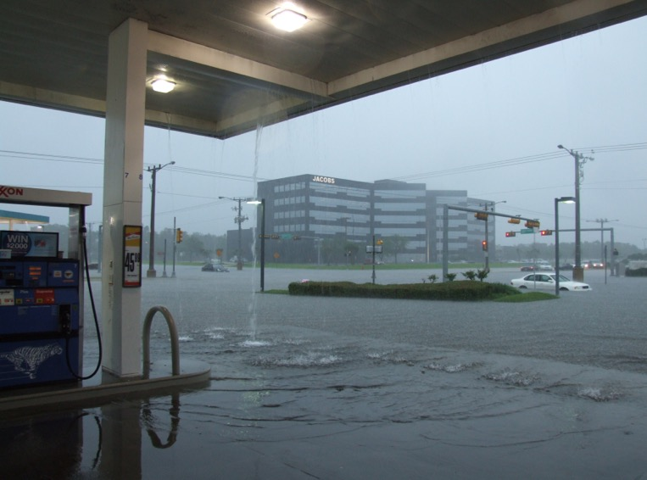
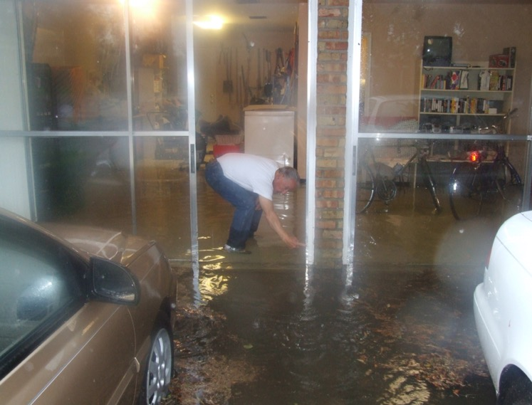
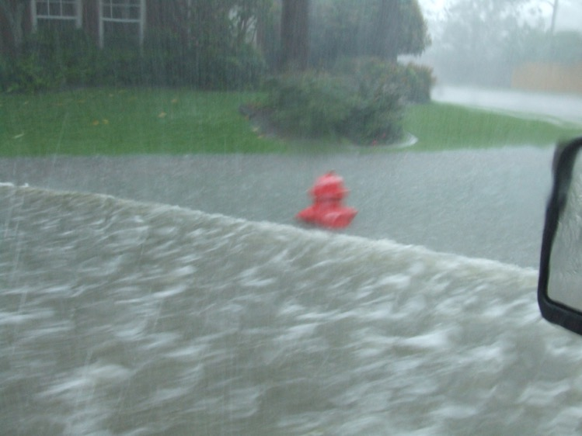
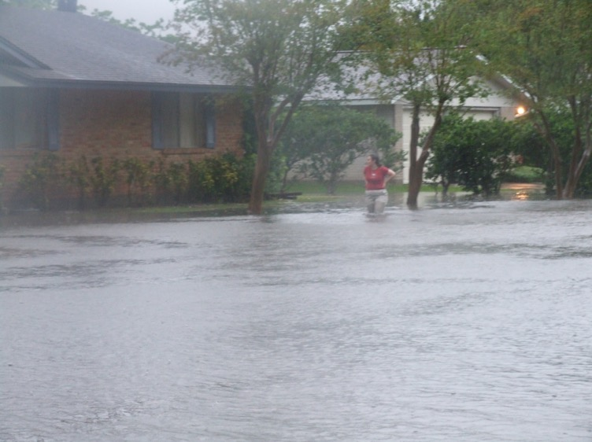
Community at Risk
Clear Lake area has had eight 100-year floods, FIVE 500-year floods & one 5,000-year rain (Harvey) since 1979
Recurring flooding during minor rain events has drastically reduced the values of affected communities.
Notes:
Homeowners and CLCWA noted that flooding continued to increase. Note that the pictures are NOT HARVEY!, but rather random photos taken during “routine” heavy rains.

Slide 4
2 studies, 8 Years & 4 Town Halls later,
Exploration Green
Concept Sketch
N
Total Acreage – 200
Permanent Water - 38
Wetlands – 39
Paved Trails – 6 miles
Total Trails – 12 miles
5,000 Trees
Water Surge – 500M gallons
3b
Underground Gas Line
3a
2
5
LEGEND
Permanent Water
Slope to Water
Upland Flats
Habitat Islands
Adjacent Property
Trails
4
1
Master Plan
5-Phases of Implementation / Enhanced Schedule
Notes:
CLCWA needed to take action, so we initiated flood mitigation studies. Beginning in 2005, we initiated the purchase of the land. That step was completed in 2011. We immediately went to the community for input through Town Halls meetings organized by a citizen’s group that later became the Conservancy. From there, SWA Architects prepared the Master Plan that we still follow today.

Slide 5
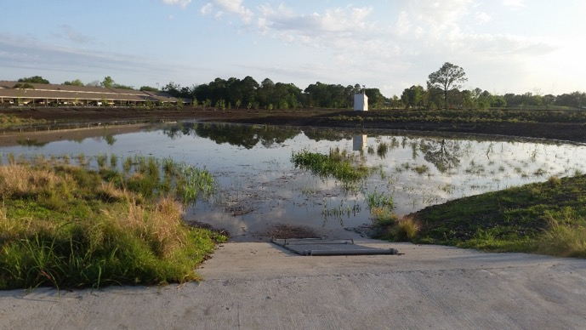
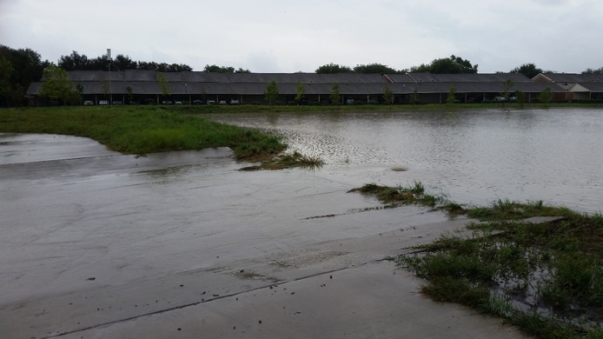
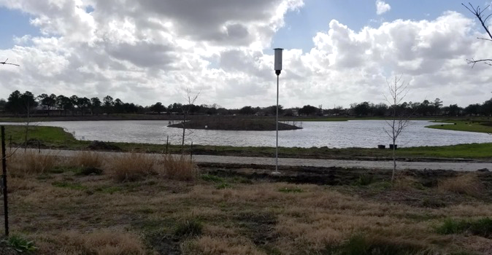
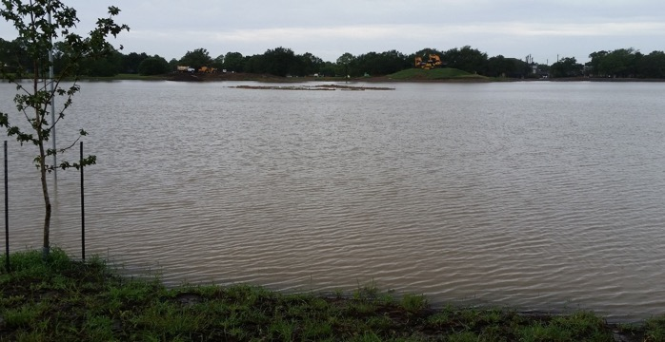
Harvey!
Over 150 Homes spared flooding from Harvey by Phase 1
Notes:
As we neared the end of the final excavation, Hurricane Harvey paid a visit. We had a temporary earthen weir in place to keep water out of the construction zone, but Harvey removed the dam in the first night of rain. Water filled the entire lake area to the top, just as designed. It held 100 million gallons of water out of the bayous, lowering the levels and reducing flooding upstream. Homes near by that traditionally flooded in much lighter rains were also spared. We estimate that over 150 homes were spared flooding just by this first Phase. Normal levels on the left, and Harvey levels on the right. Note that the habitat island in the lake was almost submerged! Storm water detention works!!!

Slide 6
Phase 1
May 2019
Notes:
Exploration Green is designed for current benefits with attention to sustainability for generations. A Green Gem in an urban setting that provides flood mitigation, environmental benefits, and healthy lifestyles opportunities.

Slide 7
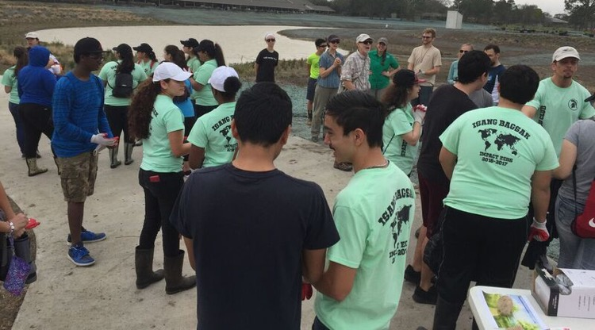
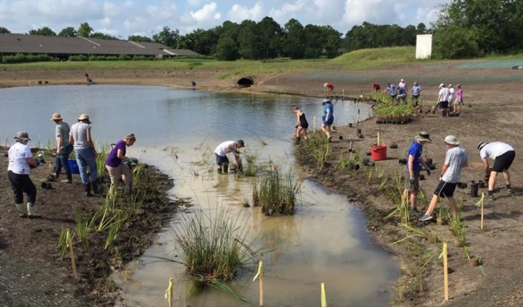
Phase 1 Amenities
100,000,000 gallons of water storage
8 acres of open water
6 acres of wetlands
1.1 miles of trails
8000 wetland plants
900 trees
A Learning Laboratory for the Community
On-site wetland and tree nurseries provide instruction and sources of plants
Notes:
Frank takes over on amenities.
In addition to the amenities shown, we have native grasses, wildflowers, and shrubs added to the area. A nearly half-acre “habitat island”, isolated from the land, holds over 175 native trees. After P2 connection to P1, we plan to put additional trees at Reseda and Diana intersection, and more trees will go around the parking lot when it is done. That will bring us to nearly 1,000 new trees in P1.

Slide 8
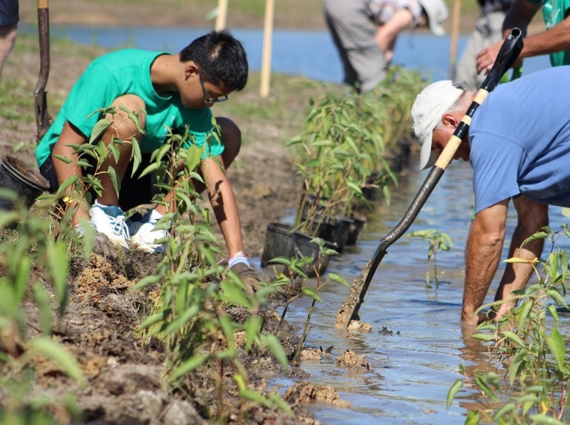
Ecological Benefit
Neighborhood Support
Over 800 volunteers donating over 9,000 hours
Centered on an important US migratory bird corridor
Community Gathering Space
Connectivity
Over 30,000 people within a
half-mile of the hike-and-bike trial

Slide 9
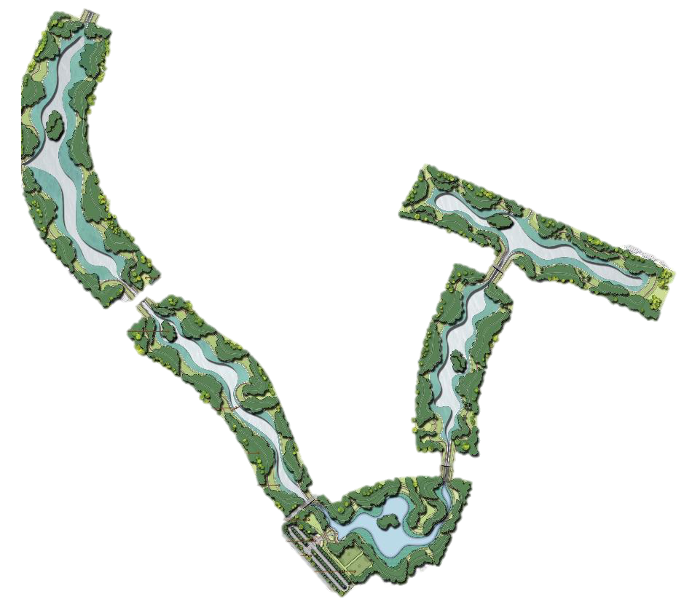
Future Plans
3B
3A
5
4
2
1
Phase 2 Complete Early 2020
Phase 3A Start Fall 2019; complete Fall 2020
Phase 4 Start Early 2020; complete Fall 2020
Phase 5/3B Start Fall 2020; complete Late 2021
Entry Plaza and planting complete 2022
9

Slide 10
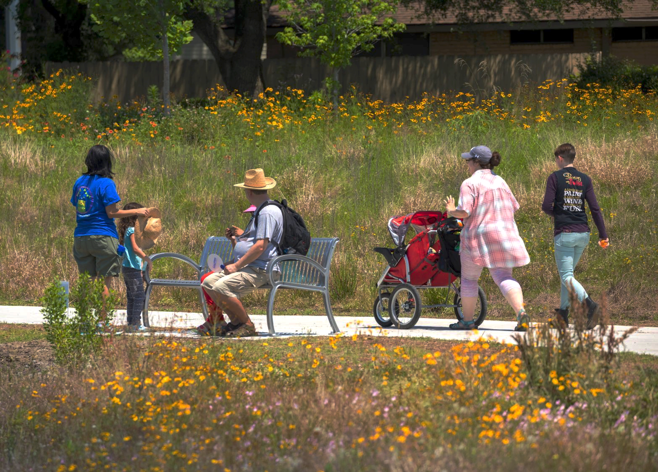














Partnerships
10
Notes:
Upcoming events: Glow-the-Green for Halloween October 25th. Sunset Yoga, 3rd Thursday of each month Sept through May. Phase 2 Grand Opening (TBD). Fundraising “Mixer” (TBD). Rain Barrel Workshop with Galveston Bay Foundation (TBD).
Glow-the-Green for Halloween: Light up your kids, strollers and friendly dogs with glow sticks, necklaces, and twinkling lights to walk the path after dark. A little candy will be handed out to the kiddos. Ritter’s will be there with their food truck with hot dogs, hamburgers, and frozen custard!

Slide 11
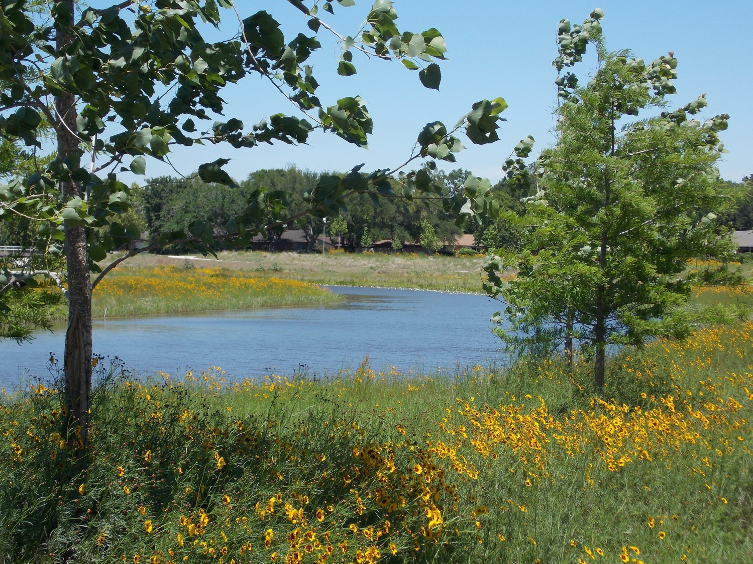

Exploration Green
Flood Mitigation
Open green space
Healthy lifestyle potentials
Ecological Benefits
A learning environment
Community gathering space
Revitalized home values
A focal point for Positive Community Spirit
Notes:
Exploration Green is quickly becoming recognized for the benefits listed above. Articles in numerous local and 4 national publications including the Washington Post and USA Today have been extremely complimentary. In the past 5 years, we have received a dozen awards from local (eg. Keep Houston Beautiful) to national (eg. EPA Environmental Excellence Award). The community impacts on flood mitigation, lifestyle, the environment, and real estate revitalization are fabulous, but for us the most satisfying is the return of a positive, cooperative can-do attitude in the community.

