Slide 1
Nature in Balance
What role do we play?
by Jo Picken, Texas A&M AgriLife Extension

Slide 2
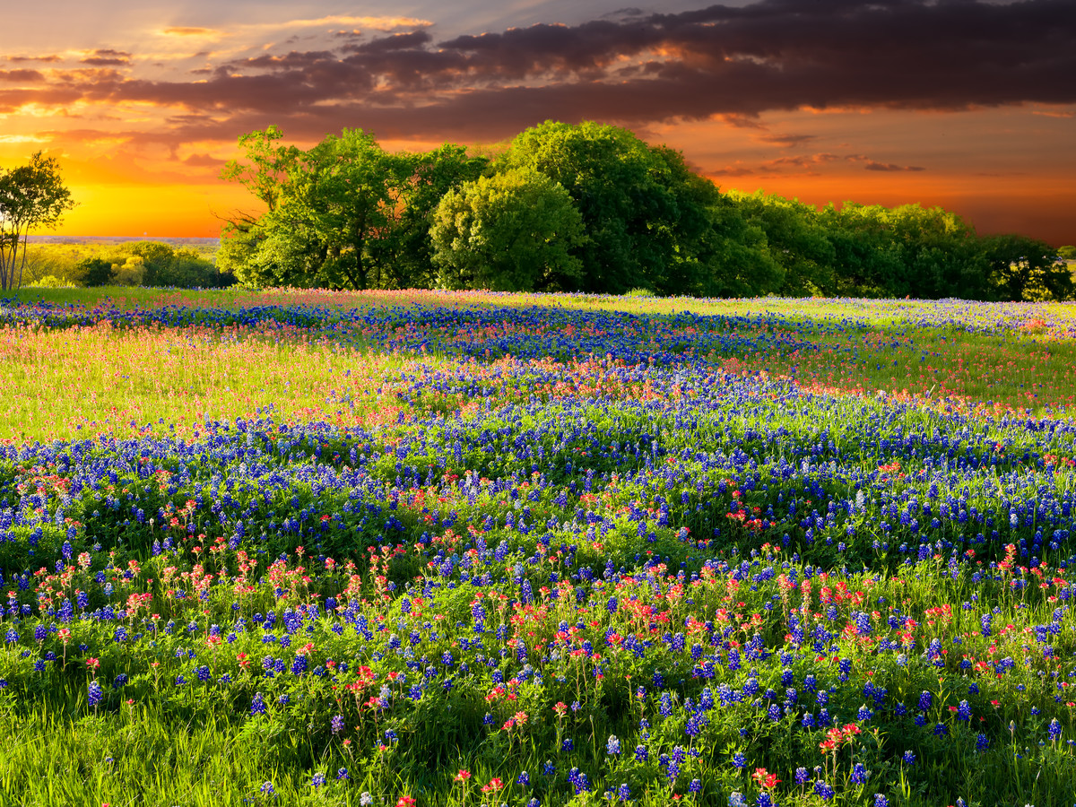
Texas is a place like no other
most diverse state for plant and animal species
#___
2nd
Behind ______________
California
in number of endemic species
#___
3rd
Behind ______________ and _______________
California
Hawaii
in number of both bird and reptile species
#___
1st

Slide 3
Texas is a place like no other
10 ecoregions
Elevations range from sea level to 5200 feet
a peak reaching 8749
1 has an annual precipitation of less than 8 inches,
Another receives 56 inches

Slide 4
Native Texas Species
In Peril
Bear
Mountain lion
Chipmunk
Prairie dog
Pronghorn
Otter*
Ocelot!
Extinct Here
Bison
Jaguar
Bighorn sheep, (brought back)
Wolf (red and gray)

Slide 5
Common Animal Species
Armadillo
Bat (33 species)
Dolphin
Mole
Alligator
Coyote
Bobcat
Fox
Raccoon
Opossum
Rabbit
Deer
Skunk
Squirrel
Beaver ** specific habitat needs

Slide 6
Which Are Keystone Species?
Armadillo
Bat (27 species)
Dolphin
Mole
Alligator
Beaver
Coyote
Bobcat
Fox
Raccoon
Opossum
Rabbit
Deer
Skunk
Squirrel
Badger
Gopher
Ground squirrel
Javelina
Porcupine
Bear
Mountain lion
Chipmunk
Prairie dog
Pronghorn
Otter
Bison
Jaguar
Ocelot
Bighorn sheep
Wolf (red and gray)

Slide 7
Beavers
Habitat Engineer = Wetlands
Increase diversity both plant & animal population
Up to ½ of all North American bird species feed or nest in
More than 1/3 of endangered or threatened species rely on
Home to nearly 1/3 of our plant species

Slide 8
Ecological Indicators
Birds
Amphibians

Slide 9
What does imbalance look like?
While threatened, endangered, or extinct species are definitely signs, there is no one answer.
Causes?
Disease
Predator/prey relationships
Weather
Human influence or interaction with the habitat

Slide 10
What does balance look like?
There is no blueprint.
Ever-changing, ebbing, flowing – dynamic equilibrium
Removing a portion of it leaves a mark.
That part is incapable of functioning independently outside of the ecosystem
Impacts the remainder of an interconnected web
Nature’s design is best.
Energy pyramid

