Slide 1


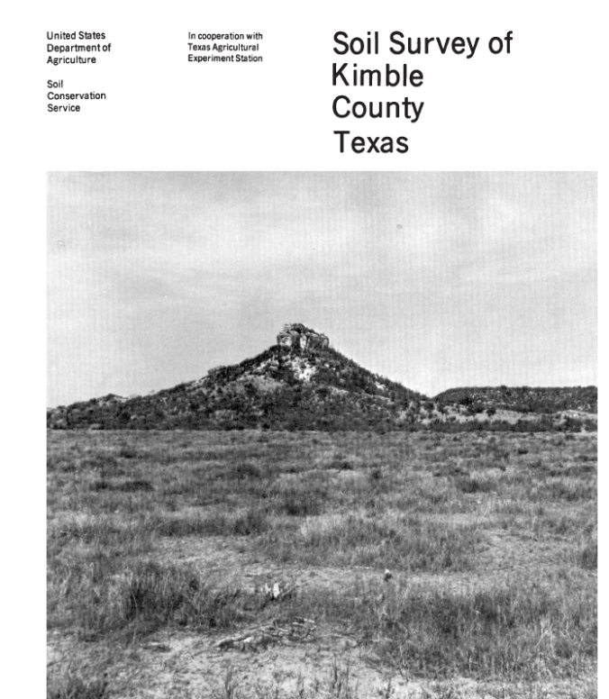
State Envirothon
2017 - Soils
Dennis Brezina
USDA-Natural Resources Conservation Service
Resource Soil Scientist – Bryan Area
Helping People Help the Land

Slide 2
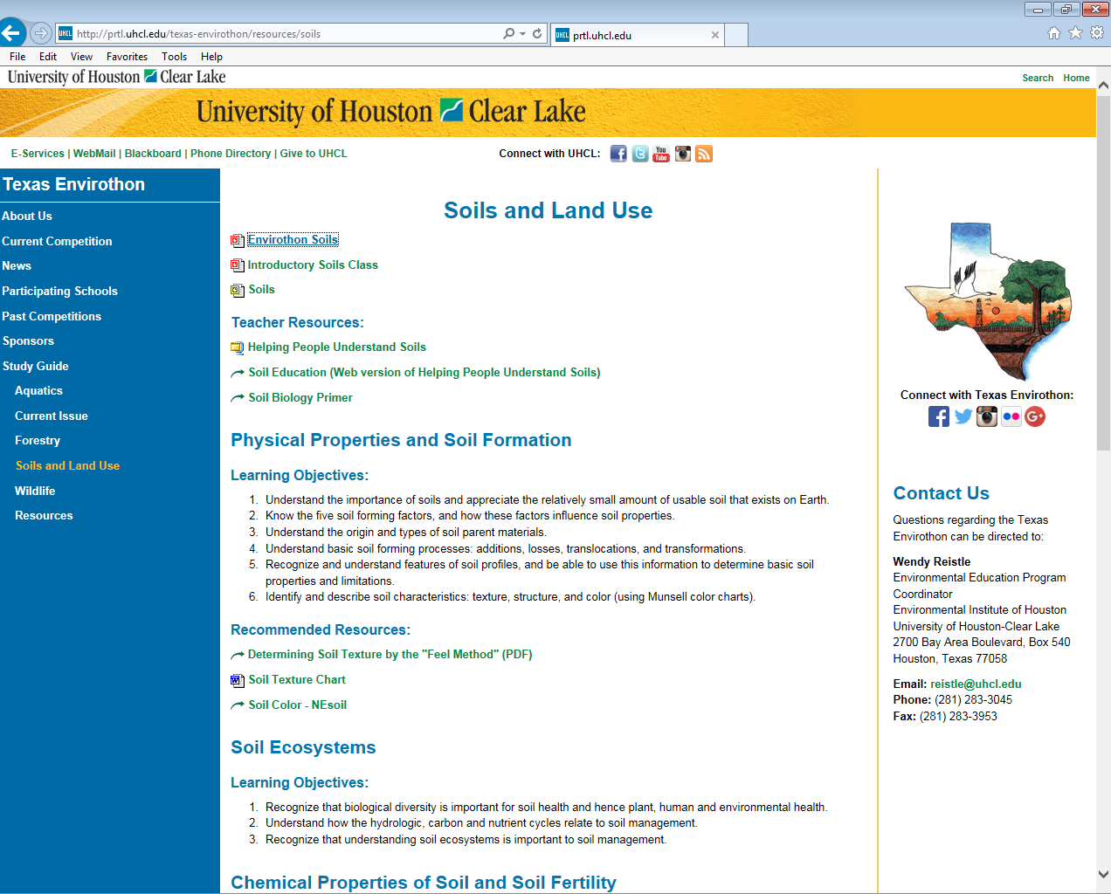
Texas State Envirothon
http://prtl.uhcl.edu/texas-envirothon/resources/soils

Slide 3
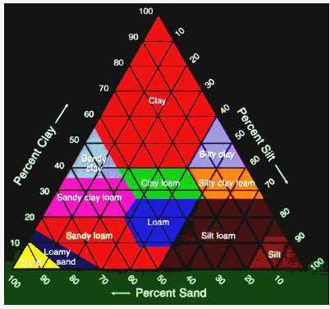
SOIL TEXTURE
How do I find soil textures?
The relative proportion of SAND, SILT and CLAY.
The MOST IMPORTANT PHYSICAL PROPERTY of the soil because it determines the capacity of a soil to retain moisture and air.
Essentially impossible to change unless you remove it, or add large amounts to it.
Notes:
SOIL TEXTURE is:
The relative proportion of sand, silt, and clay
THE MOST IMPORTANT PHYSICAL PROPERTY of the soil because it determines the capacity of a soil to retain moisture and air
Essentially impossible to change unless you remove it, or add large amounts to it
Sand size particles are the largest of the soil particles - feels gritty - compare it to the size of a baseball
Silt size particles are intermediate in size - has a smooth, talcum powder feel - compare it to the size of a marble
Clay size particles the smallest - feels sticky and plastic when wet - compare it to the size of a BB

Slide 4
The Three SOIL Particle Sizes
Sand size particles are the largest of the soil particles - feels gritty - compare it to the size of a baseball
Silt size particles are intermediate in size - has a smooth, talcum powder feel - compare it to the size of a marble
Clay size particles the smallest - feels sticky and plastic when wet - compare it to the size of a BB
How do I find soil textures?
Notes:
SOIL TEXTURE is:
The relative proportion of sand, silt, and clay
THE MOST IMPORTANT PHYSICAL PROPERTY of the soil because it determines the capacity of a soil to retain moisture and air
Essentially impossible to change unless you remove it, or add large amounts to it
Sand size particles are the largest of the soil particles - feels gritty - compare it to the size of a baseball
Silt size particles are intermediate in size - has a smooth, talcum powder feel - compare it to the size of a marble
Clay size particles the smallest - feels sticky and plastic when wet - compare it to the size of a BB

Slide 5
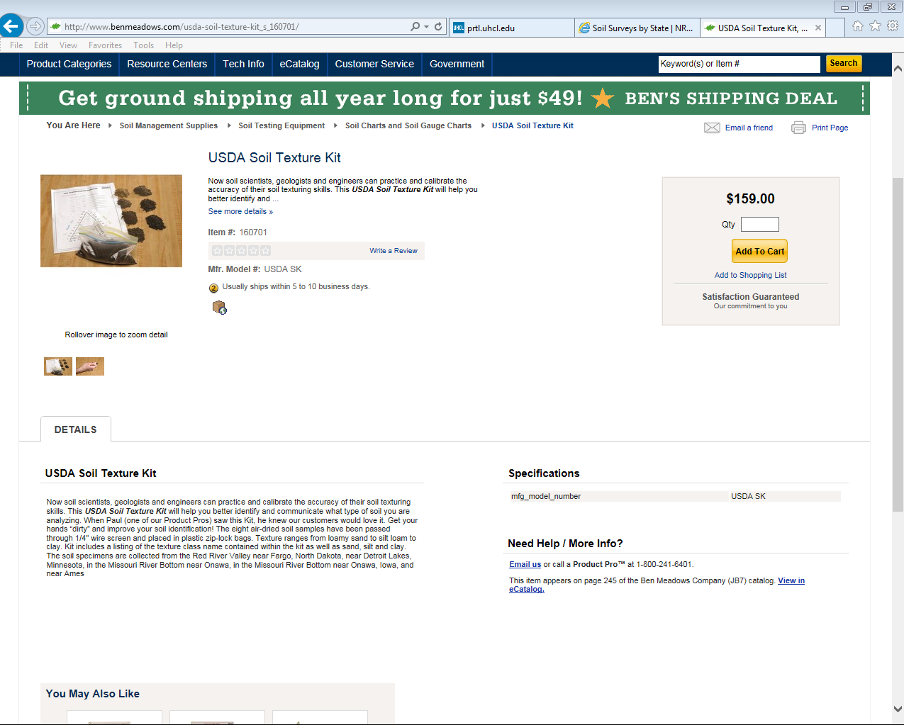
Buy a USDA Soil Texture Kit
--Or, FIND YOUR OWN!

Slide 6
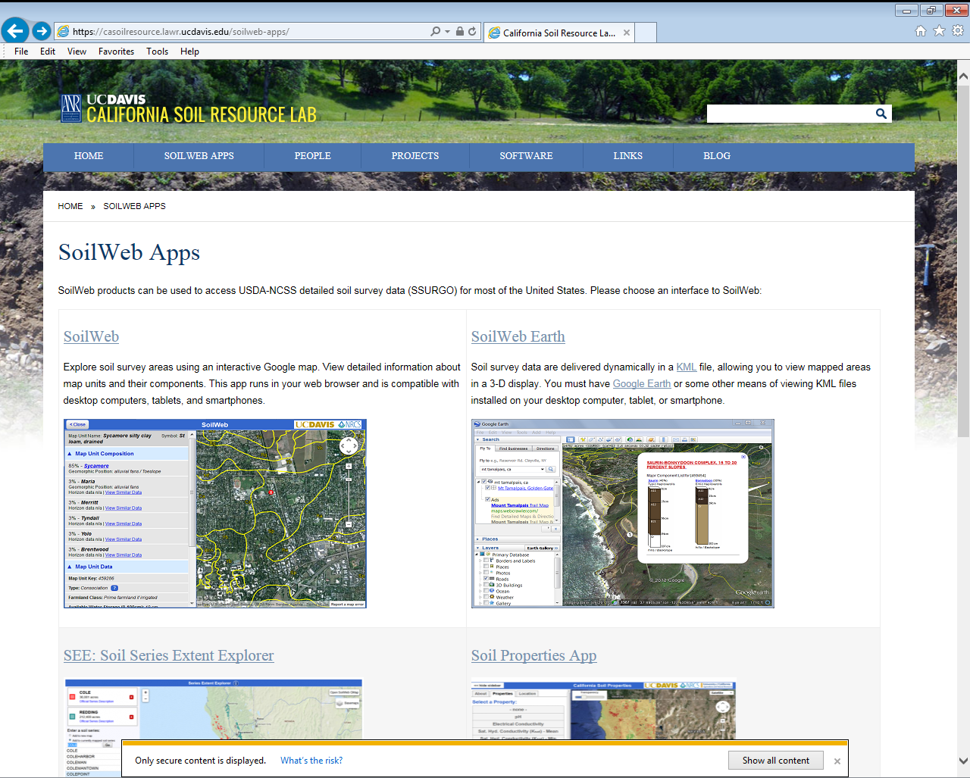
Soil Web & Soil Web App
https://casoilresource.lawr.ucdavis.edu/gmap/

Slide 7
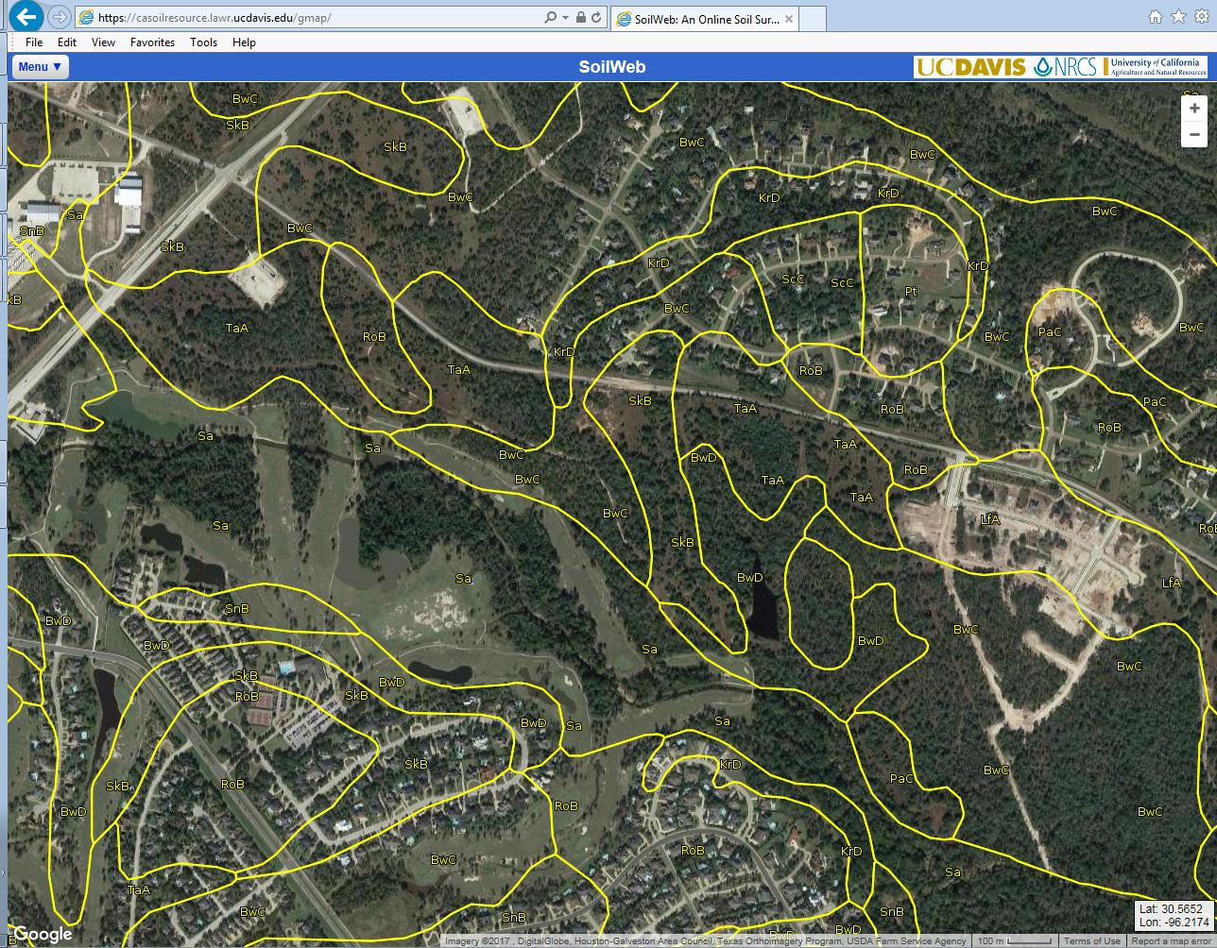
https://casoilresource.lawr.ucdavis.edu/gmap/

Slide 8
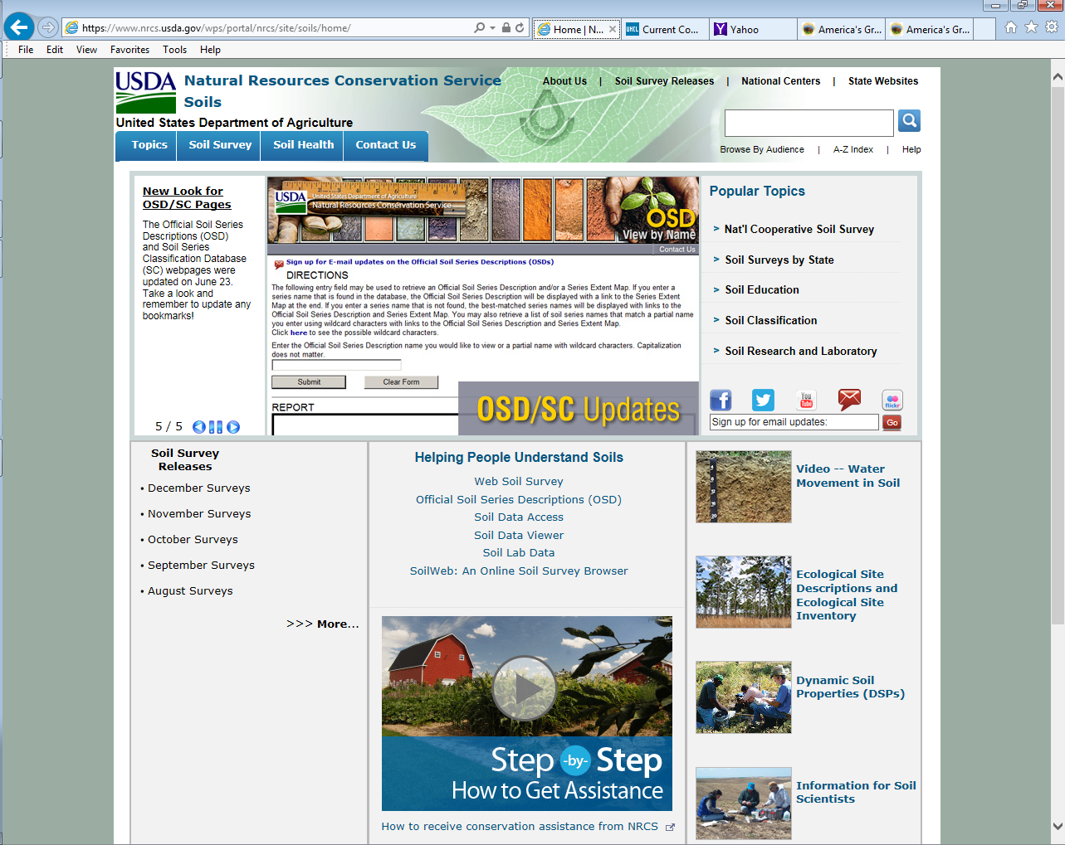
Or just
“Google”
Soils
https://www.nrcs.usda.gov/wps/portal/nrcs/site/soils/home/

Slide 9
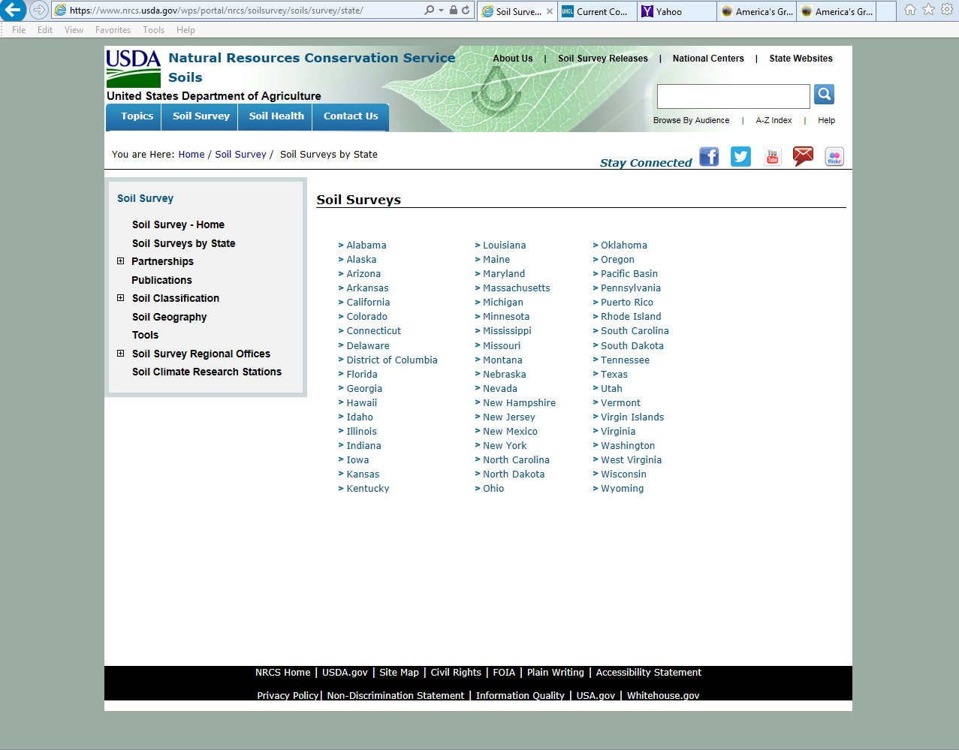
List of Published Soil Surveys by State
Published Soil Surveys have some information that is not available on Soil Data Viewer or Web Soil Survey; and you don’t need an internet connection.

Slide 10
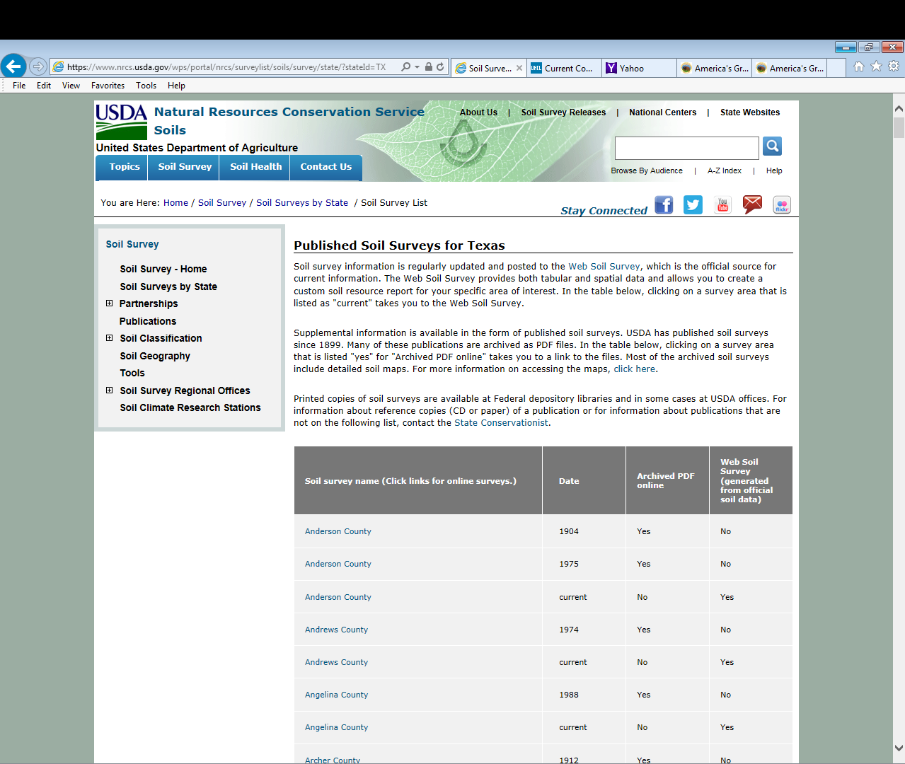

Slide 11
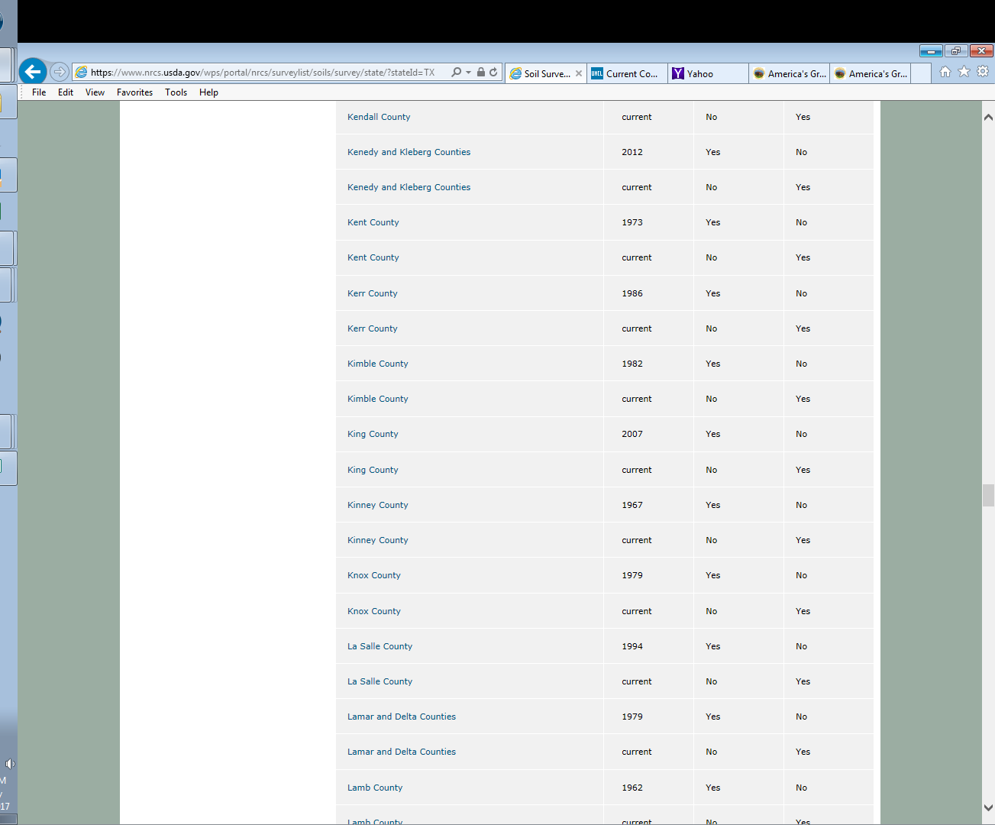
Soil survey name (Click links for online surveys.) | Date | Archived PDF online | Web Soil Survey (generated from official soil data)
“Dated” Published Soil Survey
Soil Survey Name & Link
(Can click on “Blue” links)
“Current”
Web Soil Survey

Slide 12
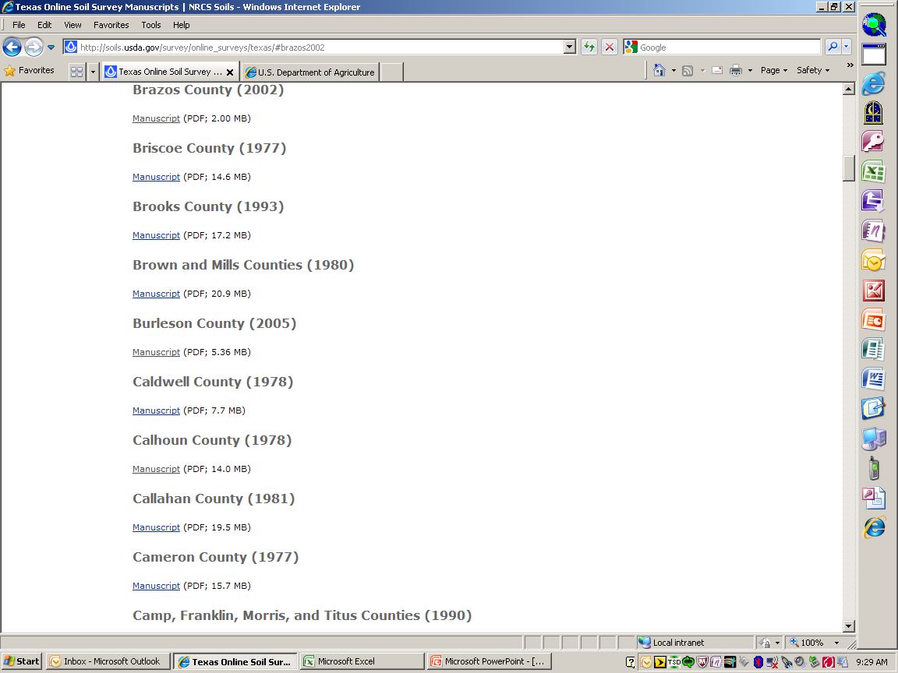
Click on “Manuscript”

Slide 13
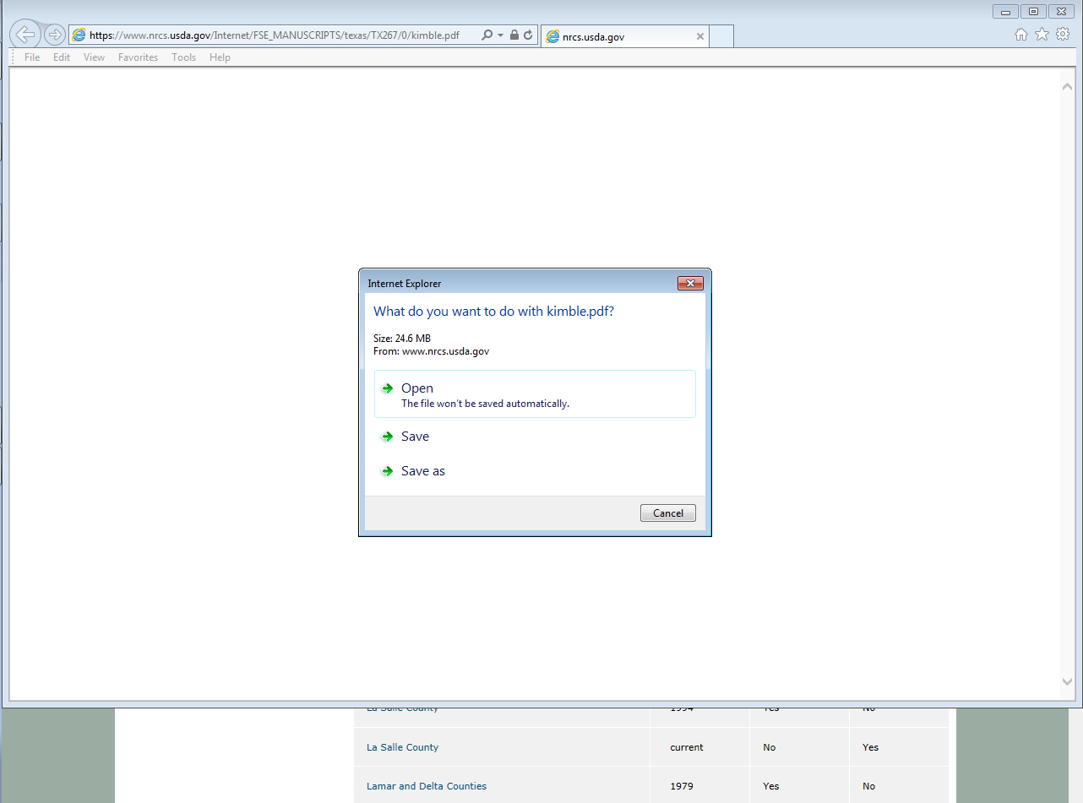
Click “Open or Save”

Slide 14
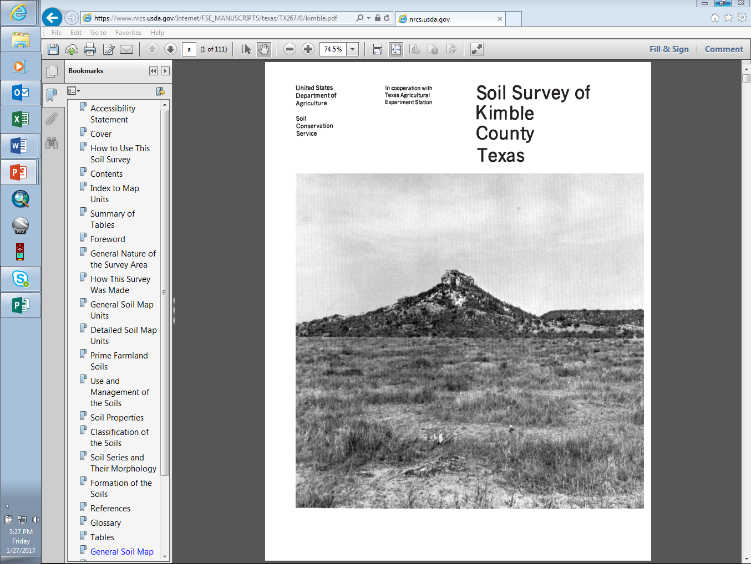
Table of Contents
https://www.nrcs.usda.gov/wps/portal/nrcs/site/soils/home/

Slide 15
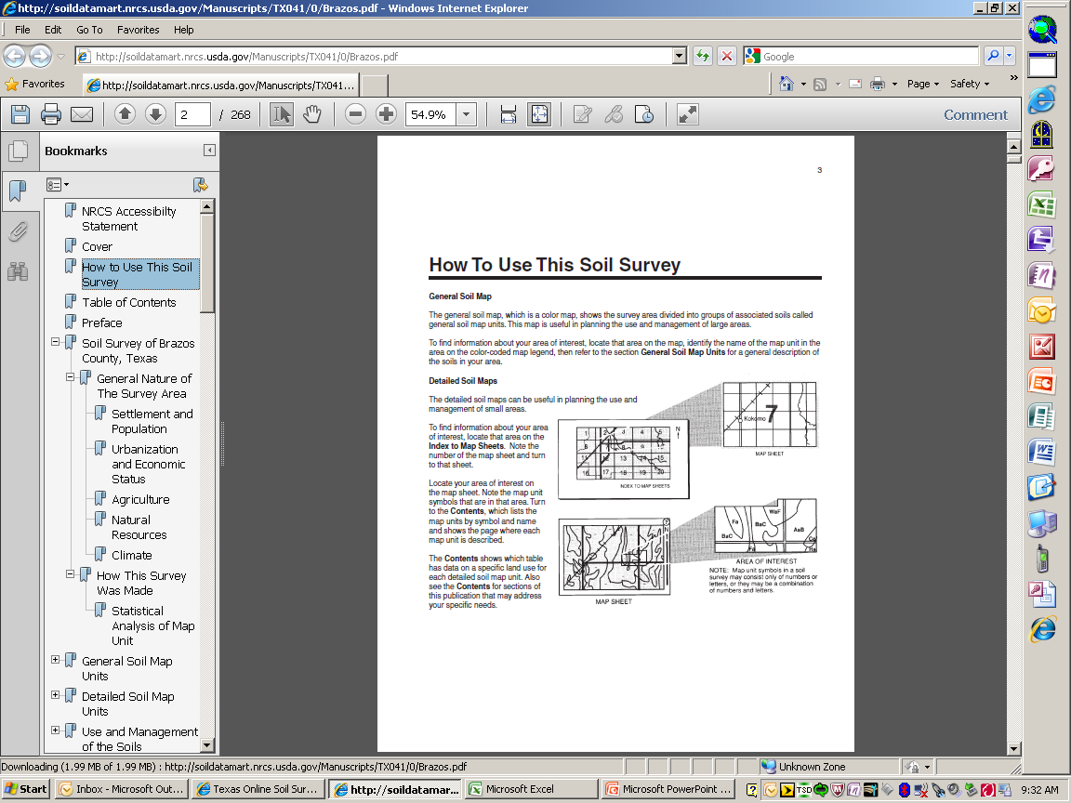
How to Use this Soil Survey

Slide 16
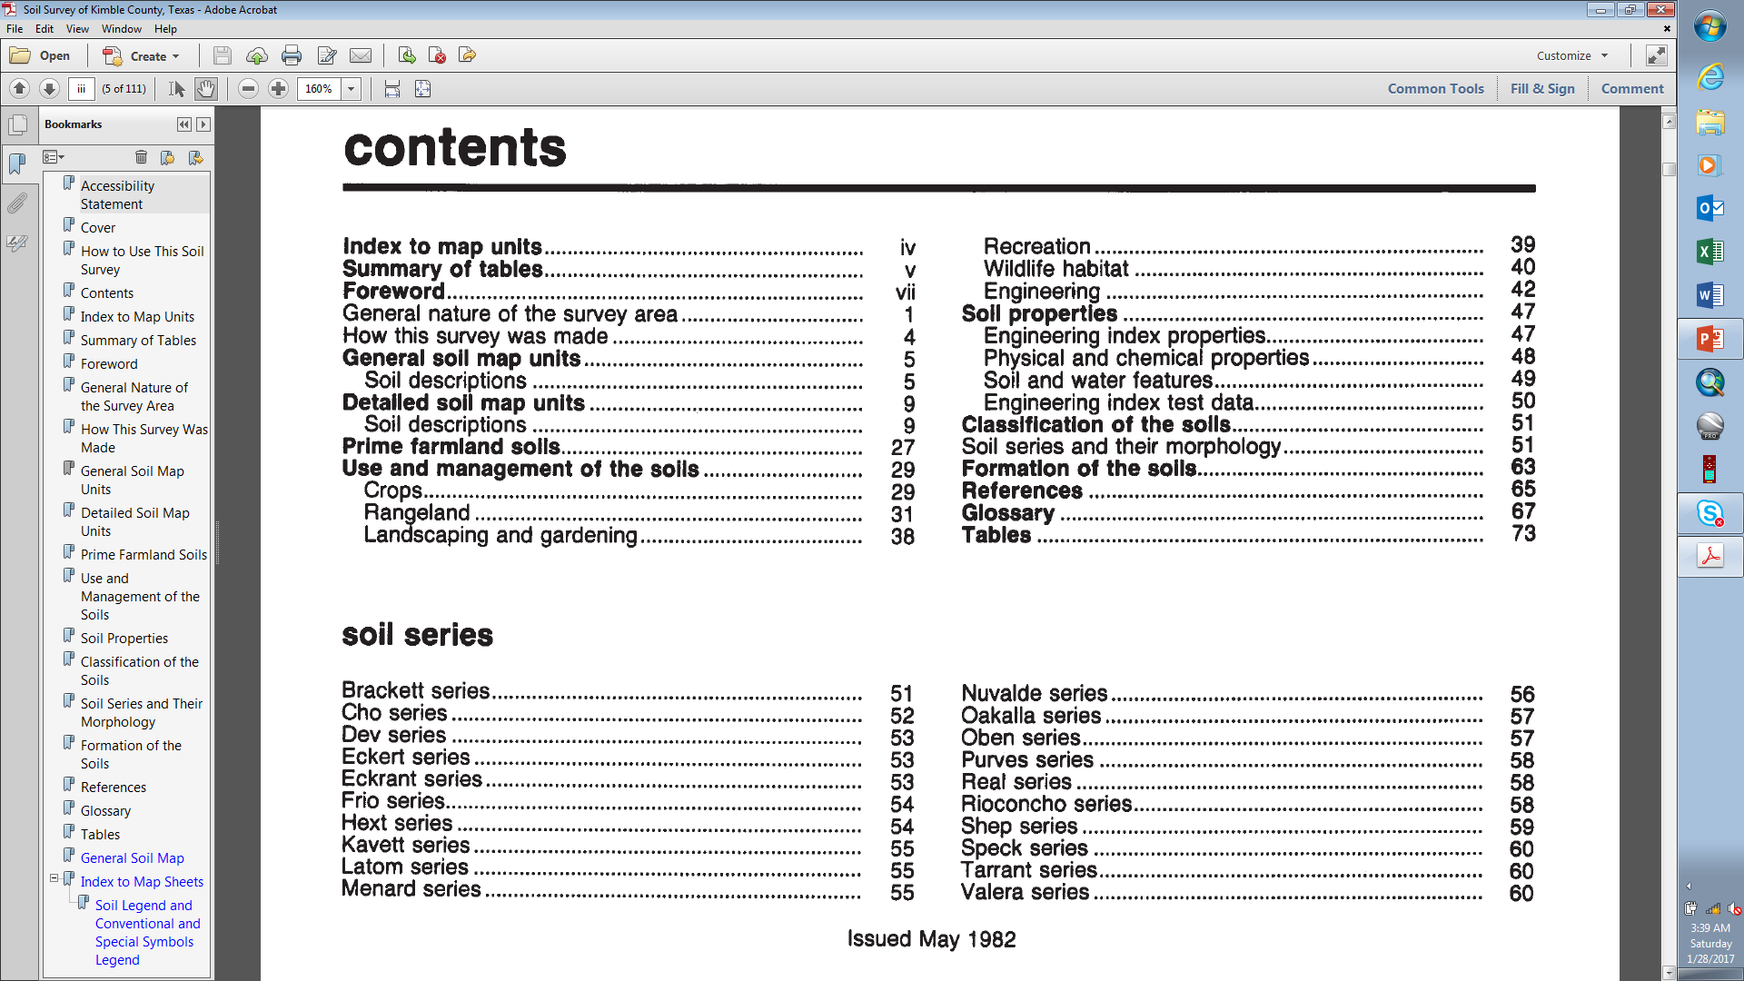
Table of Contents

Slide 17
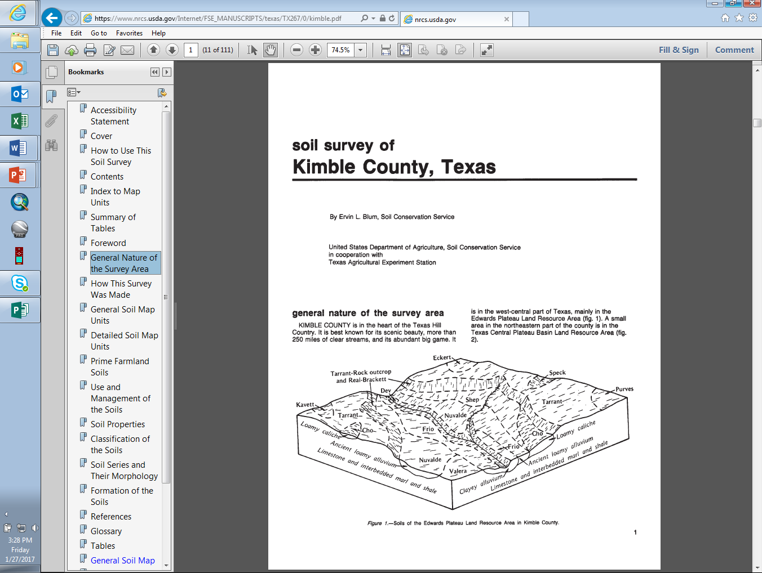

Slide 18
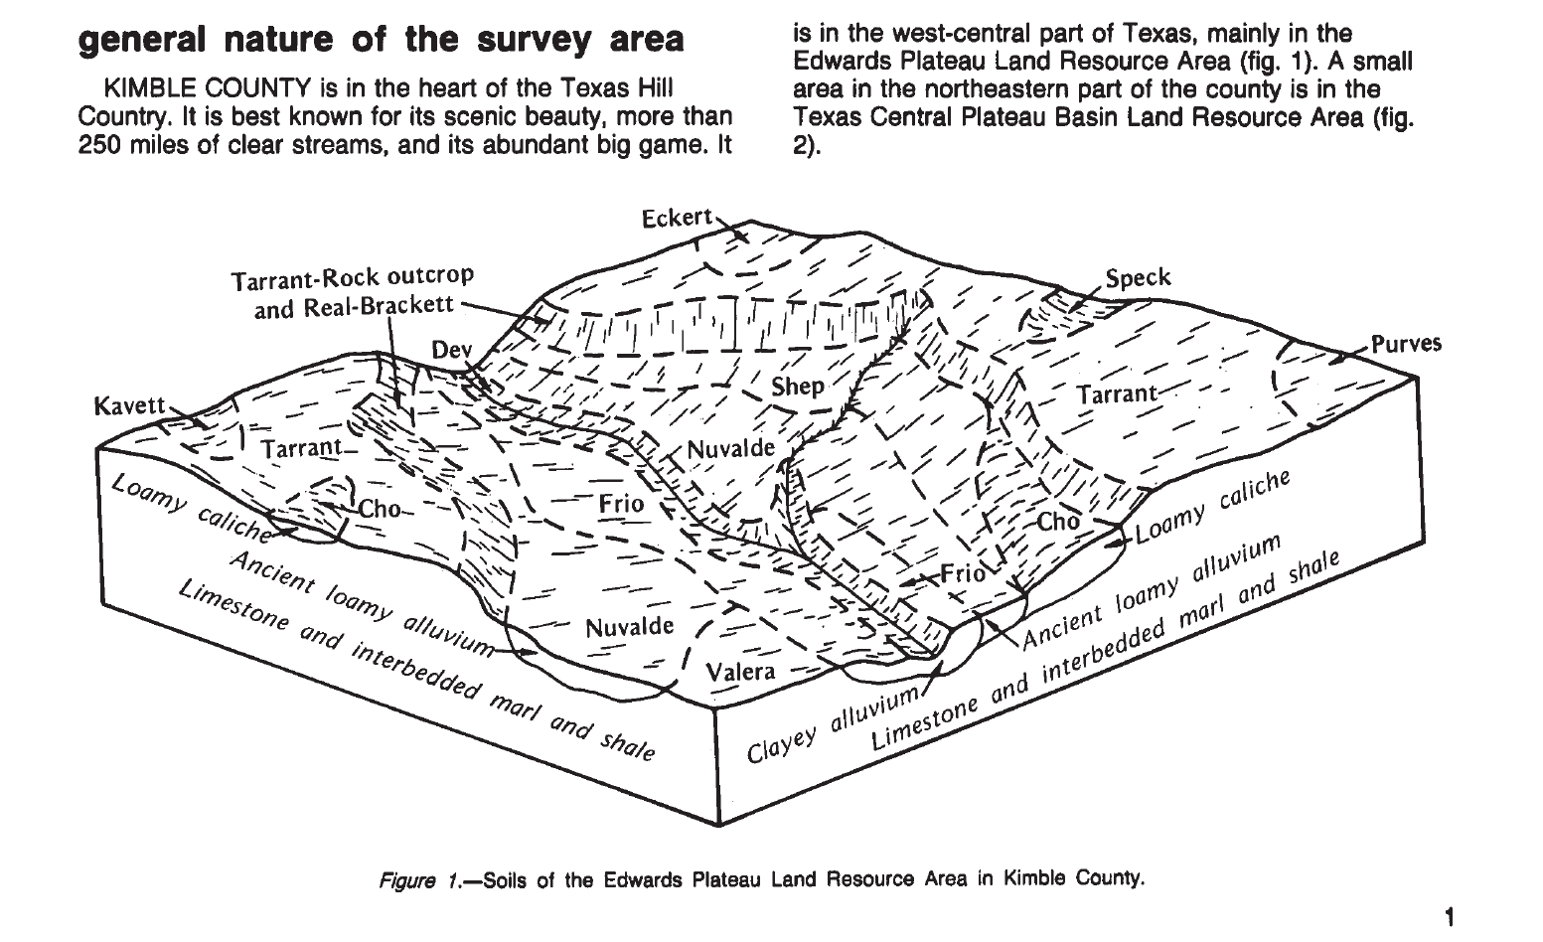

Slide 19
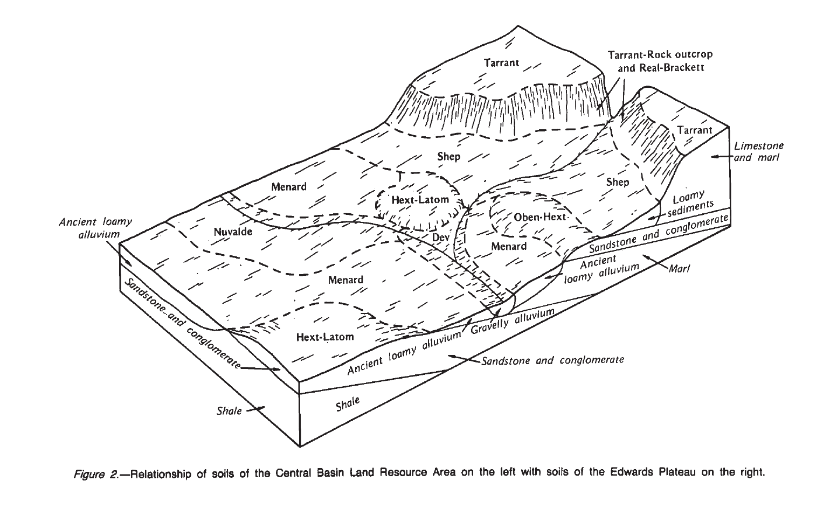

Slide 20
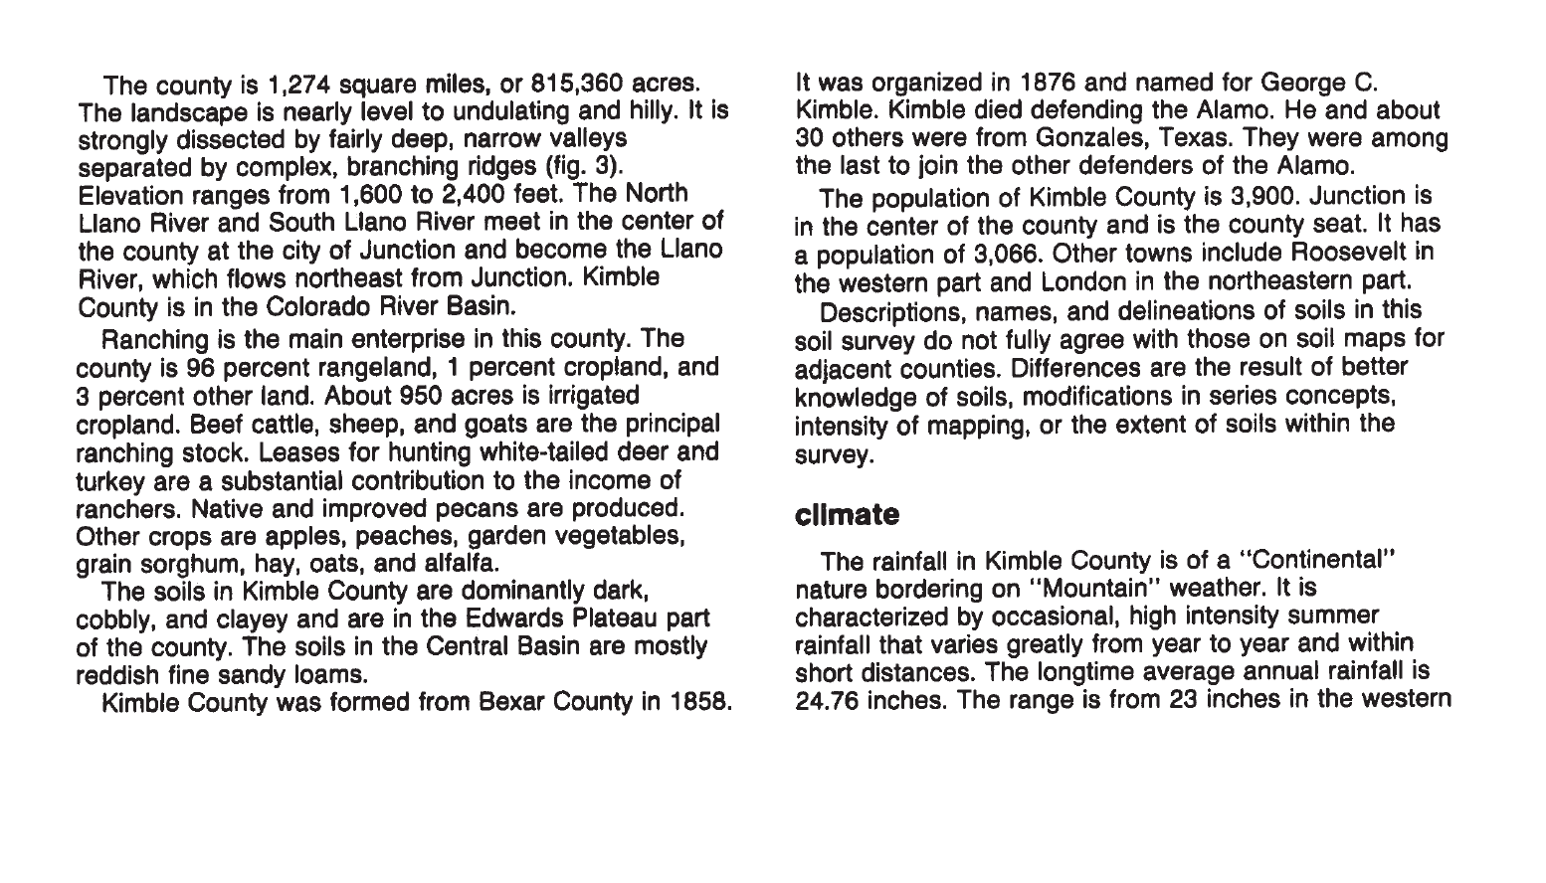

Slide 21
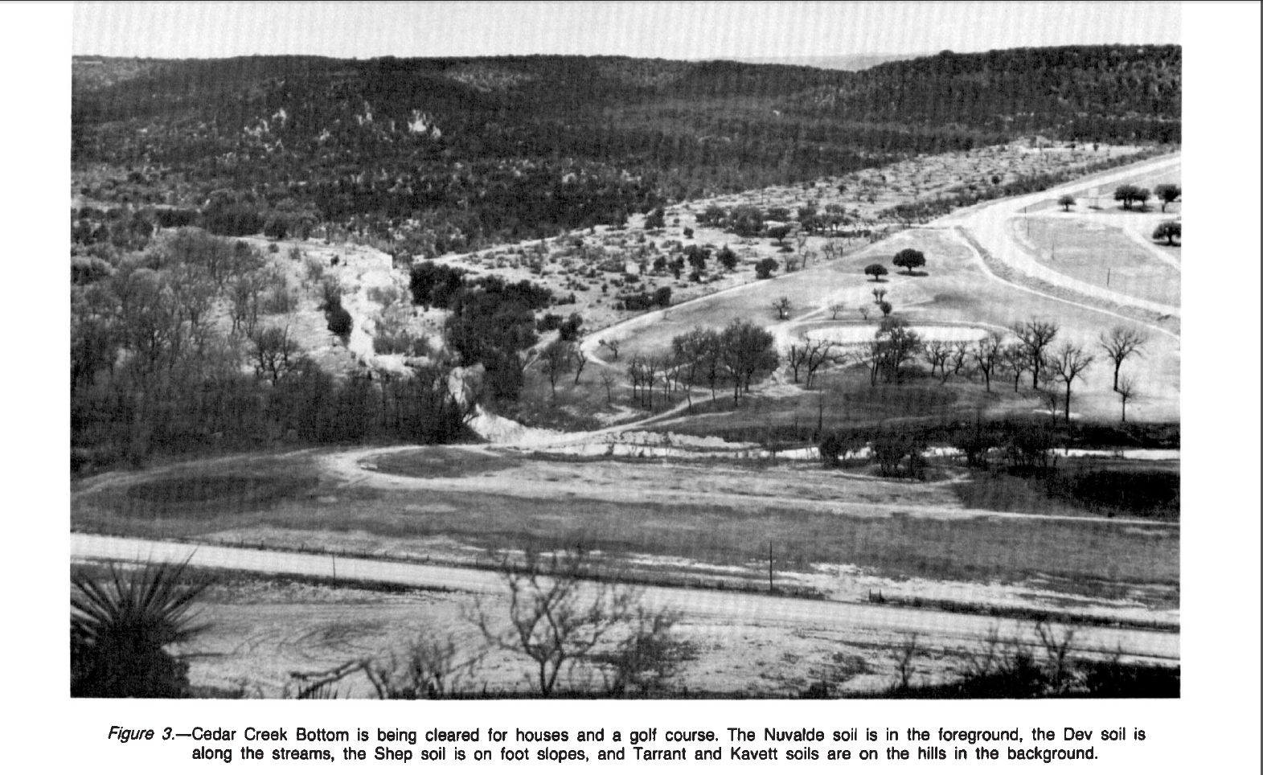

Slide 22
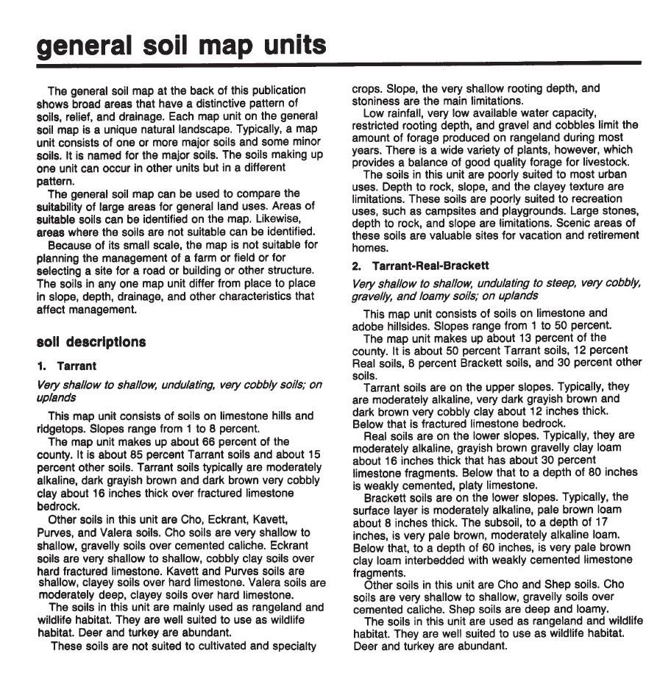

Slide 23
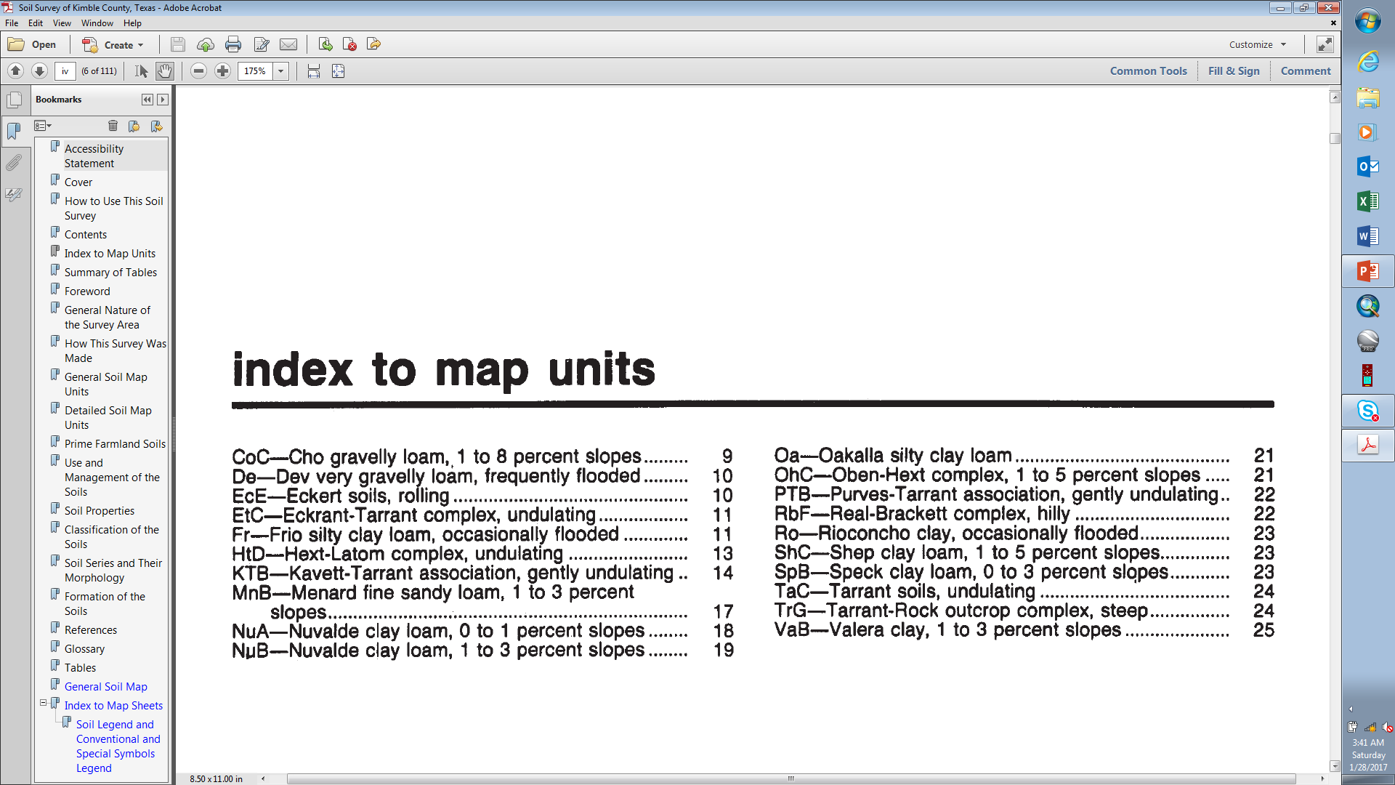
Index to Map Units - Detailed soil map unit descriptions
Surface Textures
Probably the most important description

Slide 24
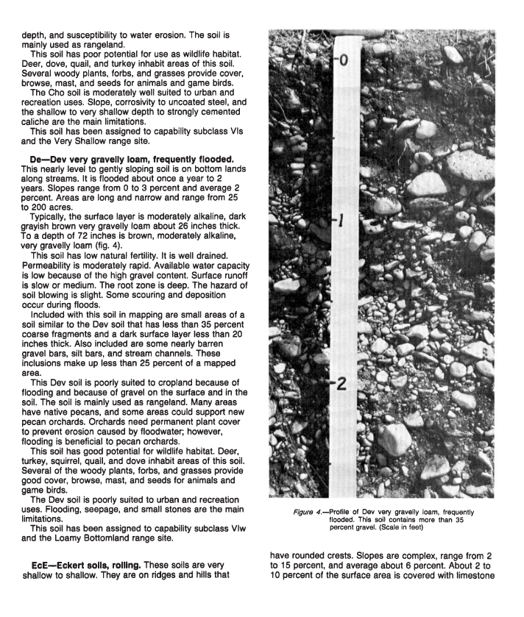
Detailed soil map unit description
Probably the most important description
Map unit symbol and name & Description of where it is mapped
Thumbnail soil description
Inclusions
Land uses
Soil Properties Narrative
Notes:
The Detailed soil map unit description is:
Probably the most important description
Map unit symbol and name
Description of where it is mapped
Thumbnail soil description
Soil Properties Narrative
Inclusions
Land uses

Slide 25
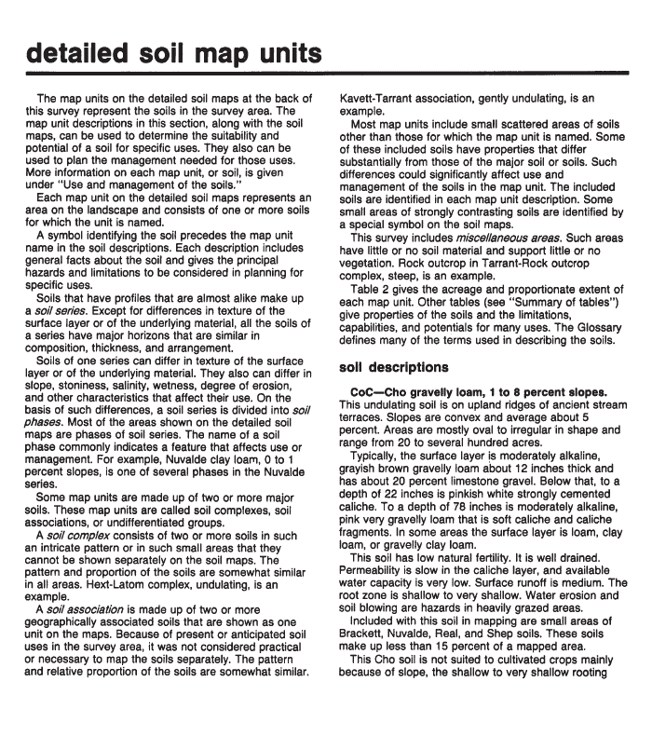

Slide 27
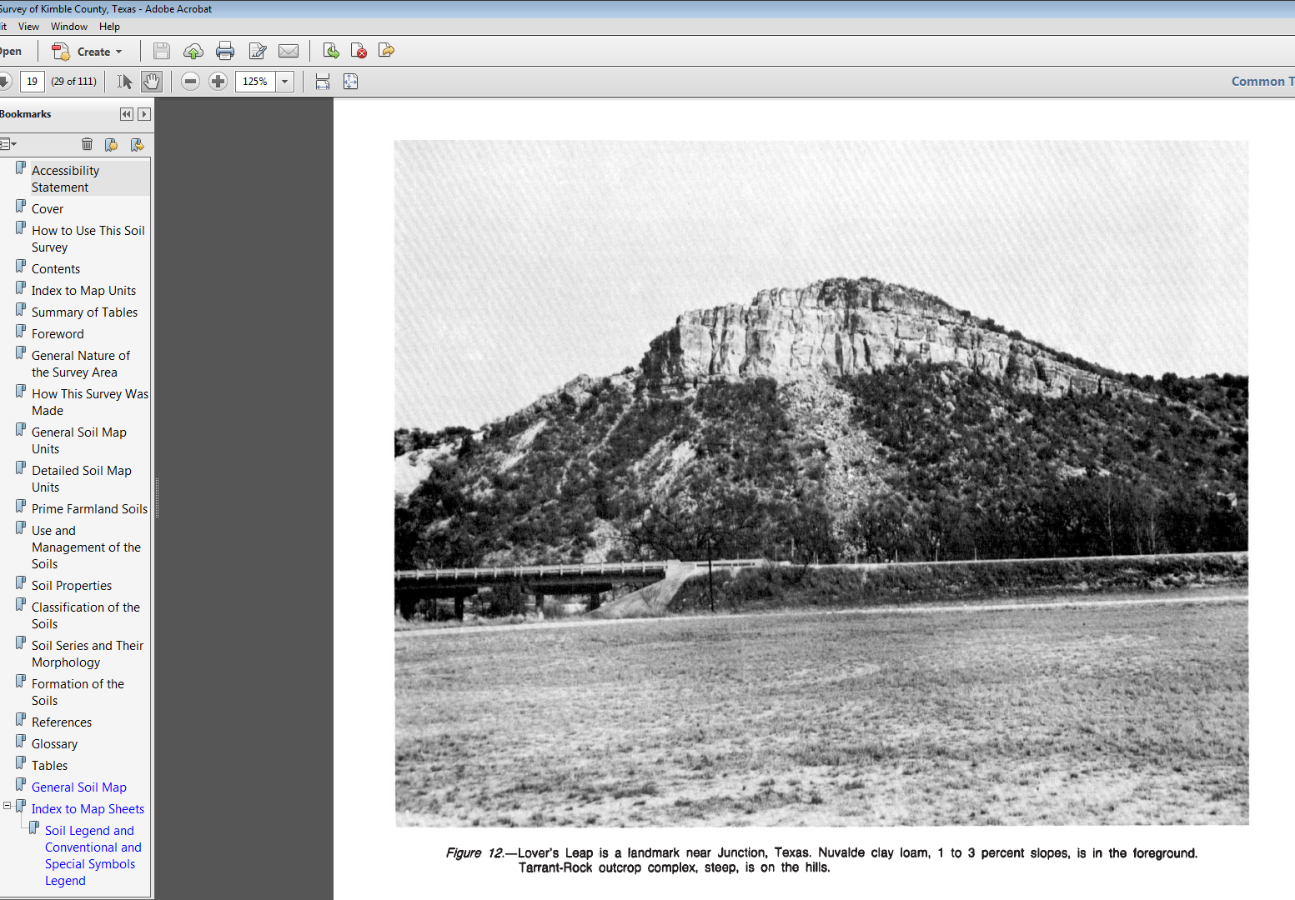

Slide 28
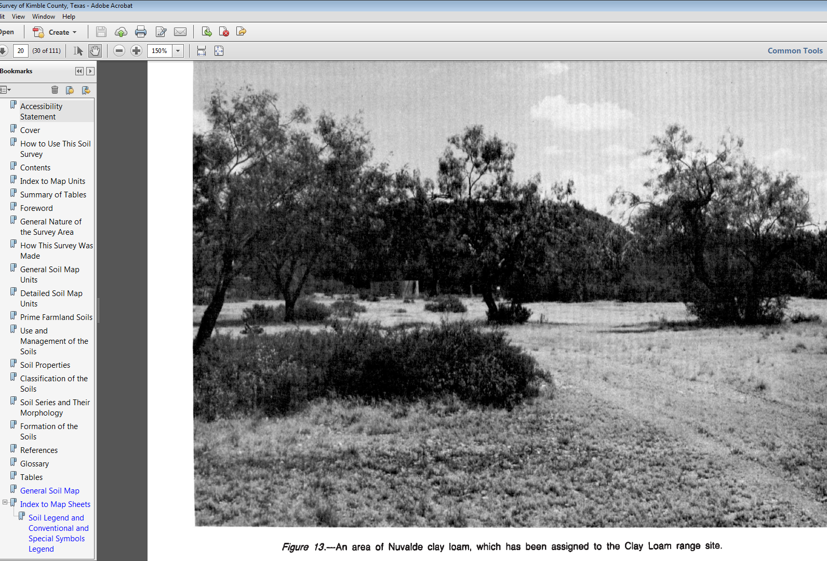

Slide 29
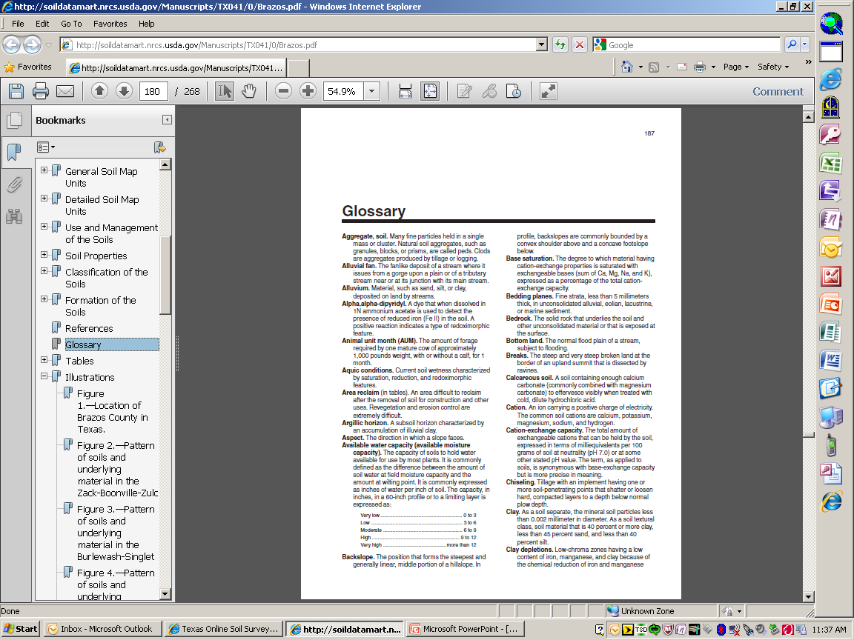

Slide 30
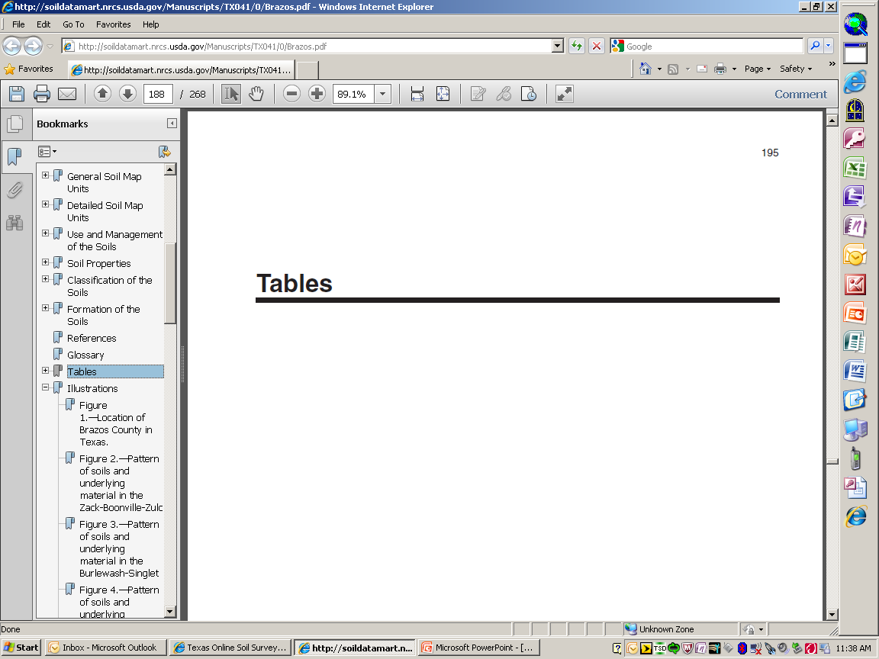

Slide 31
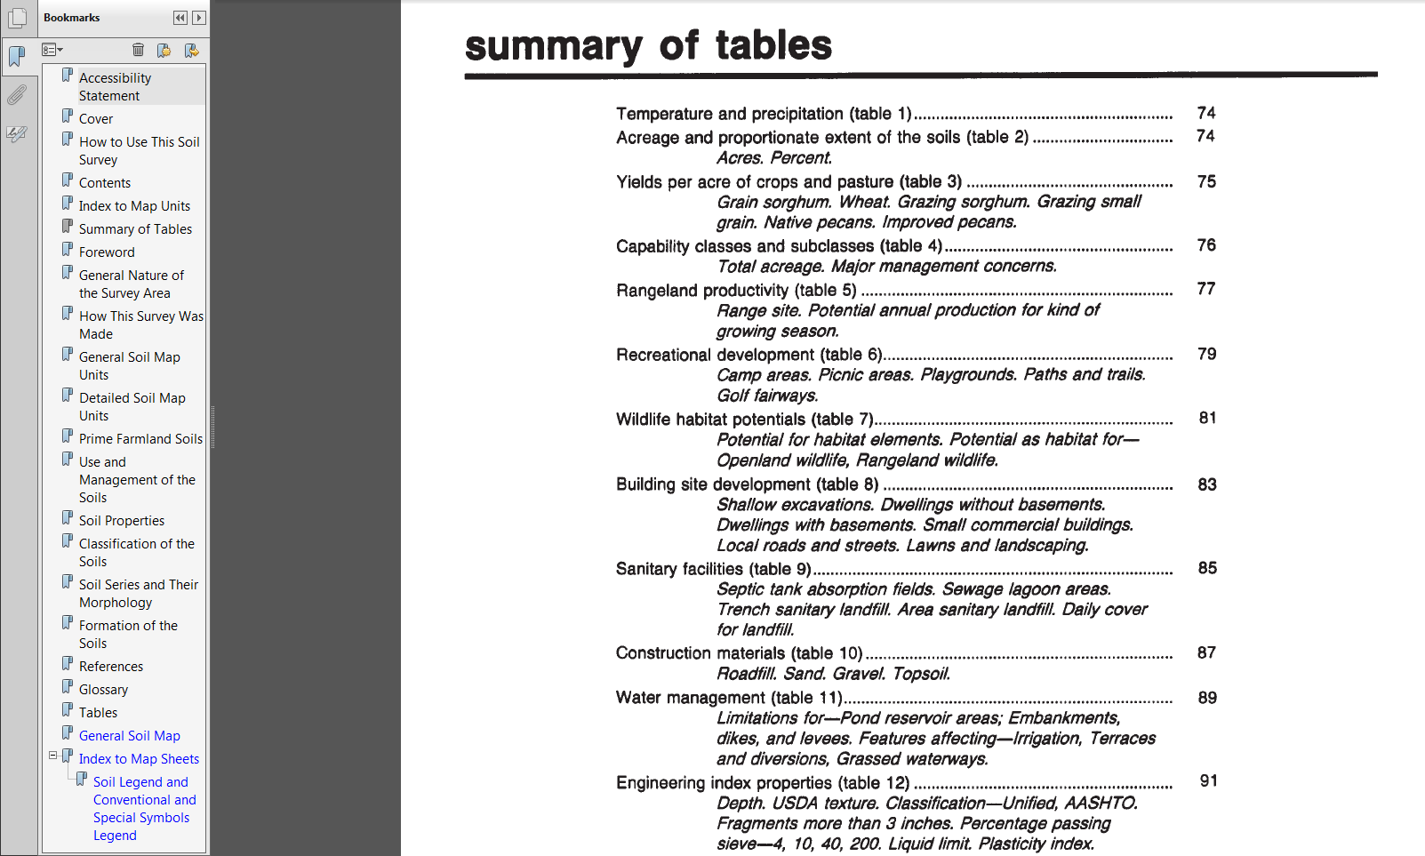
Summary of Tables

Slide 32
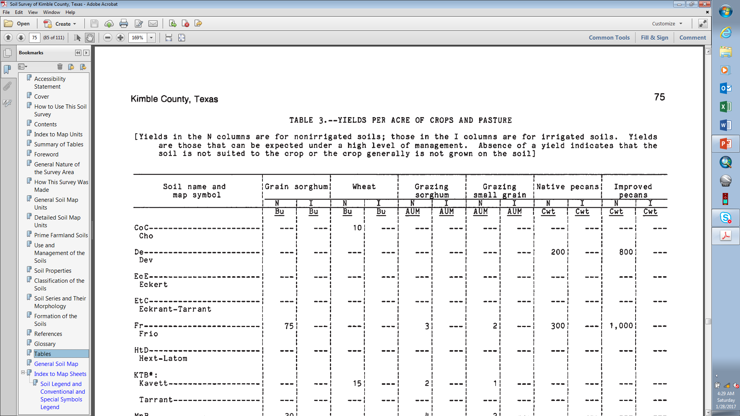

Slide 33
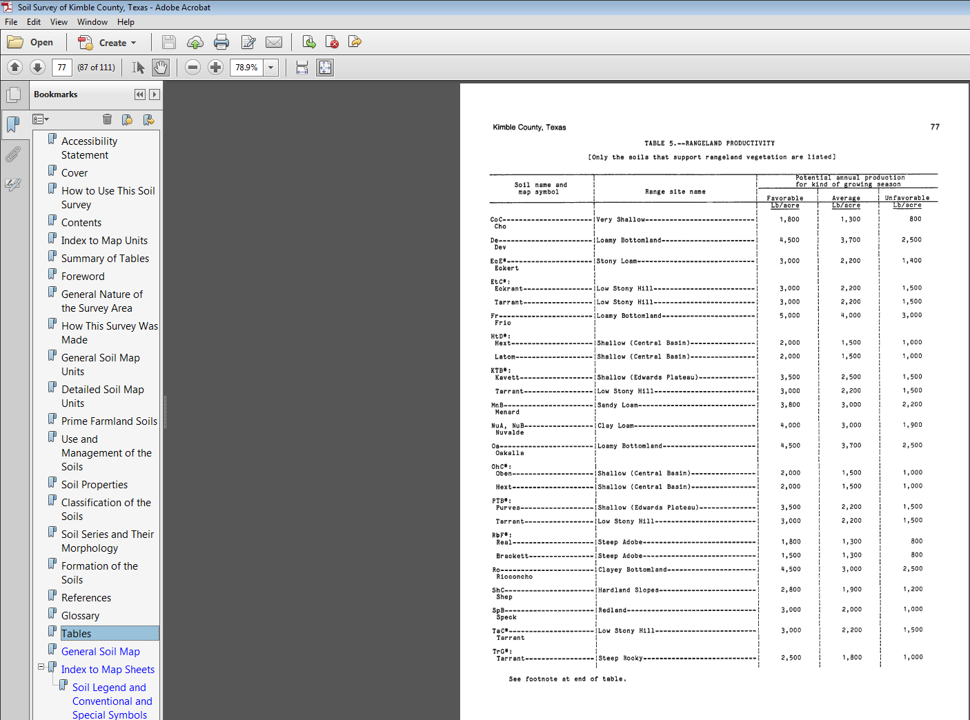

Slide 34
Slope Percentage
Rise over Run
Slope = rise/run x 100 = % slope
10 ft. rise / 100 ft. run x 100 = 10% slope
10% slope
10 ft.
Rise
100 ft. Run

Slide 35
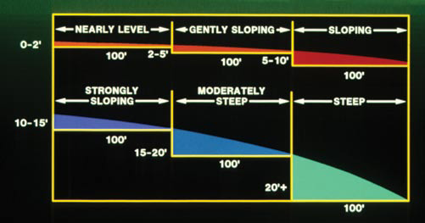
Slope Percentage
Rise over Run

Slide 36
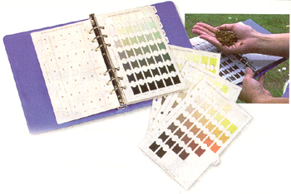
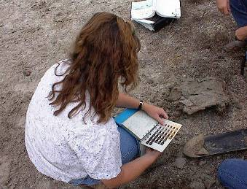
SOIL COLOR
Most visible soil property
Soil color name is on the left page, and the color notation is written as:
Hue Value/Chroma
(10YR 6/3)
HUE
CHROMA
VALUE
Color Name
Notes:
SOIL COLOR is:
Most visible soil property
Soil color is written as:
Hue Value/Chroma
(10YR 6/3)

Slide 37
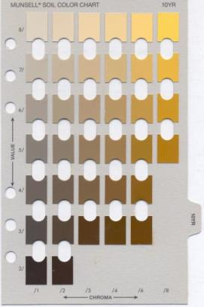
Soil Color
1. HUE
Most visible soil property
Dark=high organic content
Humus/Organic Matter is generally black or brown; thus soils that are high in organic matter are generally darker in color
Light=low organic content
Red, yellow, brown is well drained
Generally due to iron compounds. Reds are highly oxidized. Compare to rust on iron=metal gets wet, as it dries (oxidizes) it turns a reddish-yellow color
Gray could mean excessive wetness
Iron is either removed or reduced due to the removal of oxygen
3. CHROMA
2. VALUE
“Value” is the “vertical” column; “Chroma” is the “row.”
Notes:
Dark=high organic content
Humus/Organic Matter is generally black or brown; thus soils that are high in organic matter are generally darker in color
Light=low organic content
Red, yellow, brown is well drained
Generally due to iron compounds. Reds are highly oxidized. Compare to rust on iron=metal gets wet, as it dries (oxidizes) it turns a reddish-yellow color
Gray could mean excessive wetness
Iron is either removed or reduced due to the removal of oxygen

Slide 38
References
Ag Handbook 296, Land Resource Regions and Major Land Resource Areas of the United States, USDA-NRCS (available at http://soils.usda.gov/survey/geography/mlra/index.html )
Essentials of Physical Geography, by Gabler, Sager, Brazier and Wise
Field Book for Describing and Sampling Soils, by Schoeneberger, Wysocki, Benham and Broderson
The Nature and Properties of Soils, by Brady
Soil Survey of Upshur and Gregg Counties, Texas, by Galloway
http://en.wikipedia.org/wiki/Drainage_basin

Slide 39
References continued…
http://milan.tennessee.edu/
http://munsell.com/
http://photogallery.nrcs.usda.gov/Index.asp
http://soilcrop.tamu.edu/
http://soildatamart.nrcs.usda.gov/
http://soils.usda.gov/
http://tpwd.state.tx.us/
http://www.beg.utexas.edu/
http://www.epa.gov/
http://www.flickr.com/photos/
http://www.lib.utexas.edu/
http://www.tx.nrcs.usda.gov/

Slide 40
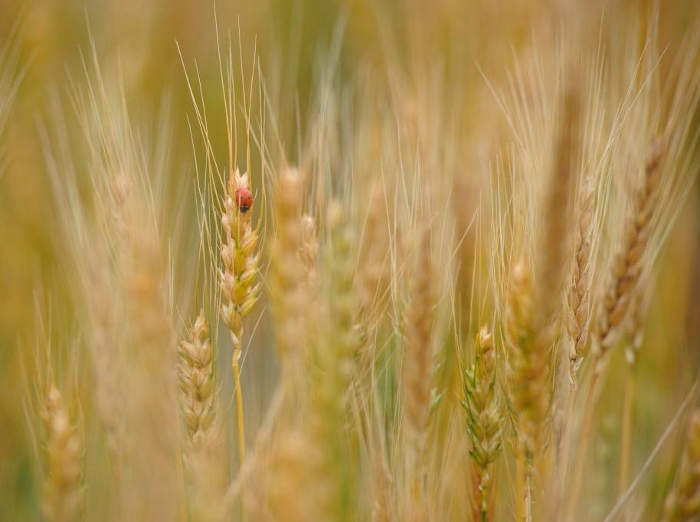
Contacts
USDA-Natural Resources Conservation Service
  Dennis Brezina, Resource Soil Scientist
  Bryan Area Office=979-846-0757 ext. 3
  1716 Briarcrest Drive, suite 510
  Bryan, TX 77802
  dennis.brezina@tx.usda.gov
  Temple State Soils Staff=254-742-9850

Slide 41
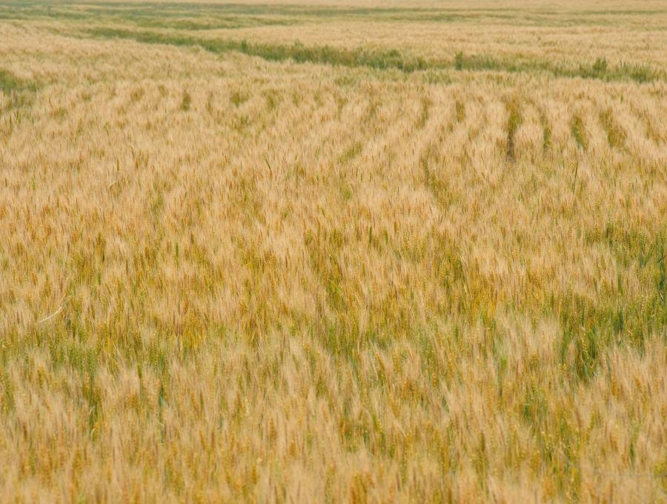



USDA Nondiscriminatory Policy...
The U.S. Department of Agriculture (USDA) prohibits discrimination in all its programs and activities on the basis of race, color, national origin, age, disability, and where applicable, sex, marital status, familial status, parental status, religion, sexual orientation, genetic information, political beliefs, reprisal, or because all or a part of an individual's income is derived from any public assistance program. (Not all prohibited bases apply to all programs.) Persons with disabilities who require alternative means for communication of program information (Braille, large print, audiotape, etc.) should contact USDA's TARGET Center at (202) 720-2600 (voice and TDD).
To file a complaint of discrimination write to USDA, Assistant Secretary for Civil Rights, Office of the Assistant Secretary for Civil Rights, 1400 Independence Avenue, S.W., Stop 9410, Washington, D.C. 20250-9410 , or call toll free (866) 632-9992 (English) or (800) 877-8339 (TDD) or (866) 377-8642 (English Federal-relay) or (800) 845-6136 (Spanish Federal-relay). USDA is an equal opportunity provider and employer.

