Slide 1
Climate Change: Impacts on Agricultural soil and water
Kathleen A. Garland, PhD
UHCL
January 28, 2017

Slide 2
Soils and Climate
Soil development
Climate—specifically temperature and rainfall
Determines whether chemical or physical weathering dominates
Determines the vegetative cover
Substrate—geologically controlled
You can’t get blood from a turnip, or sandy soils from a shale
Slope—controls soil depth and extent of development

Slide 3
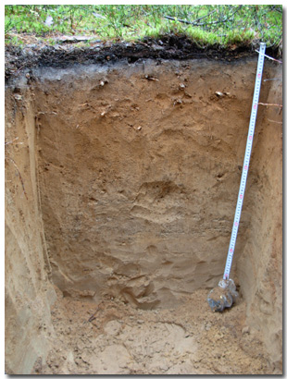
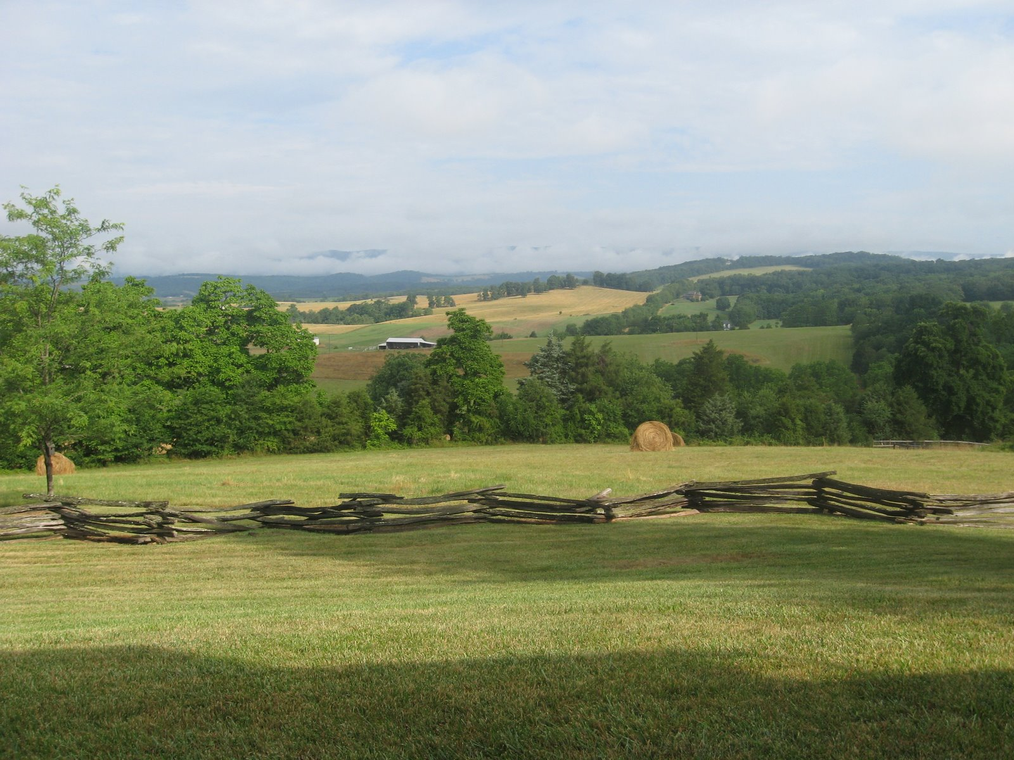
Humid temperate climate
Chemical weathering dominates—organic acids
Deep, well-developed soil profile
Form fairly rapidly—1”/100yrs
Resilient to disturbance

Slide 4
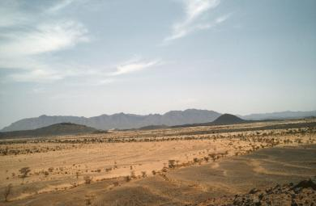
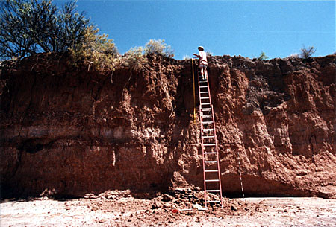
Semi-arid to Arid Climate
Physical weathering dominates
Mass wasting
Shallow, poorly developed profiles
Form slowly
Fragile and erosive

Slide 5
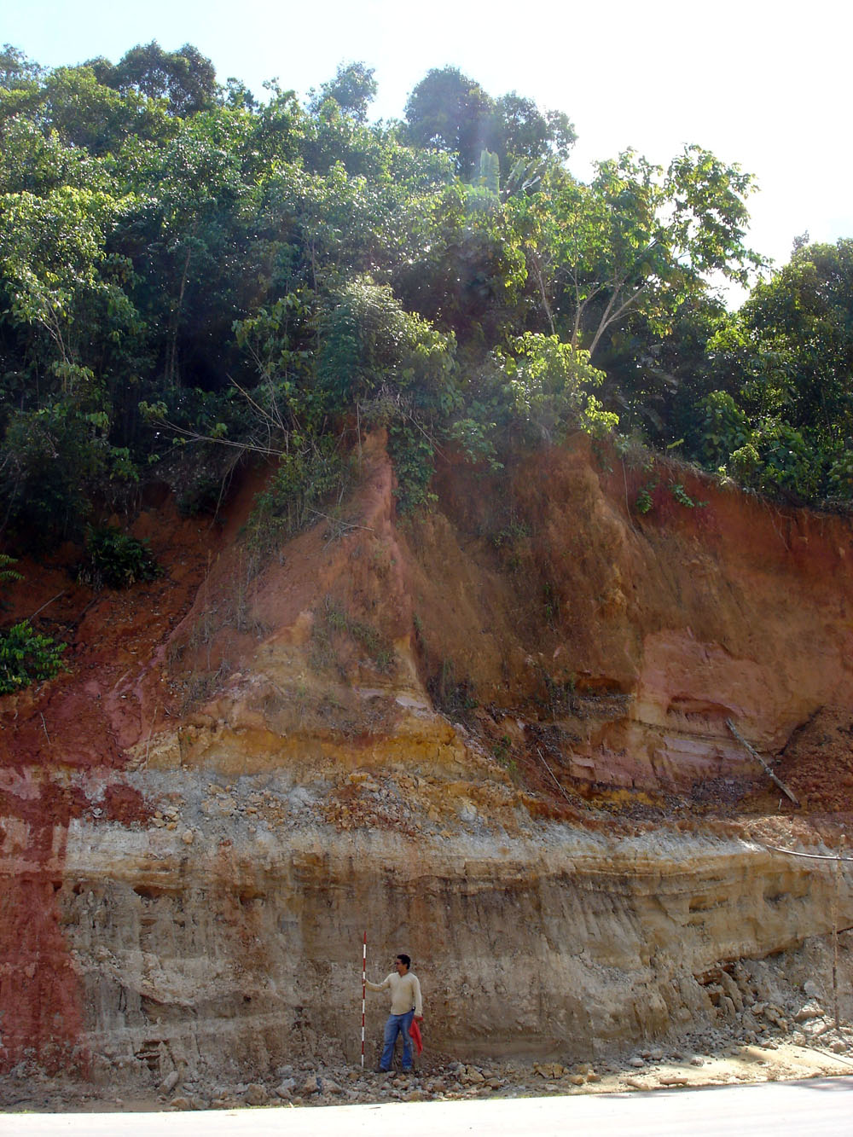
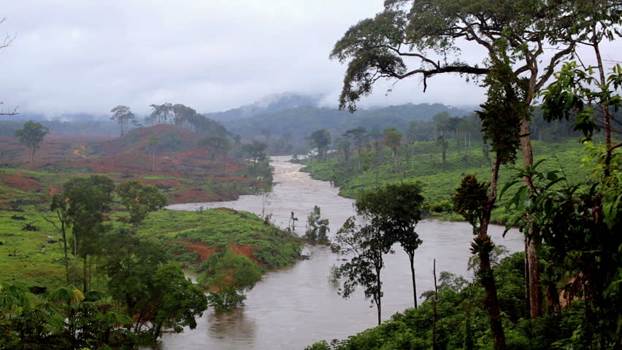
Tropical Soils
Chemical weathering
Heavily leached
Thick organic layer
Fragile once organic layer is disturbed

Slide 6
First principle: Undisturbed soils are in equilibrium with their environment

Slide 7
Climate Change Impacts
Hotter or Colder/wetter or drier
Affects the soil formation process
Affects the vegetative cover
Distribution of annual rainfall events
Do these come during the growing season or when fields are open?
May cause heavy erosion, arroyo development
Windier
Fine-grained soils are susceptible to wind erosion, especially during non-growing seasons

Slide 8
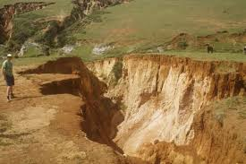
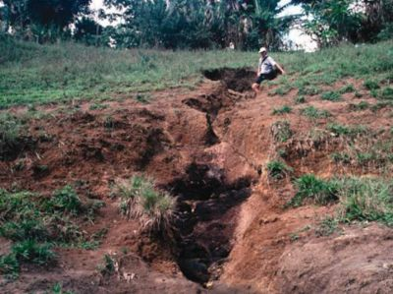
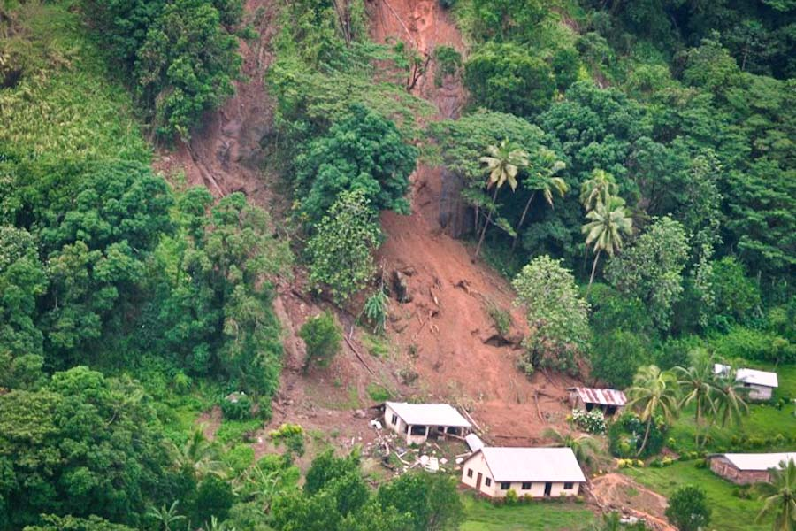
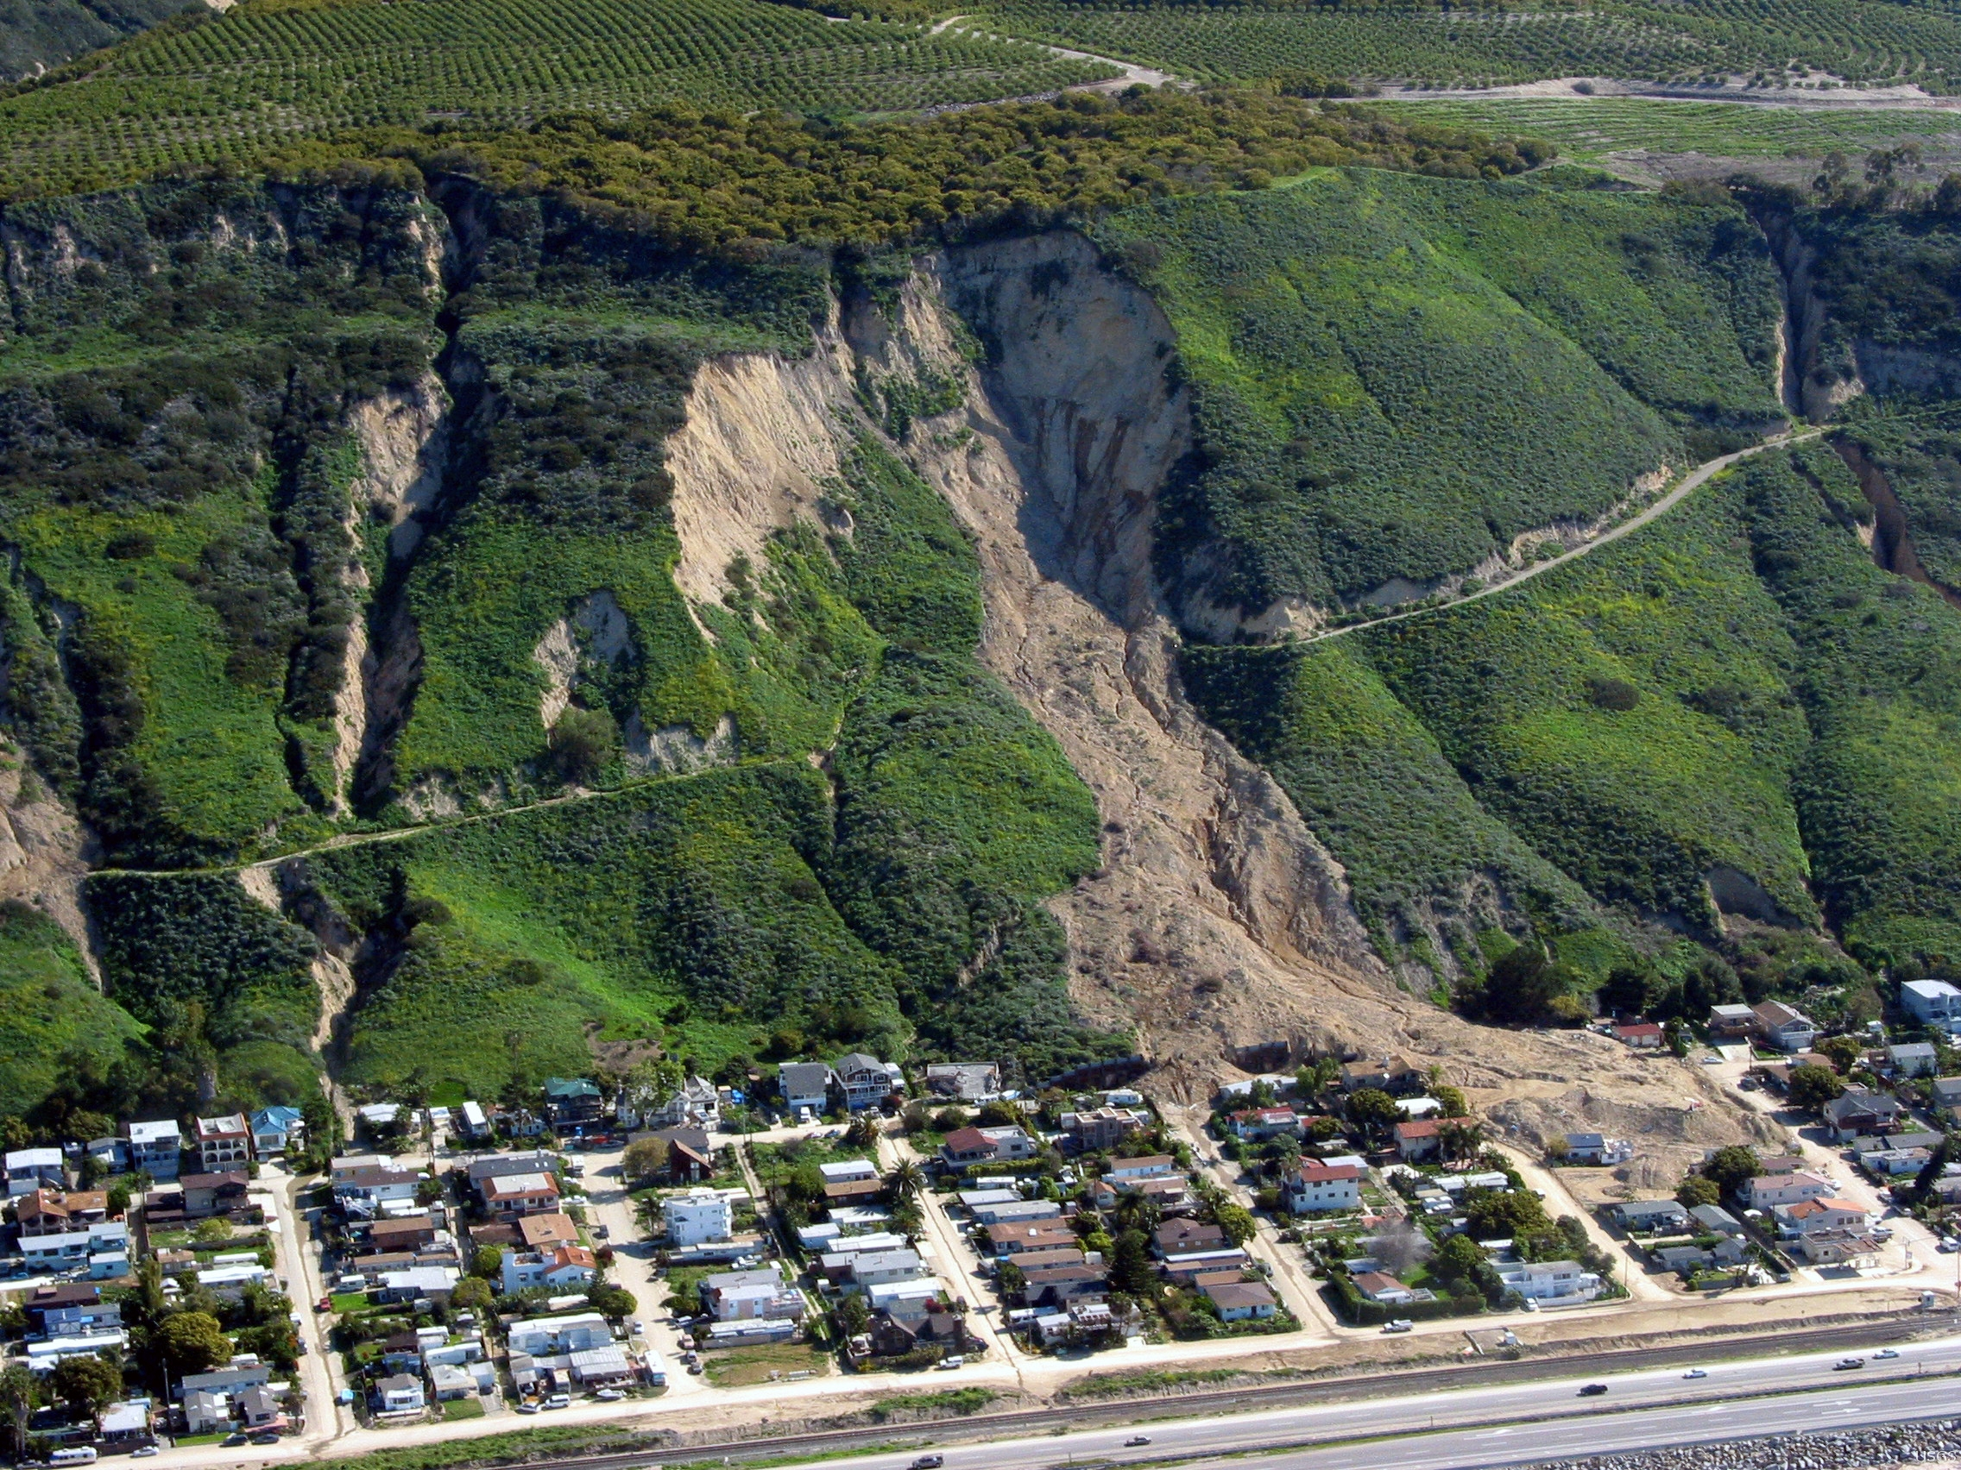

Slide 9
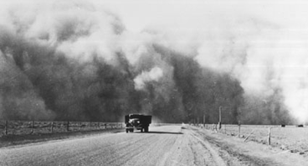
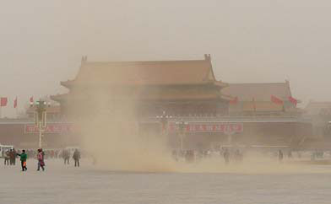
Major Soil Loss Events: Historic and Current
US Dust Bowl
Dust Storms from Gobi Desert, Beijing, China

Slide 10
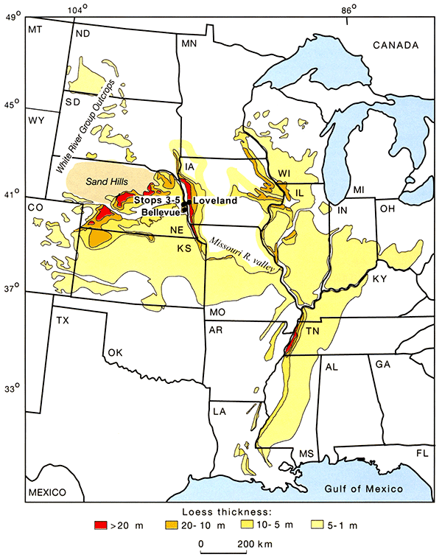
Geologic Soil Loss events
Loess plain deposits of the US
Wind-blown deposits of fine-grained sediments left behind the continental glaciers
Extremely fertile soils: Bread-baskets of the world are on loess plains
Highly susceptible to wind and water erosion under changing climate regime or poor ag practicew
NOT formed in place: so they are irreplaceable

Slide 11
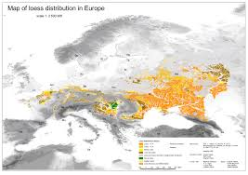
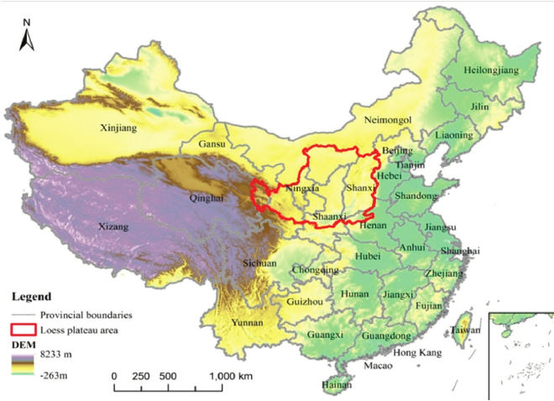
Loess Plains Around the World

Slide 12
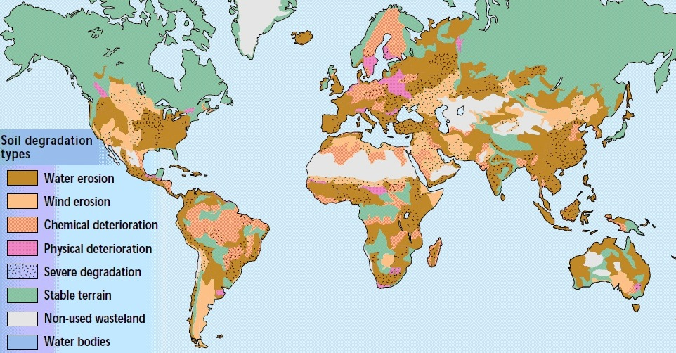
Global Distribution of Degraded soils

Slide 13
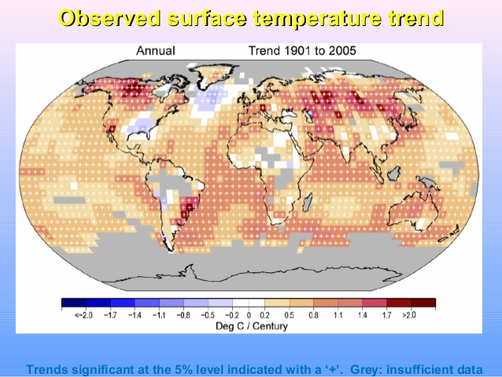
Areas of Maximum temperature INcrease

Slide 14
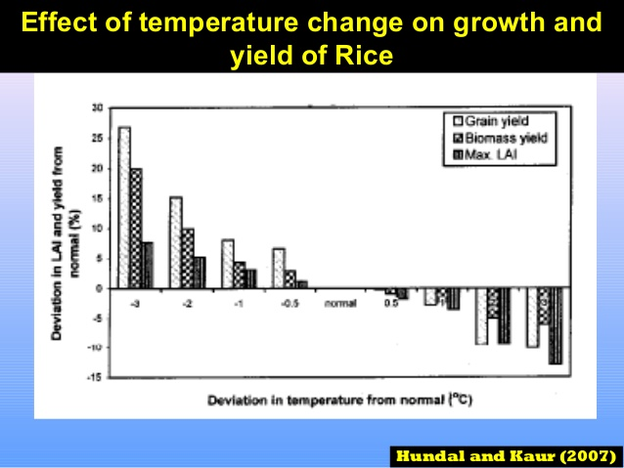

Slide 15
First principle: Soil loss equates to loss of agricultural productivity. Temperature and rainfall chANGES compound this effect.

Slide 16
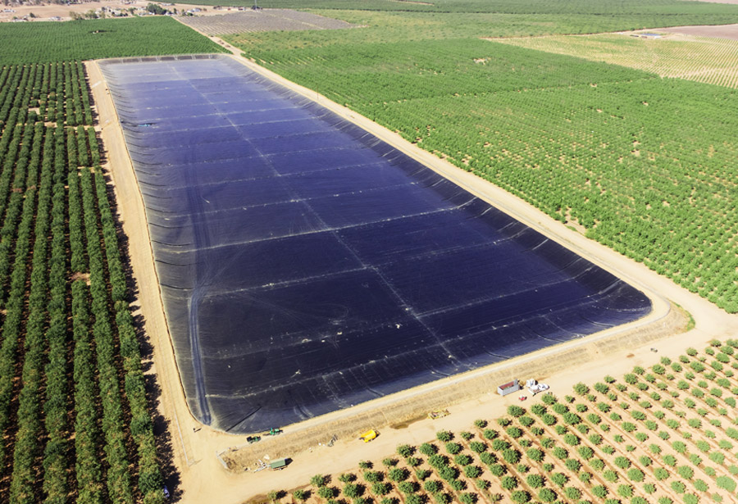
AGRICULTURAL WATER CONSERVATION
WATER CONSERVATION and storage MECHANISMS ARE SIZED AND constructed BASED ON CURRENT CLIMATE CONDITIONS
Evaporation rates
ET rates from crops
Expected precip.

Slide 17
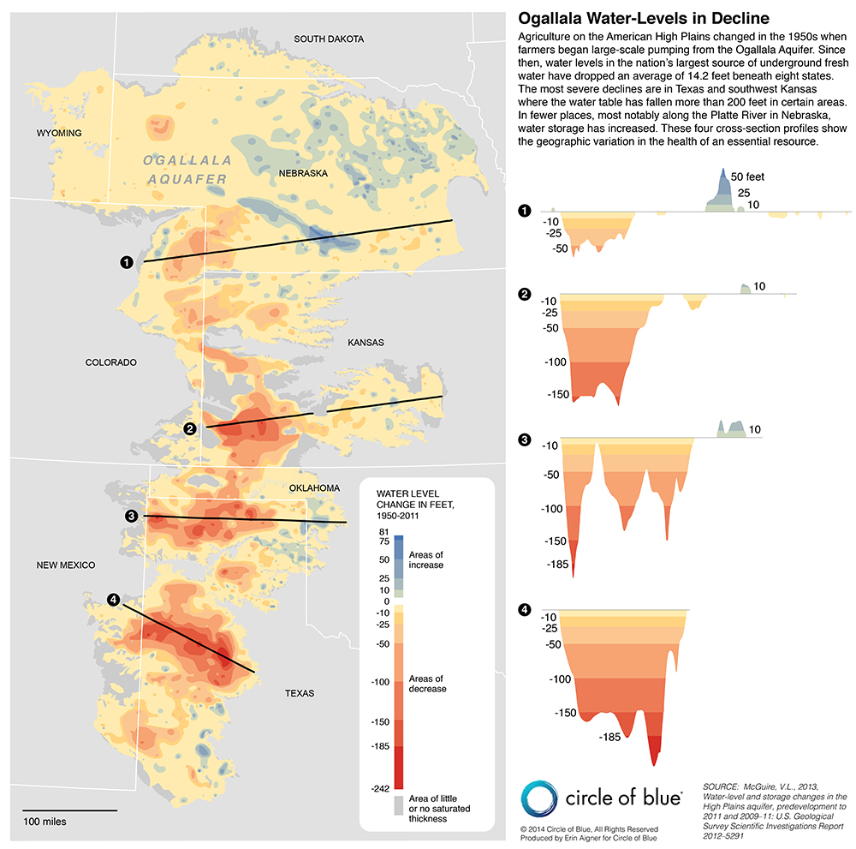
Irrigated lands: Aquifer depletion
Ogallala is the major source of irrigation water for high plains agriculture in US
Decreased rainfall in this area = lack of recharge
Map shows water level change in wells from 1950-2011
This will get worse as temperatures increase

Slide 18
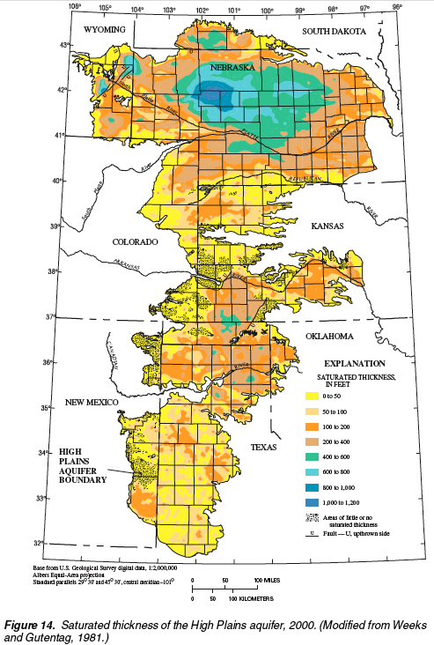
How Bad is this?
Map shows the saturated thickness of Ogallala

Slide 19
First Principle: We are already mining groundwater for Agriculture. Climate change will exacerbate this as temperatures increase.

Slide 20
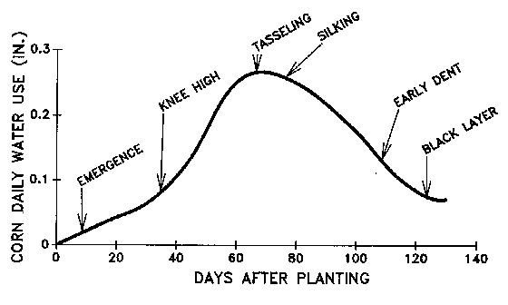
Corn water demand varies with growth stage

Slide 21
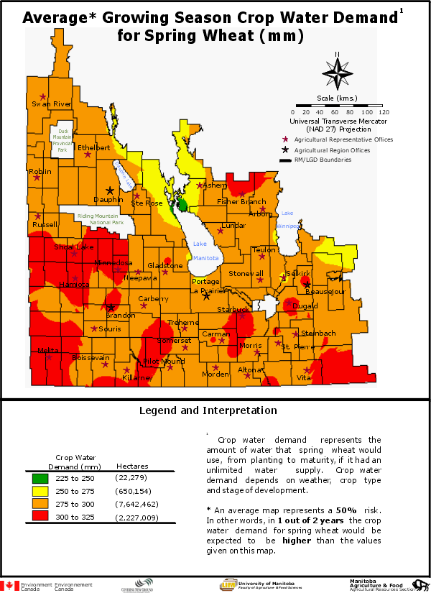
Wheat has different water demands depending on where you grow it.

Slide 22
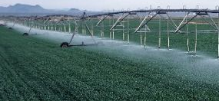
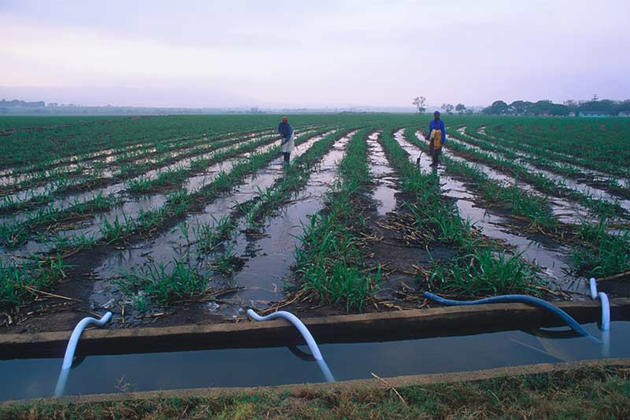
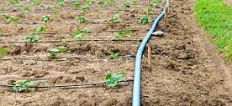
Irrigation Practices: The Bad, the Ugly, and the Good
Center-pivot irrigators
Flood irrigation
Drip systems
Large losses due to evaporation as water passes through the air
Best in tropical, high humidity climates, Not suitable for arid/semi-arid areas—but used there anyway
Deliver water directly to the plants
Lowest losses of any type of system

Slide 23
First Principle: Changing precipitation patterns affect the growth of food crops. This can have positive or negative effects. Adjusting requires adapting water conservation methods to new conditions

