Slide 1
Concur Self – registration

Slide 2
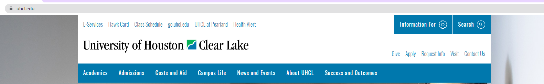
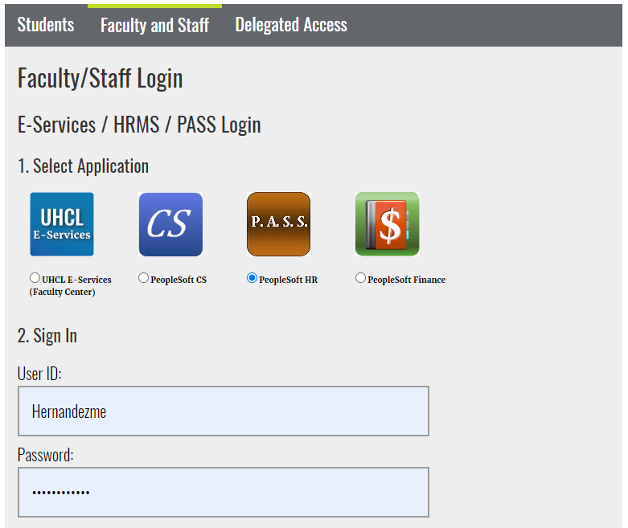
Go to uhcl.edu and click E-Services
Sign into P.A.S.S

Slide 3
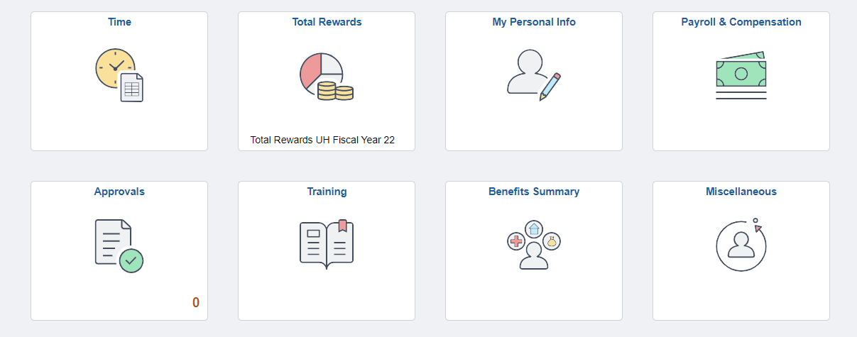
Click the Miscellaneous tile

Slide 4
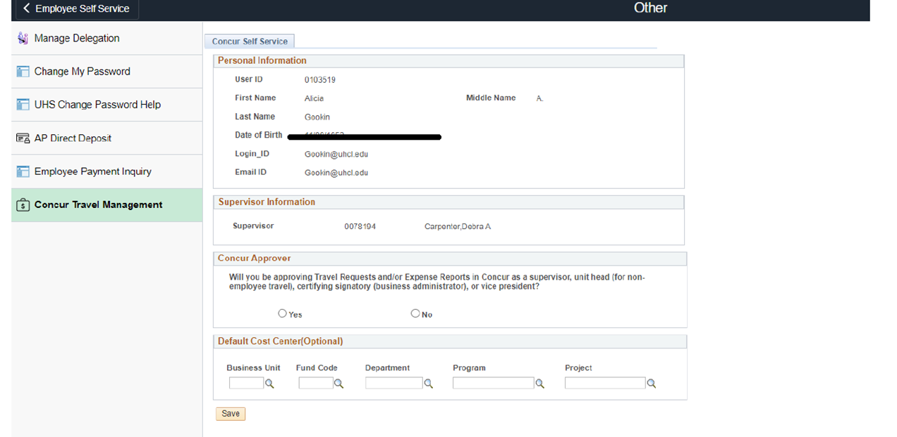
Click on Concur Travel Management.
XXXXXXX
Supervisor, Debbie
Concur Approver -If clicked yes:
Approvers are automatically notified when a Travel Request is pending their approval
Enter Default Cost Center:
The default cost center can be updated in the traveler’s Concur profile
Click Save

Slide 5
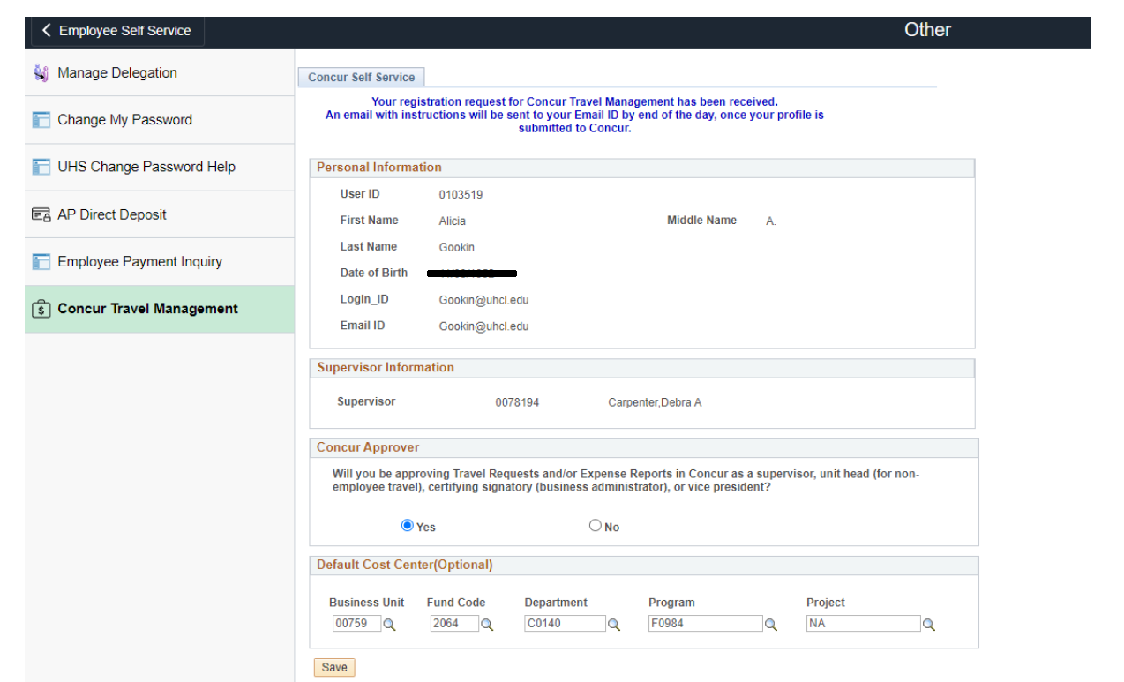
The page will update and display that the traveler’s registration has been received.
**Please note that this is an overnight process and once access has been given an email will be sent to the traveler**

Slide 6
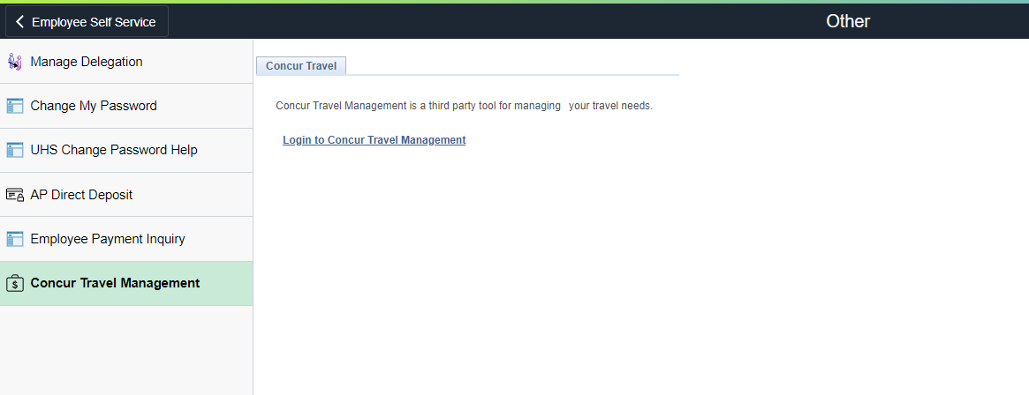
Once an email has been received informing traveler’s access in Concur.
Access Concur by returning to PASS – Click the Miscellaneous tile – Click Concur Travel Management link

Slide 7
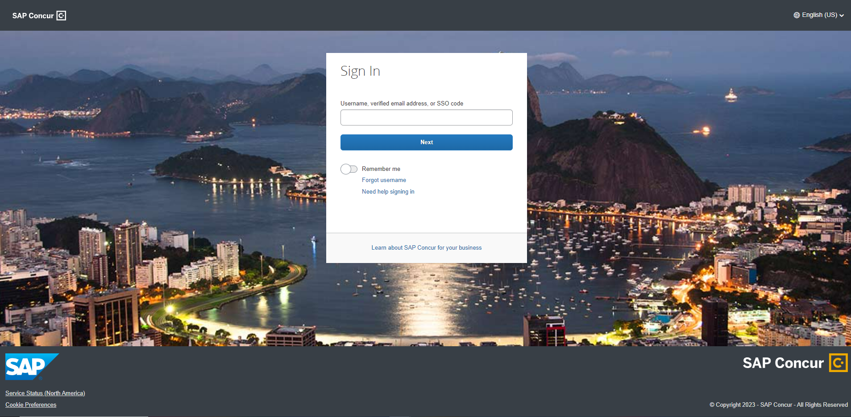
Alternatively, go to your web browser and go to http://www.concursolutions.com
Enter your UHCL email address and click next (example: doej@uhcl.edu)

Slide 8
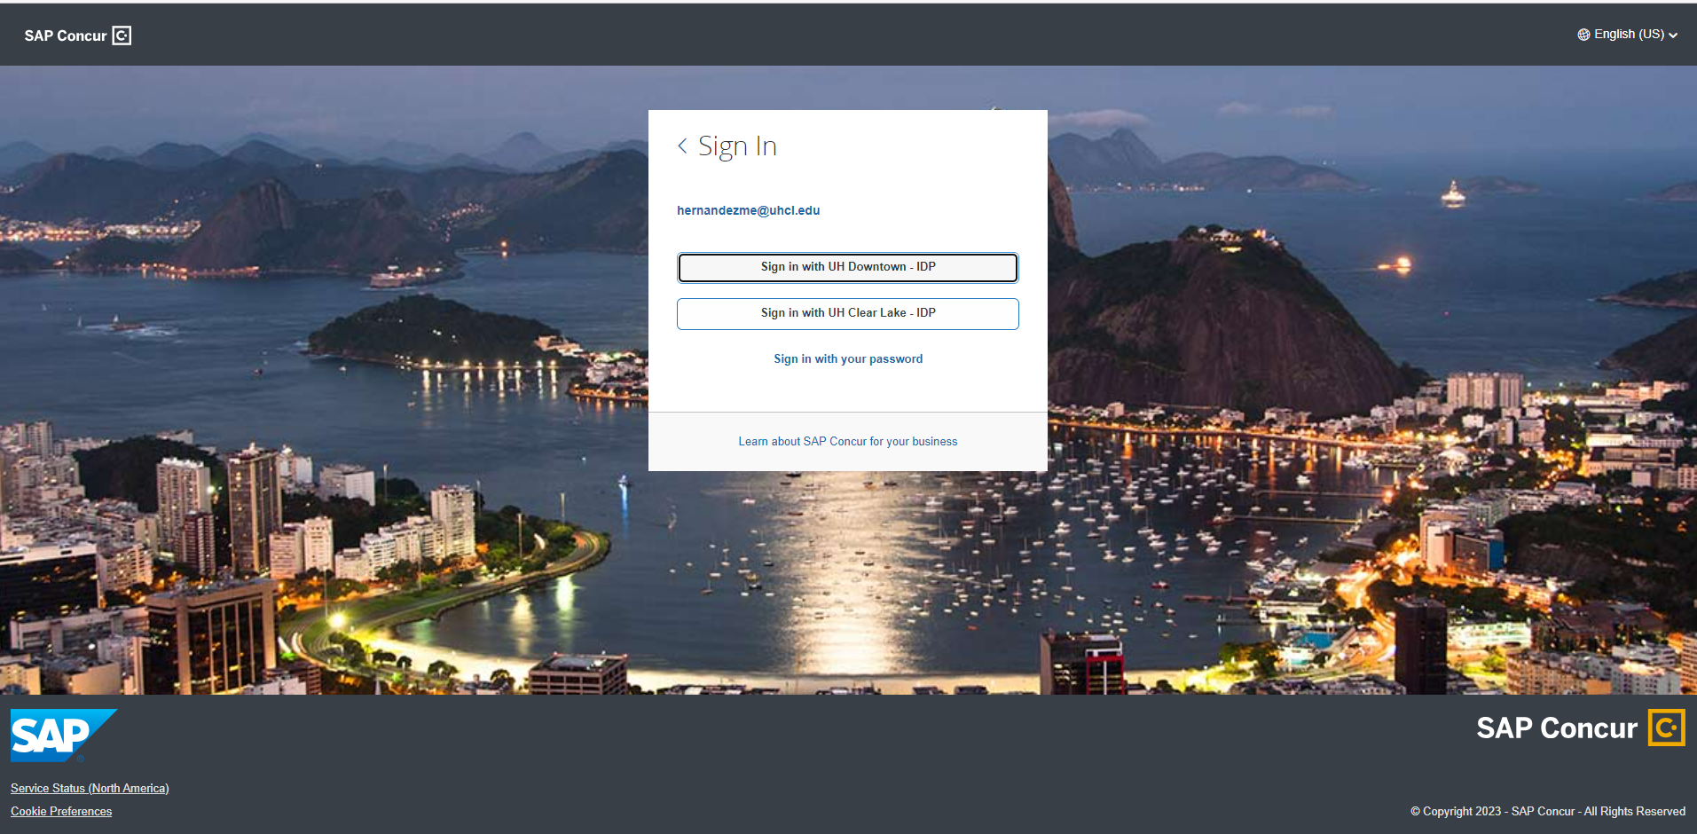
Click Sign in with UHCL - IDP

Slide 9
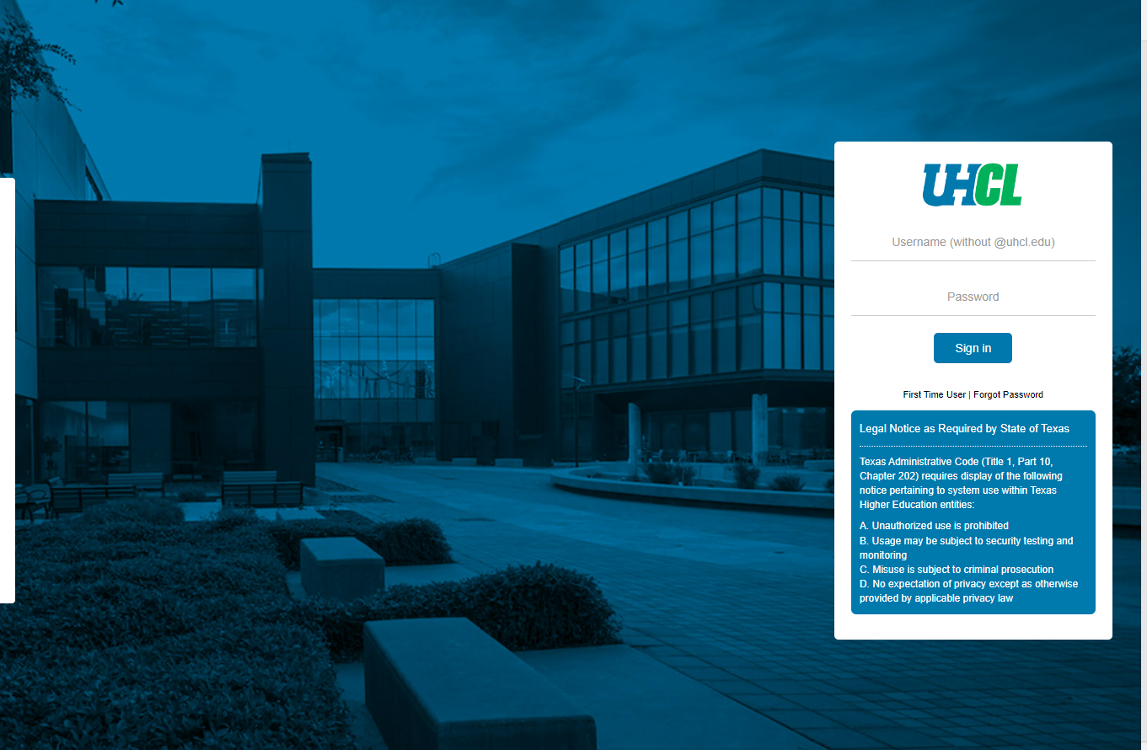
Sign in using your user name and password

Slide 10
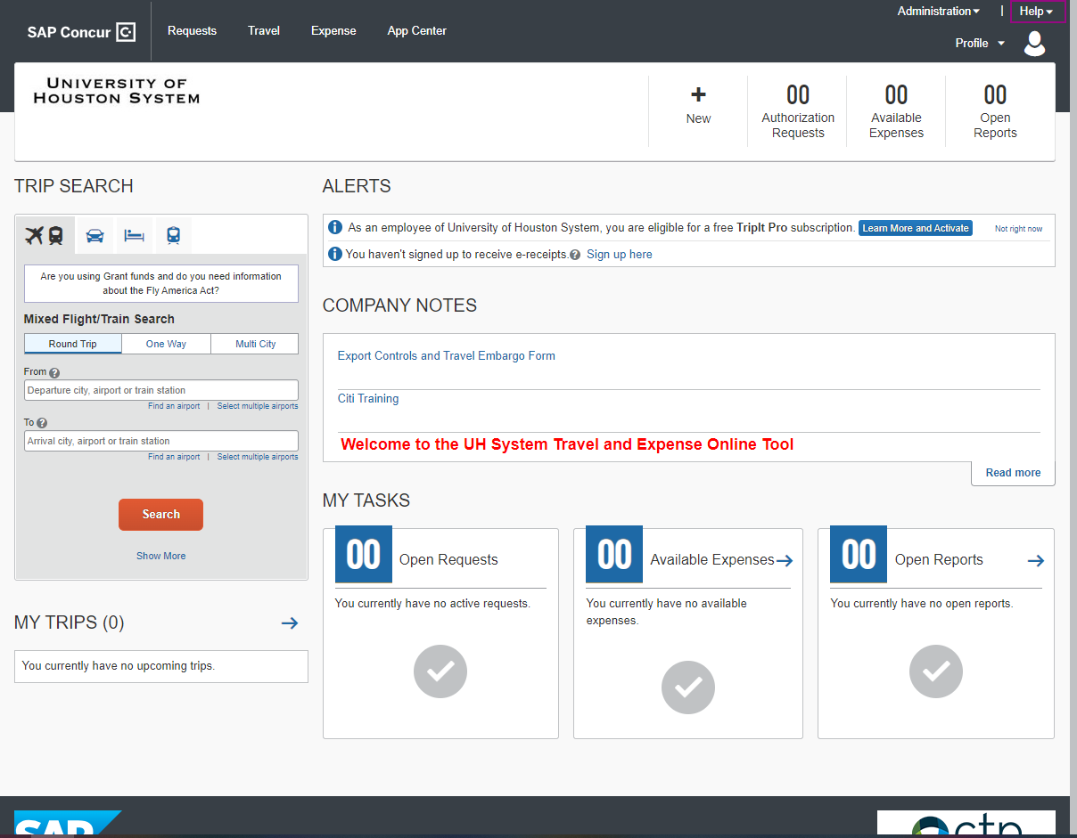
Welcome to Concur!

