Slide 1
Concur
Self – Registration
July 2023

Slide 2
For any questions regarding Concur please email: ConcurTravel@UHCL.edu

Slide 3
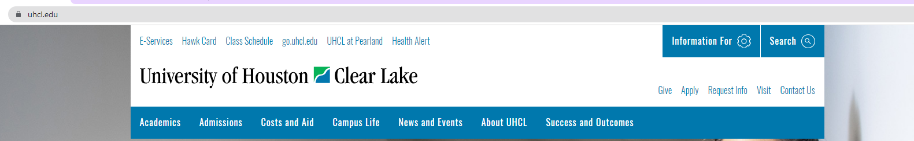
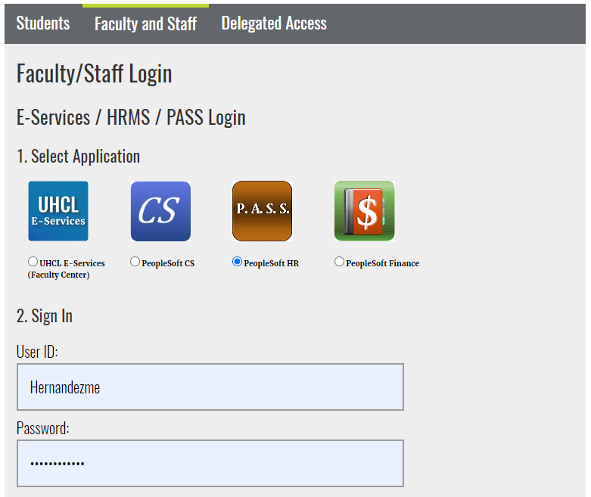
1. Go to uhcl.edu and click E-Services
2. Sign into P.A.S.S

Slide 4
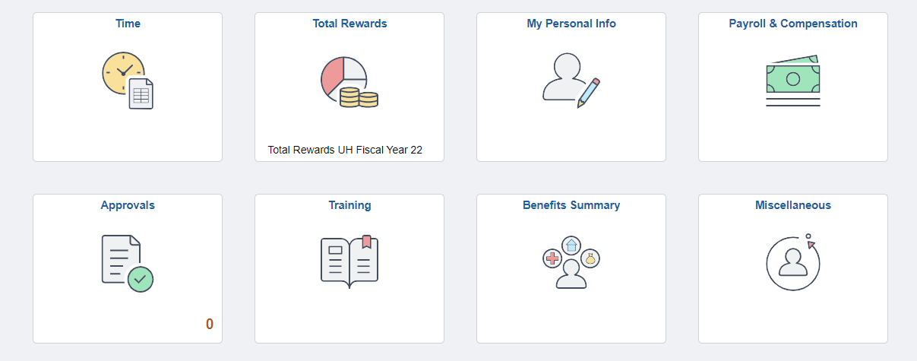
3. Click the Miscellaneous tile

Slide 5
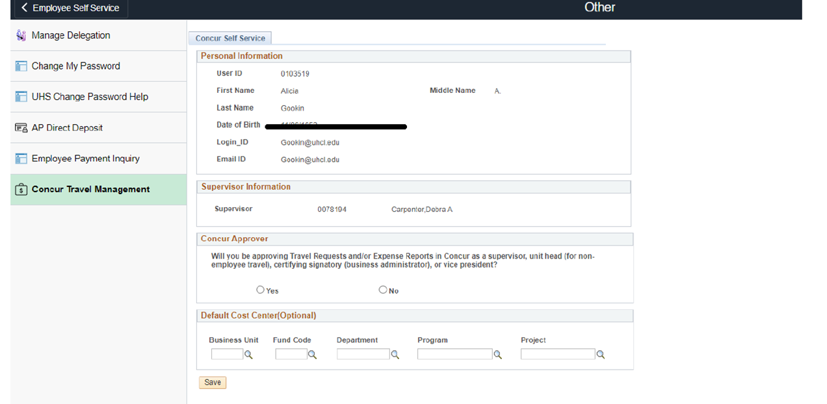
4. Click on Concur Travel Management.
Concur Approver - if you expect to approve your area’s travel request and expense report click the YES box. The Travel Office will verify approvers for each
department/division
Enter Default Cost Center: This is for registration purposes only. The cost center(s) can be updated in the traveler’s Concur profile
Click Save

Slide 6
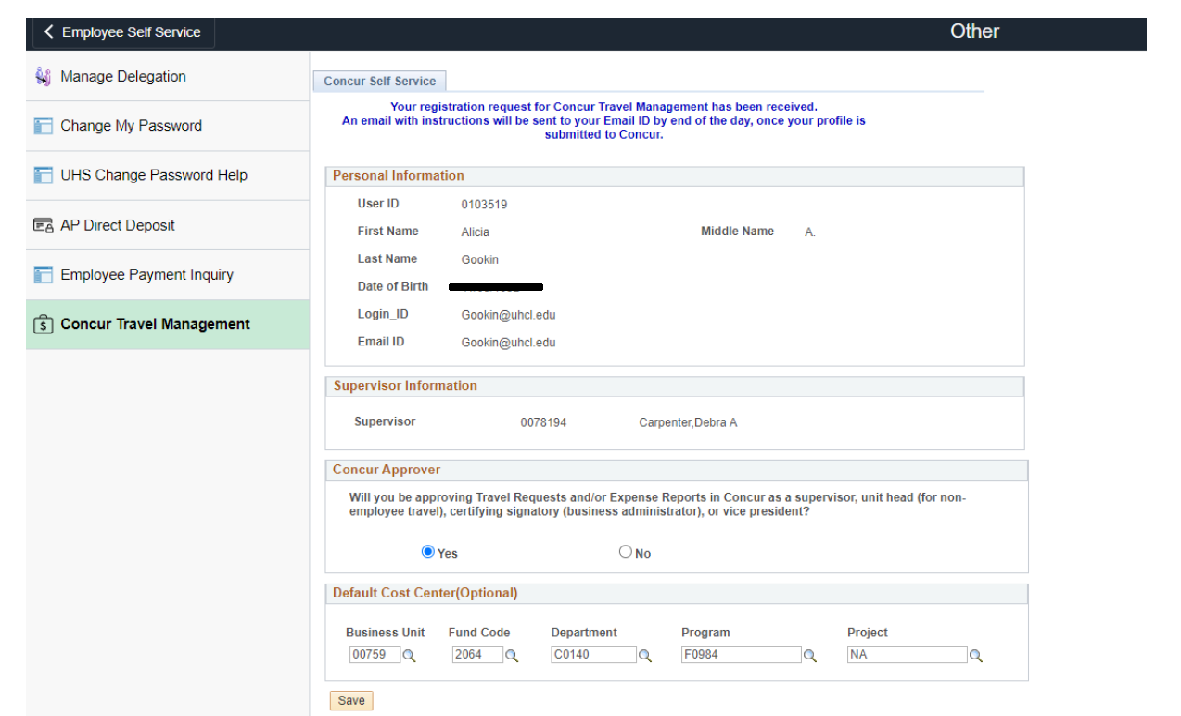
6. The page will update and display that the traveler’s registration has been received.
**Please note that this is an overnight process and once access has been given an email will be sent to the traveler**

Slide 7
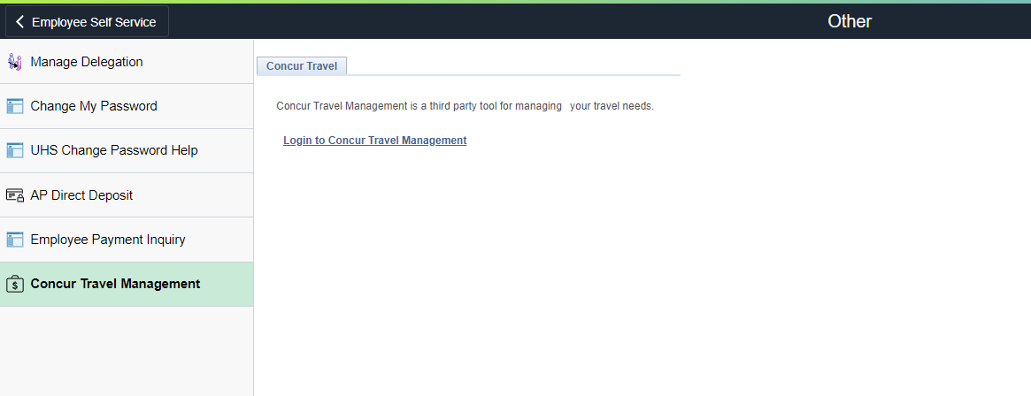
5. After the traveler receives an email confirming access, they should login again.
6. Access Concur by returning to PASS – Click the Miscellaneous tile – Click Concur
Travel Management link

Slide 8
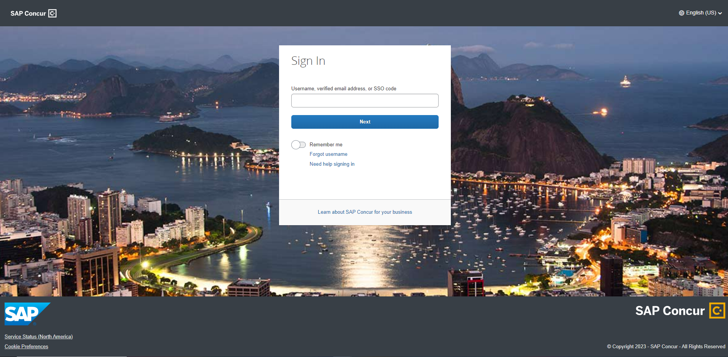
7. Or access it on the web - http://www.concursolutions.com
8. Enter your UHCL email address and click next (example: doej@uhcl.edu)

Slide 9
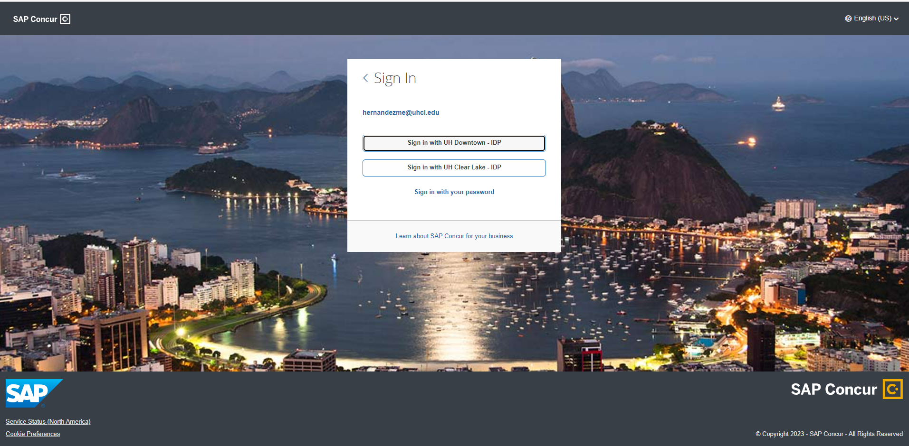
9. Click Sign in with UHCL - IDP

Slide 10
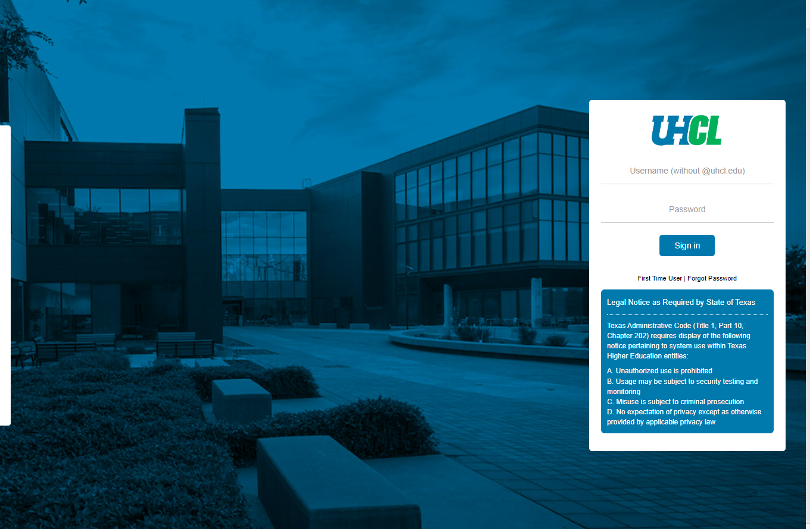
10. Sign in with your SSO username and password

Slide 11
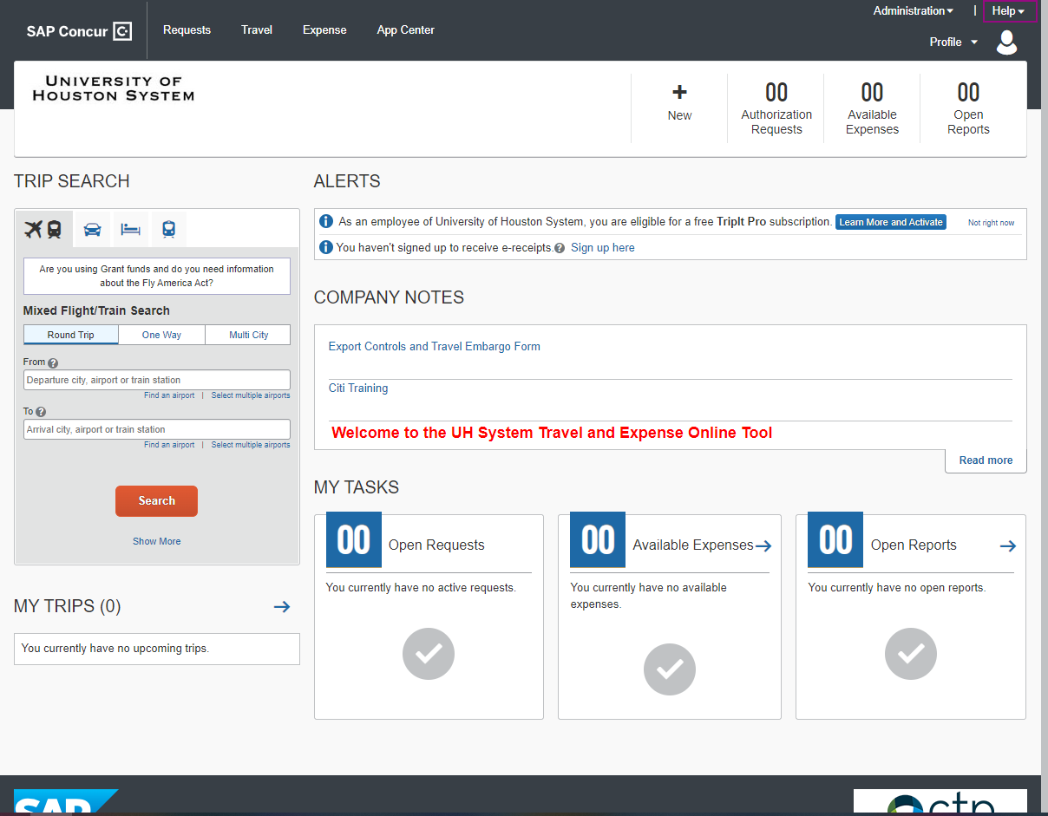
Welcome to Concur!

