Slide 1
PROJECT MANAGEMENT
Office of Sponsored Programs
Summer Live Stream Series
August 4, 2023

Slide 2
STEP 1
Documentation

Slide 3
Notice of Award
The Office of Sponsored Programs needs ALL official communication regarding awards as soon as possible.
Forward any communication you receive from the sponsor or program officer to the grant administrator who assisted with your proposal.

Slide 4
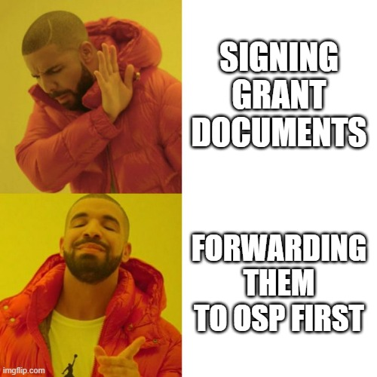
Contracts
Grant contracts and related documents can only be signed by the Provost or delegate (SAM 03.A.05)
OSP facilitates review and Provost Signature

Slide 5
STEP 2
Cost Center Setup

Slide 6
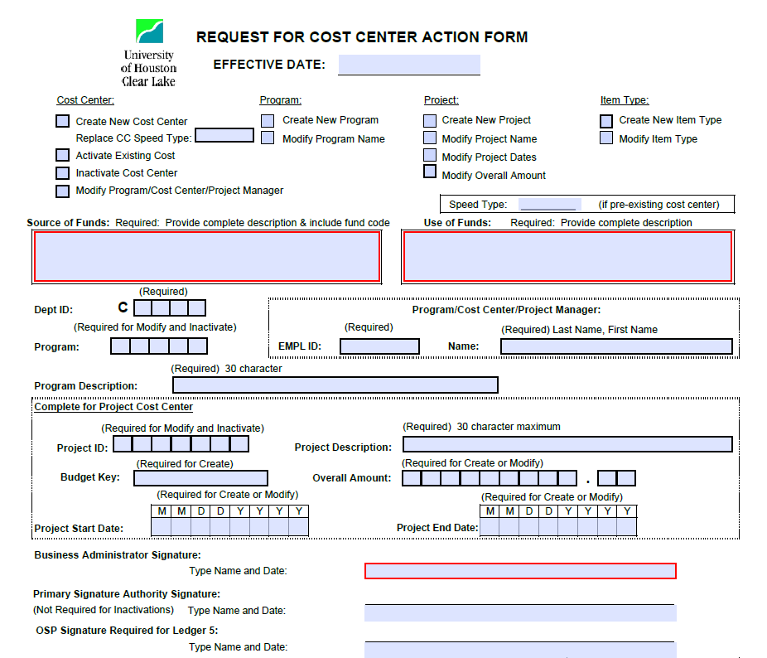
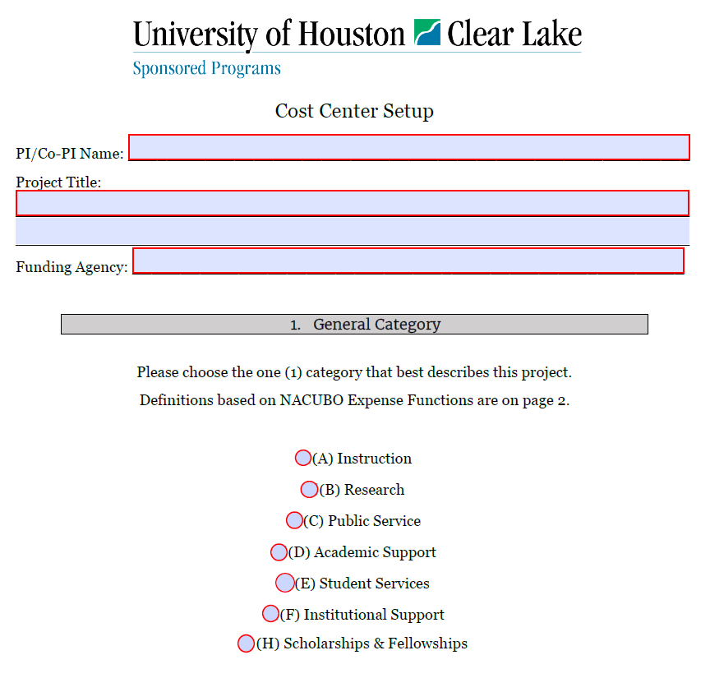
Forms PI MUST Complete and/or Sign

Slide 7
STEP 3
New Award Meeting
& Partner Notification

Slide 8

UHCL Team Notification
Let co-PI/senior personnel/Dean(s)/etc. know the good news – we’ve been funded!
Invite them to the New Award Meeting (next slide)
Coordinate project activities & meeting schedules

Slide 9

New Award Meeting
Review budget, procedures, and basics needed to get started on your project.

Slide 10
External Partner Notification
Subaward
Work with OSP to issue paperwork & obtain signatures
Contractors and Vendors
Standard services agreement issued through College (faculty) or Department (staff)
Consult with your Department Assistant, Administrative Assistant, or Business Administrator
External Evaluators
Considered a contractor, follow steps above
More on this later…

Slide 11
STEP 4
Getting Started on Your Project

Slide 12
External Evaluator
Meet at beginning of project to set up timeline
Pre-assessment
Midterm assessment
Yearly assessments
Reporting
Establish evaluator’s role in reporting, if any
What data do they need to collect?
When will the data and/or report be due to you in order to meet sponsor deadlines?

Slide 13
Ready, Set, Go!
You’re ready to start your project!
Guidance
Proposal Narrative
Project Timeline
Management Plans
Hiring
Consult Business Administrator and Department Assistant
Supplies
Order through usual department procedures
Charge to grant cost center

Slide 14




As Your Project Progresses
Regular team meetings
Focus on progress towards goals and objectives
Assign goal- or objective-based tasks

Slide 15
If Issues Arise
Programmatic
Resolve within team
Consult external evaluator
If scope of project may be affected, consult OSP
Monetary
Refer to final approved budget
May be different from submission if agency modified
Consult OSP immediately

Slide 16
Thank you!
sponsoredprograms@uhcl.edu

