Slide 1

THE BIG IDEA
Transforming a Great Idea to a Fundable Project

Slide 2
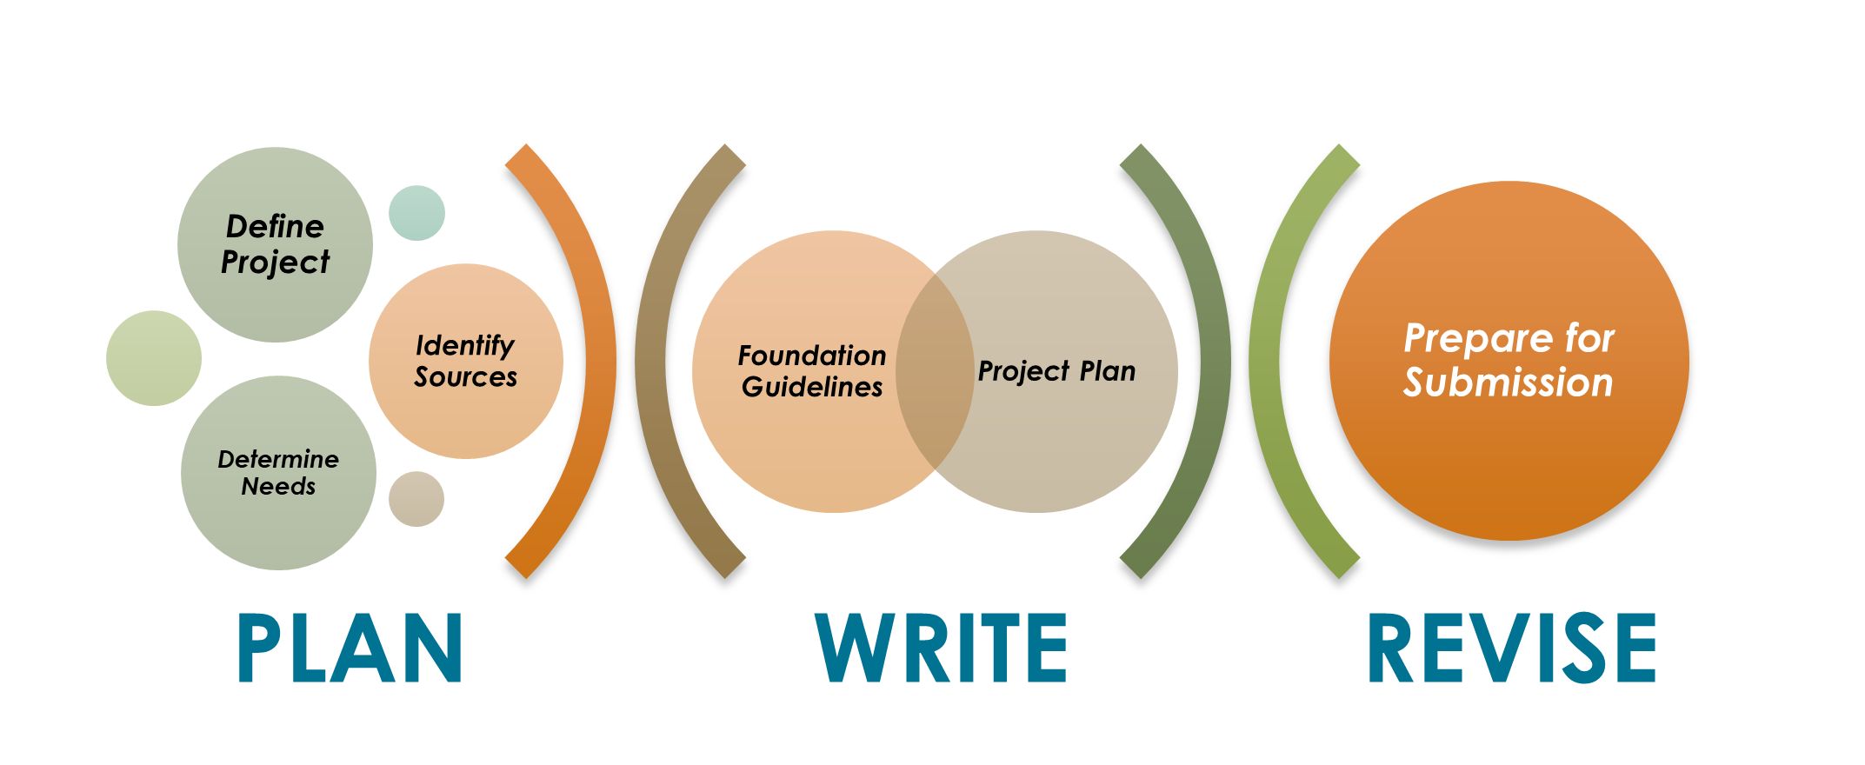
THE WRITING PROCESS

Slide 3
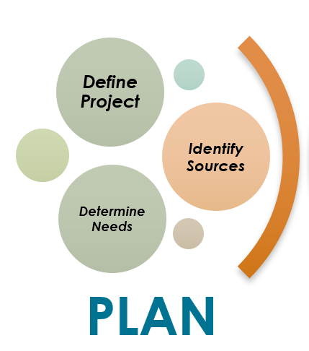
MODULE 1 FOCUS

Slide 4

PLAN
Successful grant writing starts with a great idea. Use that idea to develop your project goals and devote ample time to planning your project. Why? Clear goals will help you define the project and determine what resources are needed to conduct the research effectively. Knowing your goals and resource needs will focus your search for funding. The better the fit between your goals and the funding agency’s priorities, the more likely your proposal will be funded.

Slide 5
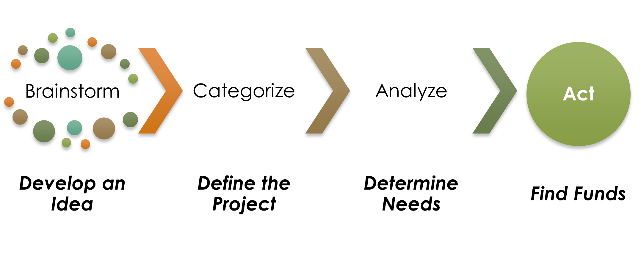

Slide 6
DEVELOP AN IDEA
Your idea may be the solution to the tough issues affecting your community or society as a whole. What impact do you want to make?
Solve a specific problem
Challenge an existing paradigm
Address a barrier to progress
Develop a new program
Other

Slide 7
DEFINE THE PROJECT
Use these questions as the starting point to define the project.
What do you want to accomplish?
Why is this relevant to your community, society, etc.?
How will you do the work (methods)?
How will you measure results (evaluation)?
Who can help you do the work?
Where will you do the work?
When will you do the work (timeline)?

Slide 8
GOALS
Use your planning information to develop a project goal. Your goal can serve as a guide when you start writing your proposal.

Slide 9
OBJECTIVES
Objectives provide measurable steps towards achieving the overall goal. Create a few objectives that delineate the specific tasks necessary to achieve the goal.

Slide 10
LITERATURE REVIEW
The literature review provides an important perspective on the project and can help:
Determine where this project fits within your field
Identify current problems, hypotheses, and opportunities
Review the program designs of experts in the field
Find support to show why your project plan should work.

Slide 11
DETERMINE PROJECT NEEDS
Use these questions as the starting point to define the project.
Personnel: Are you working alone? How much time is needed?
Supplies: What materials and supplies are needed to do the work?
Equipment: Do you need specialized equipment?
Facilities: What workspace is needed?
Travel: What travel is needed to do the work or disseminate results?
Partners: Do you need specific expertise or access to resources?

Slide 12
FIND FUNDS
Finding the needed funds can be challenging. A variety of agencies and organizations provide grant opportunities throughout the year.
Federal Departments and Agencies
State and Local Governments
Corporate Foundations
Nonprofit Foundations
Professional Organizations

Slide 13
SEARCH ENGINES
Search engines provide grant information from various sources such as:
Grants.Gov www.Grants.gov

Slide 14
KEY WORDS
Good key words related to your project will help narrow your search.

Slide 15
GUIDELINES
Once you identify a potential funding source, read the guidelines carefully to make sure project goals align with the funding priorities. Guidelines inform you about due dates, eligibility and submission requirements.

Slide 16

THE BIG IDEA
You have completed the foundation for writing the proposal.

