Slide 1

PROCUREMENT TRAINING

Slide 2
Procurement Department
Debra Carpenter, Executive Director, x2152
Catina Chapman, Associate Director, x2155
Kimberly August, Procurement Specialist II, x2154
Tripti Das, Procurement Assistant, x2150
Alicia Gookin, Sr. Staff Assistant, x2149

Slide 3
Procurement Department
Our Purpose
Financial Benefit - To monitor and process purchases that are in the very best interest of the University.
Risk Control/Liability - We are also charged with the duty of preventing litigation as
a result of a purchase/contract.
Audit/Compliance - Purchases must be in compliance with Legislative Statues, State and Federal Laws.

Slide 4
Purchasing Thresholds
$0 - $5,000 | Order is placed directly with vendor. Method of Payment: P-card, Voucher or PO.
$5,001 - $15,000 | Department submits Purchase Requisition for a PO. No bids are required.* *Procurement has the option to bid; if necessary.
$15,001 - $25,000 | Department prepares purchase requisition, or contacts Procurement with bid Scope of Work (SOW) and Vendor suggestions. Procurement creates an informal bid (bids 25k or less; submitted directly to vendors via email; not placed on ESBD).
$25,001 plus | Department prepares purchase requisition or contacts Procurement with bid SOW and Vendor suggestions. Procurement creates a formal bid with department’s SOW. Formal bids must be placed on state ESBD website.

Slide 5
UHCL CONTRACT PROCUREMENT PROCEDURES
$0 - $15,000 No bid is required.
$15,001 plus A bid or Sole Source Justification may be required for these goods or services.
- Other Procurements are considered (cooperative contracts; emergency purchases; other exceptions)
Above $25,000 A bid or Sole Source Justification may be required for these goods or services.
ALL contracts (including Standard Agreements) must be sent to Office of the General Counsel (OGC) for review. Coversheet is required for legal.

Slide 6
FORMAL AND INFORMAL BIDS
Informal Bids
$15,001 - $25,000
Departments are required to recommend a vendor for the item(s) to be purchased.
The Procurement Department will solicit a minimum of three (3) informal bids.
A minimum of two (2) HUB Vendors will be solicited for bids.
Formal Bids
Above $25,000
Departments are required to recommend a vendor for the item(s) to be purchased.
The Procurement Department will solicit a minimum of three (3) formal written bids.
A minimum of two (2) HUBs will be solicited.
The bid will be posted to the Electronic State Business Daily (ESBD) for a minimum of 14 days.
Emergency purchases may be posted for less than 14 days.

Slide 7
TRIVIA QUESTION
Is a Purchase Order (PO) a Contract?
A Purchase Order is a contract.

Slide 8
PURCHASE REQ When and Why?
Deliverable is a tangible product.
Item(s) that do not require an executed contract.
Maintenance/Repairs on existing tangibles (varies)
This may include:
Office supplies, furniture, copier, promotional items, classroom/study items, etc.

Slide 9
CONTRACT REQ When and Why?
Vendor renders a service to the University.
Facilities
Catering
Speaker
Performer
Other service to the University.
**Services cannot be purchased on a p-card.**

Slide 10
How to avoid Requisition rejections
Insurance Verification (COI)
Contract is fully Executed
Account Codes (fund not restricted)
Category Codes is correct
UCT Approval
Back-up Documentation
Proposal/Quote is the same as the Requisition

Slide 11
CONTRACTS

Slide 12
Most Common Type of ContractsCONTRACTS
Standard Agreements
Non-Standard Agreements
Purchase Orders
Memorandum of Understanding

Slide 13
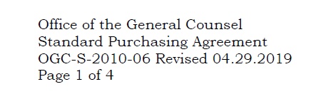
STANDARD AGREEMENTS
Legally Approved Agreement Templates
Vendor signs without changes
UHCL’s Standard Agreements:
Standard Purchasing Agreement,
Speaker Agreement;
Performer Agreement;
Affiliation Agreement; &
Services Agreements are all Standard Agreements.
Identified by legal stamp of approval:

Slide 14
NON-STANDARD AGREEMENTS
Agreements using Vendor’s Template
When is Legal review not necessary?
Exceptions:
Vendor accepts our Standard Contract Addendum (SCA) (without changes)
Agreement is below 50k AND
Vendor’s Agreement does not contain language that states that the Agreement prevails over the SCA.
****This does not apply to revenue agreements***

Slide 15
SERVICES (REVENUE) AGREEMENT
ALL Revenue Agreements above $20,000 MUST be approved by the UH System tax office prior to execution.
ALL Services Agreements MUST be submitted to Contract Administration along with the Revenue Contract Coversheet AND an OCA Coversheet.
***Contract Administration will route all documents for approval.***

Slide 16
Standard Contract Addendum (SCA)
Used WITH a non-standard agreement to bring the entire agreement into compliance with Texas Government Code.
UHCL Procurement Office should review the terms of the non-standard agreement; Procurement may make some revisions as to not void the use of the SCA
Department submits SCA to Vendor after receiving approval by Procurement
If vendor accepts Procurement’s revisions and SCA terms the agreement will only require legal review if it is above 50,000.

Slide 17
STANDARD CONTRACT AMENDMENT Used to change an existing contract
MUST be processed before the original contract expires.
MUST be processed with the same approval level or higher as the original contract.
MUST be sent to Legal for review.
In most cases, Agreements are not to be extended pass five (5) year terms. Exceptions may occur.
Always attach the original agreement

Slide 18
TRIVIA QUESTION
What are OCA Coversheets used for?
OCA Coversheets are the tracking mechanisms that legal uses to track their incoming contracts.
OCA Coversheets are only required when sending a contract to OCA/Legal.

Slide 19
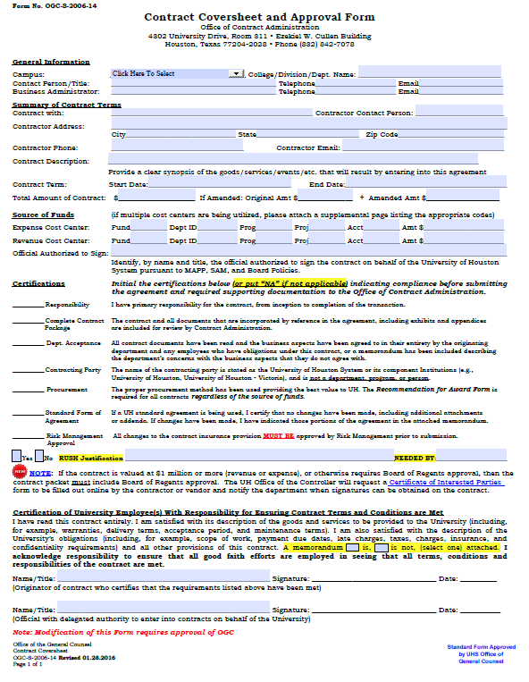

Slide 20
P-CARDS
and
VOUCHERS

Slide 21
VOUCHER PURCHASES UNDER $5,000.00
PURCHASES UNDER $5,000 CAN BE MADE ON A VOUCHER UNLESS:
Vendor requires a Contract
Vendor is unwilling to invoice
Computer related (requires prior approval from UCT)
Please view additional Voucher Guidelines on UHCL’s Accounts Payable Page

Slide 22
P-CARD PURCHASES UNDER $5,000.00
PURCHASES UNDER $5,000 CAN BE MADE WITH A P-CARD UNLESS:
Vendor requires a signature/contract
Vendor does not accept credit cards
Any purchase using State Funds
Alcoholic Beverages
Fuel
Travel Expenses (airlines, car rentals, hotels, meals, etc.)
Service Contracts (labor only)
Computer related (requires prior approval from UCT)
Please view additional P-Card Guidelines on UHCL’s Procurement Card (P-Card)Page

Slide 23
LIABILITY & RISK MANAGEMENT
Certificates of Insurance Requirements
List UHCL as the Certificate Holder
List UHCL as Additional Insured
Waive Subrogation
Limits must match the limits within the Insurance Clause in the Contract
Insurance Waiver Consideration Basis
Risk Levels
Premises Liability
Consequences

Slide 24
Food Service Waiver
Chartwells Catering
Waiver Required when all matters apply:
On-Campus Events
Food Delivery or Catering
$100 or above
Off-Campus events do not need a Food Service Waiver.

